Slide 1
GOOD AFTERNOON TO ALL

Slide 2
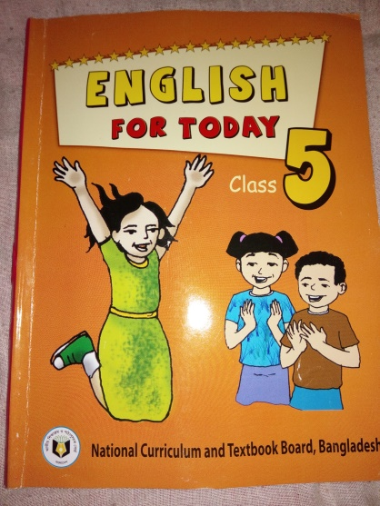
Lesson introduction
Class– Five
Subject-English
Unit– 24
Lesson: 1(b) (Cyclone Aila)
Date– 01.10.2017.

Slide 3
Let’s see a video

Slide 4
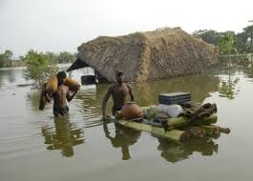
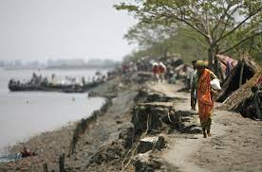
Look at the pictures and think about these.
What about are these pictures ?
These pictures are natural disaster
( flood and river erosion ).

Slide 5
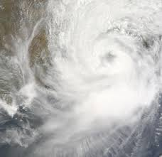
Today’s lesson is -
Aila
Cyclone

Slide 6
Learning outcomes--
Listening:
3.4.1:Understand statements made by teachers &students
Speaking
6.2.1:Talk about people, objects, events etc.
Reading:
1.5.1:Read words, phrases and sentence in the text with
Proper pronunciation, stress and intonation
writing:
3.1.1:Write words, phrases and sentences using non-
-cursive Capital and small letters.
8.1.1:Make sentences using words & Phrases given in
the textbook.

Slide 7
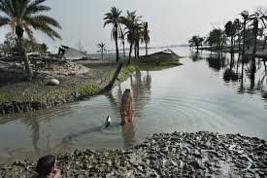
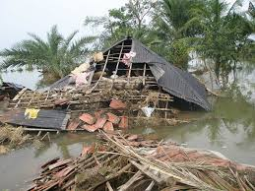
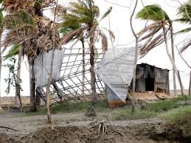
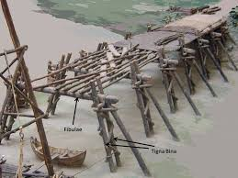
Everybody see the pictures and say , what are about these?
These pictures are about natural Calamity ‘Cyclone’.

Slide 8
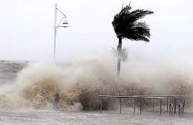
What are you looking at the pictures ?
The pictures are about ‘Cyclone Aila’

Slide 9
What can you see in the pictures ?
The river is rising.
Cyclone is in the Sea.

Slide 10
Let’s see another video-

Slide 11
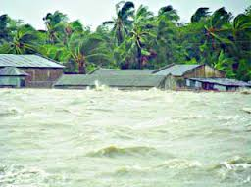
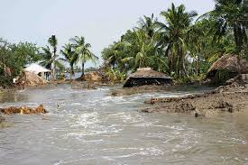
What can you see in the pictures ?
The river flooded the field.

Slide 12
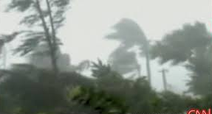
Look at the pictures and think about these.
Look at the pictures and think about these.
The wind is blowing and the roof away

Slide 13
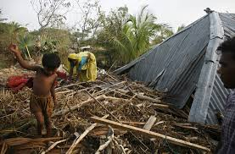
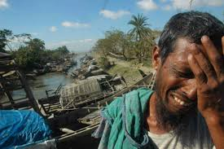
See another pictures and think about these
The wind has blown the roof away
and the man is so sorrow.

Slide 14
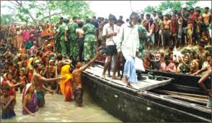
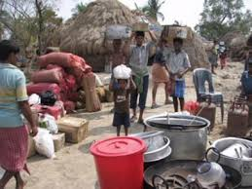
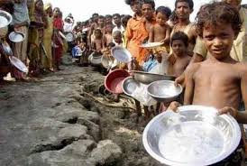
What can you see in pictures? Think about these.
The people are house & foodless for Cyclone Aila
The Army are distributing food to the people .

Slide 15
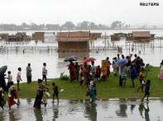
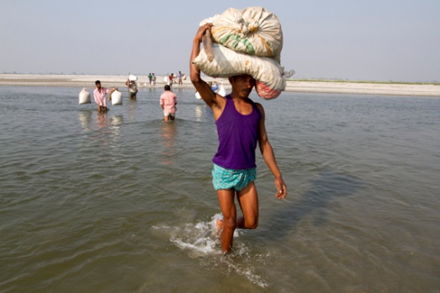
Why do the people gather on the bank of the river?
The people gather on the bank to pass the river and want to go for shelter.

Slide 16
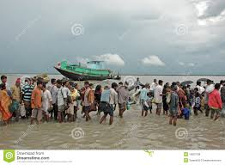
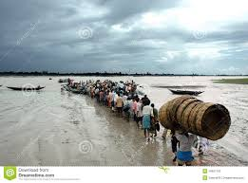
Why are these people running ?
These people are running for going to shelter center.

Slide 17
See another pictures and think about these
The wind has blown the roof away
and the man is so sorrow.

Slide 18
What can you see in pictures? Think about these.
The people are house & foodless for Cyclone Aila
The Army are distributing food to the people .

Slide 19
Everybody make a list of
some new words.
Afternoon , happened
Emergency , kit
Batteries , plastic
Earthquake , through
Grandparents , blew away

Slide 20
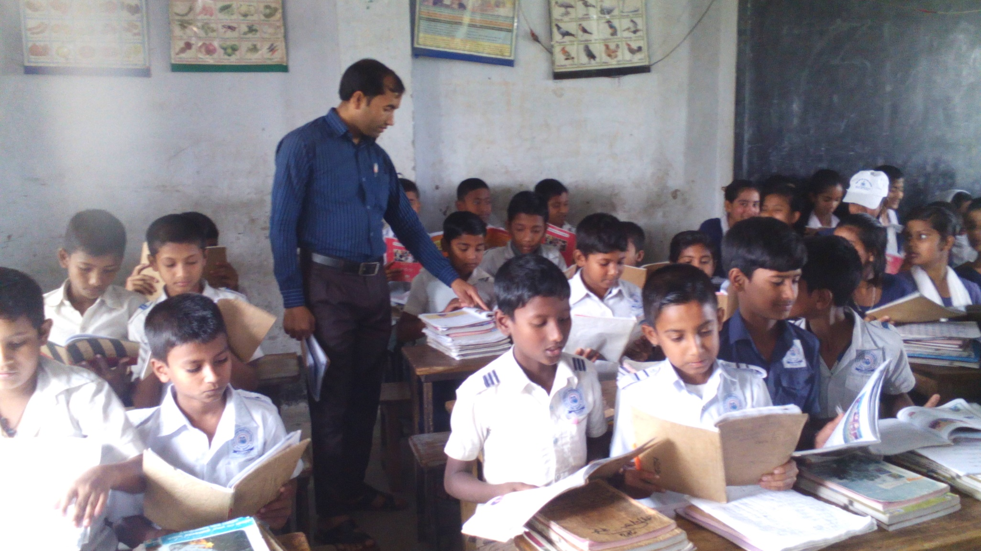
Everybody take your book and open page at 95.

Slide 21
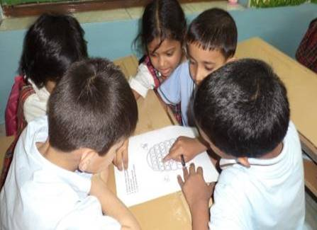
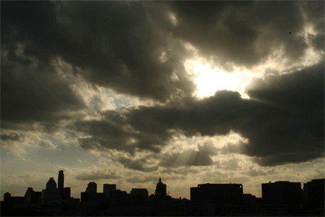
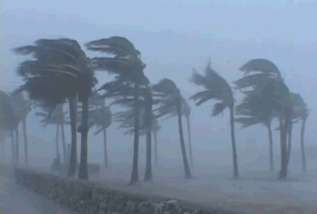
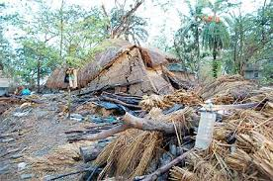
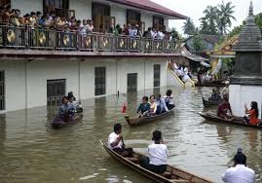
Look at the pictures and discuss in groups.
What is happening in the picture?
The sky is cloudy
The wind is starting
The wind has broken house & trees.
People have gone in shelter center.

Slide 22
Look at the pictures and discuss in pairs.
The wind is blowing.
The roof is blown away.

Slide 23
Evalution
Choose the best answer from following questions.
1. What is the passage about?
a. Cyclone b. natural calamity c. earthquake d. flood.
2. Why have the people lost their house ?
a. for wind b. for flood c. for cyclone d. for air.
3. What is uprooted by cyclone?
a. houses b. tins c. cloths d. trees.
4. How can you save from cyclone ?
a. to go shelter center b. to stay at home c. to leave home d. to run quickly.
5. What is the past form of “blow” ?
Blows b. Blown c. blowed d. blew.
Write the correct answer of the following questions.
What is cyclone ?
2. Why did the people loss their land and properties?
3. How can you save from natural calamity ?

Slide 24
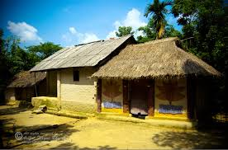
Home work
Everybody read about ‘Cyclone Aila’.

Slide 25
Thanks to all.

