Slide 1
WELCOME
EVERYBODY

Slide 2

Introducing
Md. Forhad Hossain
Assistant teacher (English)
Louhajang Girls’ Pilot High School,
Louhajng, Munshiganj.
Mobile:01714420516

Slide 3
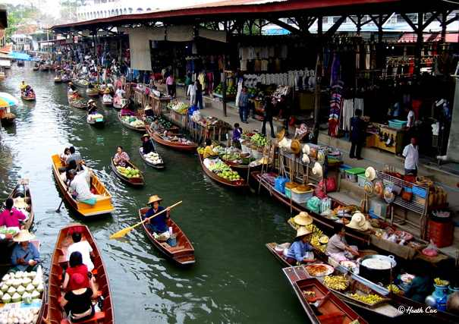
LOOK AT THEPICURE

Slide 4
SO, OUR TODAY’S LESSON IS....
THE THA KHA FLOATING MARKET

Slide 5
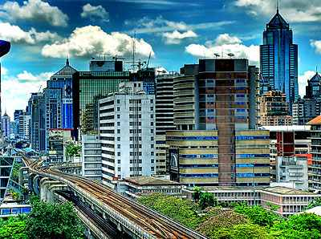
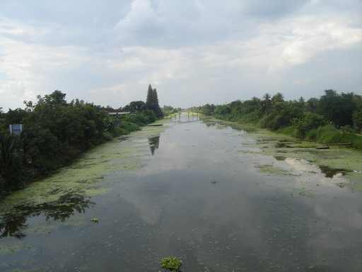
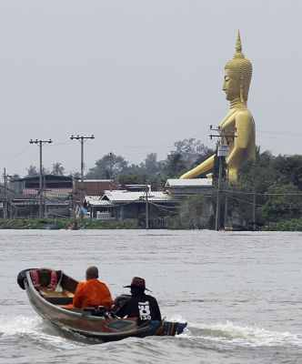
Vocabulary
canal
Visit
town
Travel
city
Klongs
There are many Klongs in Bangkok
They always travelled by boat
Bangkok is a large noisy city

Slide 6

Open your EFT book (Unit-6, Lesson-9, Page no – )
Read the passage (10mins)

Slide 7
Evaluation
1. Guess the meaning of the following words and choose the correct meaning closest to the text.
i) quickly
a. roughly b. slowly c. smoothly d. hastily
ii) ready
a. aware b. caution c. prepared d. warming
iii) surrounded with
a. consisted b. beset with c. consists in d. formed
iv) mainly
a. secondary b. vital c. chiefly d. important
v) elderly
a. aged b. youth c. adolescent d. immature

Slide 8
Evaluation
1. Guess the meaning of the following words and choose the corwith rect meaning closest to the text.
vi) laden
a. barren b. bare c. loaded with d. empty
vii) delicious
a. saline b. tasty c. pungent d. bitter
viii) display
a. hide b. hidden c. cover d. exhibit

Slide 9
EVALUATION (Pair work)
Ask and answer the questions in pair . First oraly, then write.
1. What kind of market was it?
2. Why did the boatman row slowly?
3. Who were selling goods? How were they selling their goods?
4. What were they selling?
5. What was the atmosphere at the market?
6. Why is Tha Kha floating market ‘traditional’?
7. How many days a week does the market sit?
Ans: It was a floating market.
Ans: Because there were boats everywhere.
Ans: The elderly Thai women were selling goods by boats
Ans: They were selling lotus flowers,farm-fresh coconuts, fruits, vegetables, local food and delicious sweets.
Ans: The atmosphere was nice. The canals were
surrounded with coconut palm trees.
Ans: The Tha Kha floating market is traditional with with a few tourists .
Ans: The market sits six or seven days a month depending on the phase of the moon..

Slide 10

Homework
Write a paragraph on
“The floating Market”

