Slide 2
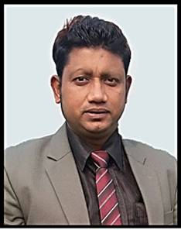
MD.FORHAD HOSSAIN
Assistant Teacher( English)
Louhajang Girls’ Pilot High School,
Louhajang, Munshigonj.
PRESENTED BY

Slide 3
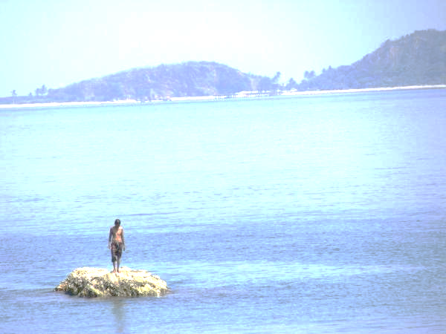
What can we see ?
we can see a man alone.

Slide 4
Can you live alone ?
Topic’s Name………?
Unit: One Lesson:1
Time: 5o Minutes.

Slide 5
A SMALL HOUSE MADE OF STRAW, BAMBOO AND WOOD
Hut
He lives in a little hut.

Slide 6
companion
Friend / partner/ mate
Man wants companion.

Slide 7
cooperation
Help / assistance
We need cooperation to live on earth.

Slide 8
community
Society / group
We live in a peaceful community.

Slide 9
Read
the text
silently
and
carefully
Unit-One
Lesson-1
10 mins

Slide 10
GROUP WORK
(Books shut) What five things did the young man do in the jungle? Discuss in groups . Tell the story to the groups sequentially.

Slide 11
Evaluation
Answer these questions. First discuss in pairs, then write the answers individually.
1 Why did the young man leave his house?
2 Where did he make a hut? What did he make the hut with?
3 Was the man happy in his hut?
4 How did he find himself again in a family?
5 Where and how can a person be happy?
6 What is the moral of the story?

Slide 12
THANKS

