Slide 1
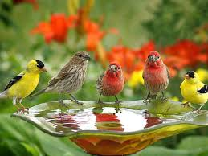

Slide 3
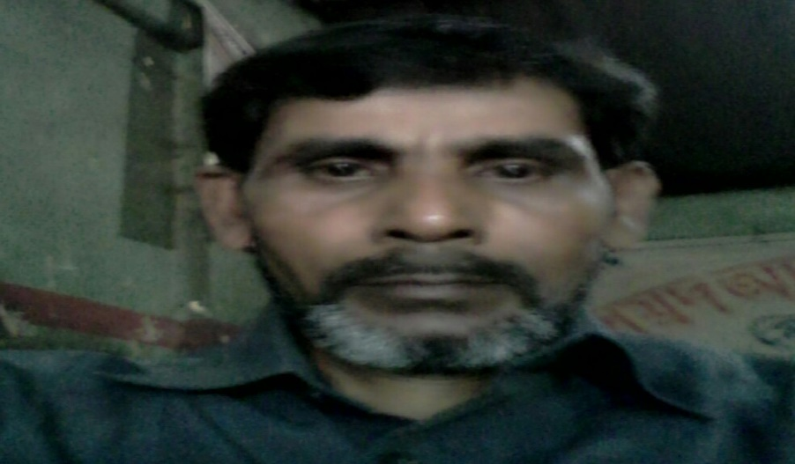
MD ABUL KASHEM
ASSISTANT TEACHER
LAKESHWOR DAKHIL MADRASA
CHATAK SUNAMGONJ
MOBILE 01786498922

Slide 4
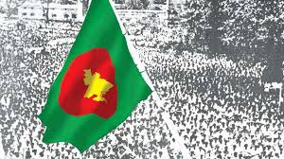
Lesson introduce
The liberation war museum
Lesson-1-2
Unit- 19
Class- Five
Time: 50 minutes
Date : 04/12/2901

Slide 5
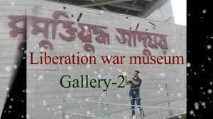
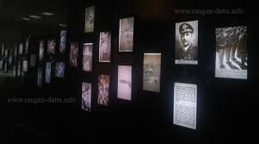
LET SEE SOME PICTURES

Slide 6
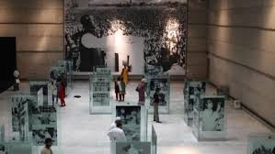
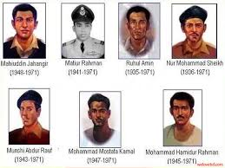
LET SEE ANOTHER PICTURES

Slide 7
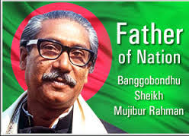
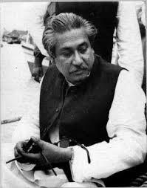
WHAT DID YOU SEE IN THE PICTURES ?

Slide 8
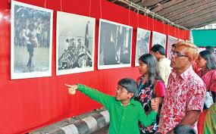
READ LOUDLY
On 14 December, our class went on a field trip to the Liberation war Museum at Agargaon, Dhaka, The trip was planned as part of our Bangladesh and Global studies Course. Our bus reached the museum at 10 a.m. A guide was waiting for us.

Slide 9
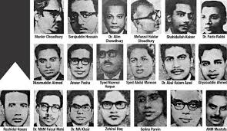
Word meaning
যাদুঘর
Museum
Exibition
প্রদর্শনী
Intellectuals
বুদ্ধিজীবি
Martyrs
শহীদ

Slide 10
Correct pronounciation
Liberation, Museum, Gallery, Newspaper clipping, Sunshine magazine, Bangabandhu Sheik Mujibur Rahman , Independence.

Slide 11
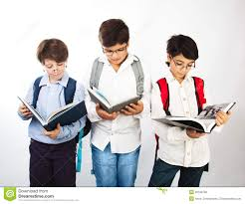
Group work
1.What is the name of students magazine ?
2.Who writes the articles in the magazine ?
3.Who is the writer of the news story ?
4.Who is the magazine for ?

Slide 12
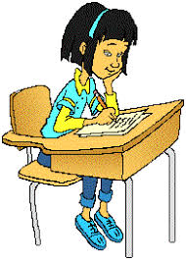
Evaluation
1.When did the class go on a field trip ?
2.How did the students travel to the liberation war museum ? 3.Where is the place ?

Slide 13
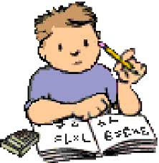
Home work
Write your own story in your exercise book .

