Slide 5
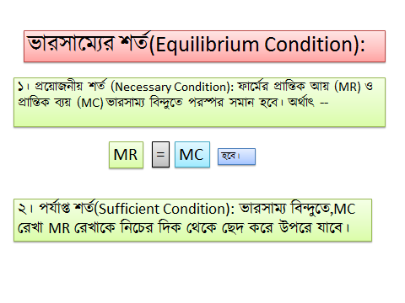
MR
=
MC
হবে।

Slide 12
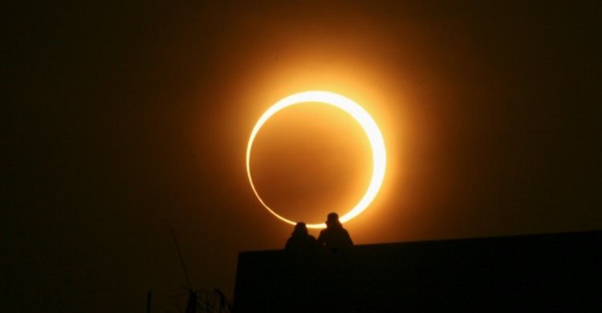
THANK YOU

