Slide 1
WELCOME
To
English Class

Slide 2
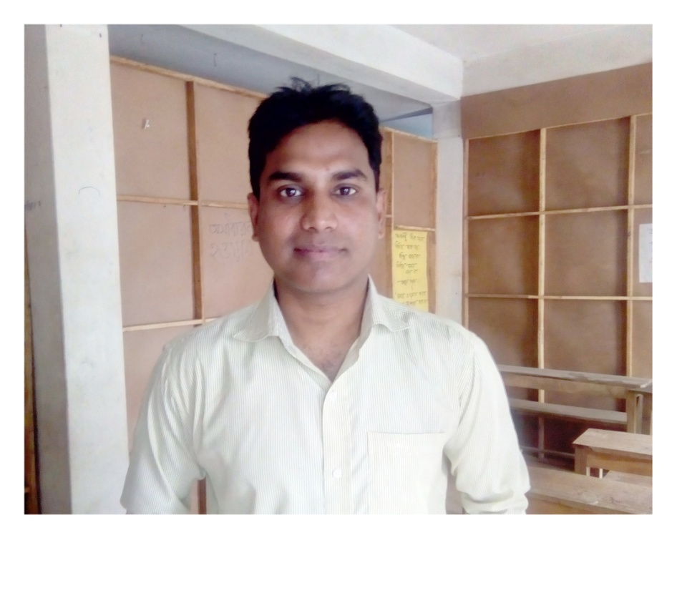
Asif ahmed
Assistant Teacher
Kathuli Government Primary School
Gangni, Meherpur

Slide 3
Title of the Lesson:
Write to me soon!
Unit:8 Lesson: 1
Page No. 30

Slide 5
Let’s sing a song.

Slide 6
Let’s do a quick review of our previous class
Notes:
Ouestions: 1. Ss, tell me the names of some healthy food. 2. Tell me the names of some unhealthy food.

Slide 7
Healthy or Unhealthy?
Draw the table and write the names of the foods. Then write “H” for healthy foods and “U” for unhealthy foods beside the names.
pineapples
vegetables
ice-cream
chocolate
tomatoes

Slide 8
Healthy or Unhealthy?
Answers:
Pineapples H
Vegetables H
Ice-cream U
Chocolate U
Tomatoes H

Slide 9
Let’s watch a video
https://www.youtube.com/watch?v=MfX6xGdQco0
Notes:
Ouestion: Students, try to find out what disease the doctor is taking about.

Slide 10
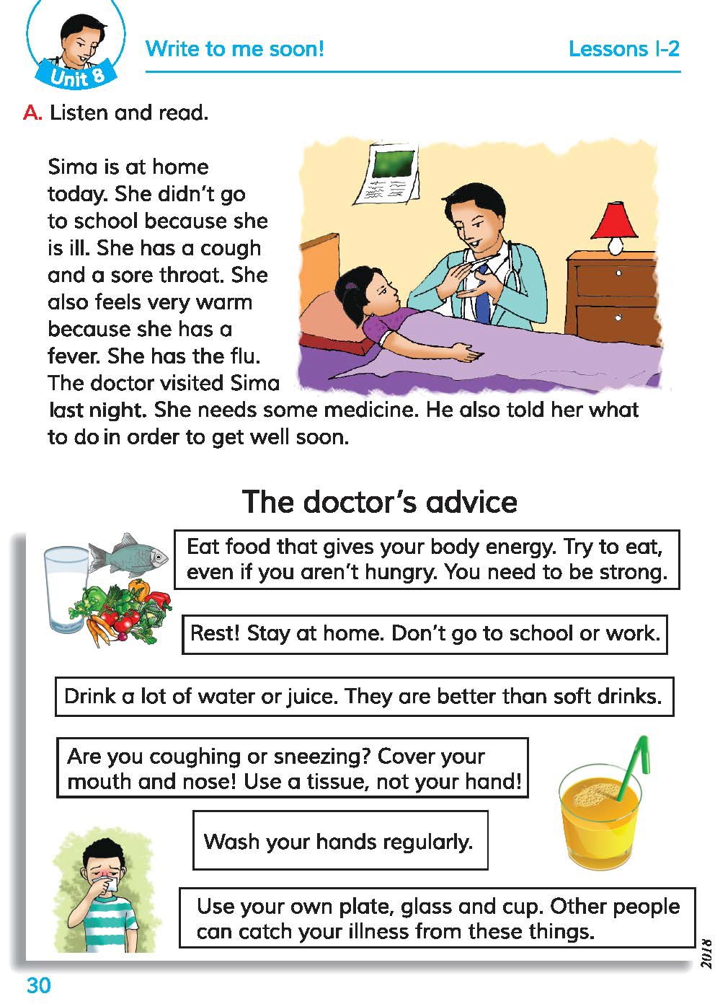
Now open your book at page no. 30

Slide 11
Today’s segment of the lesson
p.30

Slide 12
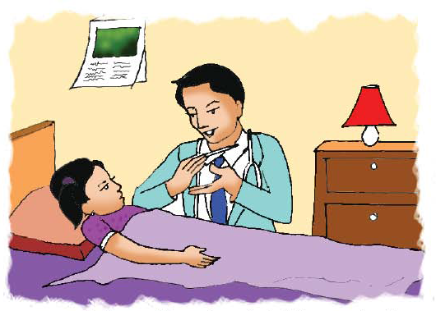
Let’s talk about the picture
Notes:
Questions: 1. What is the man? 2. How do you that he is a doctor? 3. What is the girl doing? 4. What is the doctor doing?

Slide 13
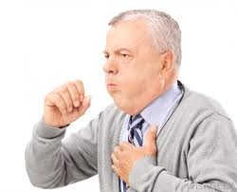
cough
To suddenly puh air out of your throat with a short sound, often repeatedly-
কাশা

Slide 14
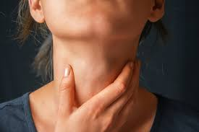
throat
the front of your neck- গলা

Slide 15
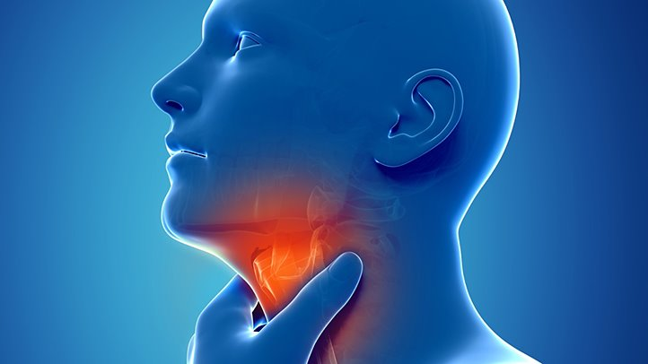
sore throat
painful front of your neck- গলাব্যথা

Slide 16
warm
slightly hot-হালকা গরম

Slide 17
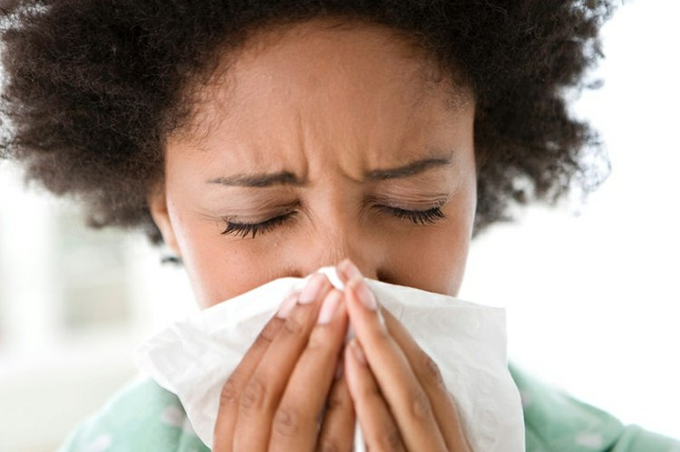
flu
influenza- ইনফ্লুয়েনজা

Slide 18
in order to
so as to - যাতে

Slide 19
Teacher’s loud reading

Slide 20
Students’ loud reading

Slide 21
1. Sima is at home today.
2. She didn’t go to school because she is ill.
3. She has a cough and a sore throat.
4. She also feels very warm because she has a fever.
5. She has the flu.

Slide 22
6. The doctor visited sima last night.
7. She needs some medicine.
8. He also told her what to do in order to get well soon.

Slide 23
Students’ silent reading

Slide 24
Group Work: Discuss the questions in group and try to find out the answer.
Questions:
Why didn’t Sima go to school?
Why is she feeling warm?
Who visited Sima?
Who needs medicine?
Notes:
After the qroup work, 1 student from each group will challenge students of another group by asking any one of the above questions.

Slide 25
Home work
You will write a short composition about a doctor in five sentences.

Slide 26
G
O
O
D
BYE

