Slide 1
GOOD MORNING STUDENTS.
How are you.

Slide 2
bcpsbipra@gmail.com
INTRODUCTION
INTRODUCE BY
Biplab chandra Paaul
Head Teacher
Aauliabad GPS
Maadhabpur, Habiganj
Class- one
Sub: English
Time:45 min.

Slide 3
Learning outcome
1.Able to understand the word meaning.
2. Able to discuss about the picture .
3. Able to read the word.
4. Able to write these word.

Slide 4
What do you see at your village?
With my help the students will say
Tree,house,cow,plant,cat,dog,hen,river,pond,goat

Slide 5
Todays
lesson

Slide 6
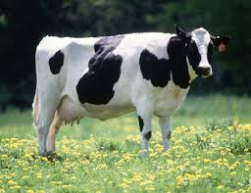
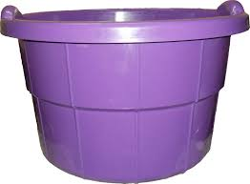
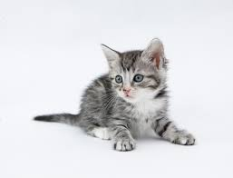
I will show you a some picture. try to answer me.ok
COW
TUBLEWELL
TUB
KITTEN

Slide 7
Think ,what thigs do you see outside your house?

Slide 8
I will ask some students.

Slide 9
One student ask another student.

Slide 10
I will say them to open their textbook at the page number 44.
Indicate these picture I will ask them ,what’s this.

Slide 11
We see all these things in the village.

Slide 12
Thank you.
Good bye students.

