Slide 1
Welcome

Slide 2
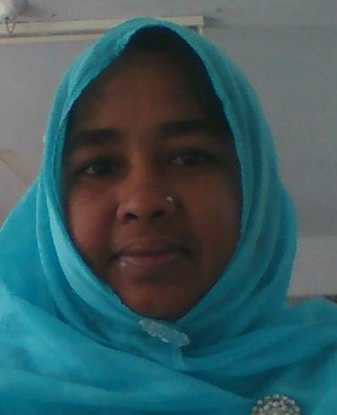
Presenter

Slide 3
WELCOME
To
Class

Slide 4
English 2nd Paper
Class-7
Unit Lesson

Slide 5
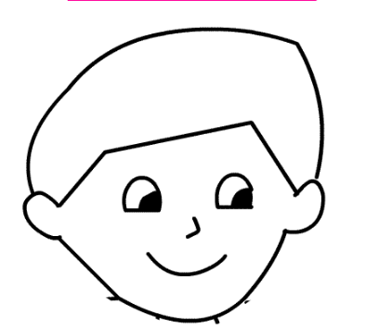
Let’s see the pictures
Parts of body

Slide 6
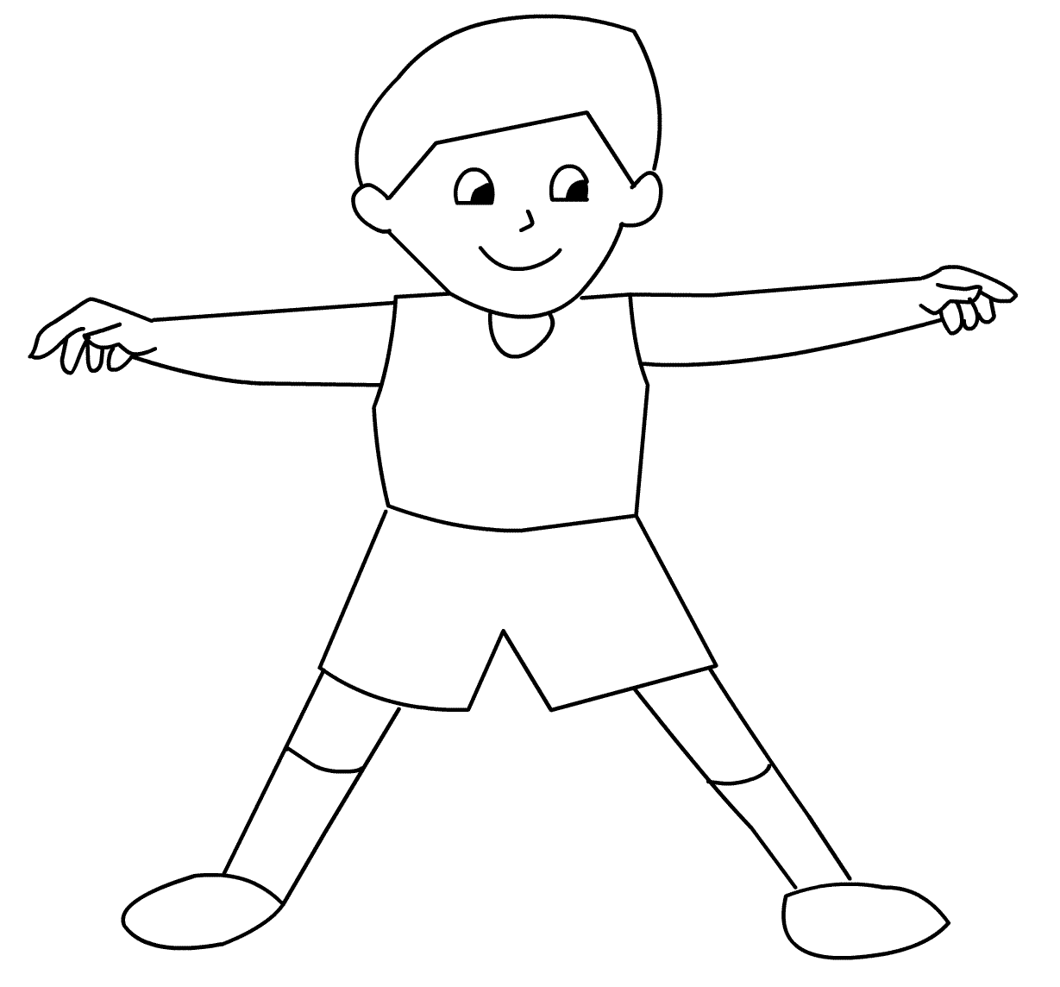
Human body

Slide 7
Guess-
What is our topic?

Slide 8
Todays topic
Parts of Speech
Episode- One

Slide 9
Learning Outcomes
Students will be able to-
#. Learn about Parts of Speech.
#. Define Parts of Speech.
#. Classify Parts of Speech.

Slide 10
Parts of Speech
* The different kinds of words used for different purposes in a sentence are called parts of speech.
We are in the class room.
Here Six parts = A sentence/Speech

Slide 11
Kind of Parts of Speech
There are Eight kinds-

Slide 12
Noun
Pronoun
Adjective
Parts
of
Speech
Interjection
Verb
Adverb
Conjunction
Preposition

Slide 13
We =
are =
in =
the class room=
Pronoun
Verb
Preposition
Noun
We are in the class room.
=
Speech

Slide 14
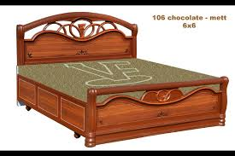
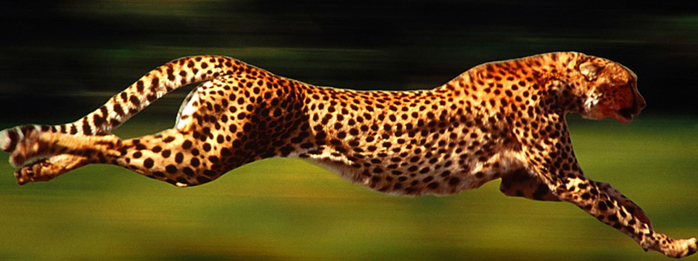
Tell about the pictures

Slide 15
Noun
A noun is the name of any person, place or thing.

Slide 16
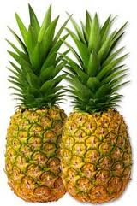
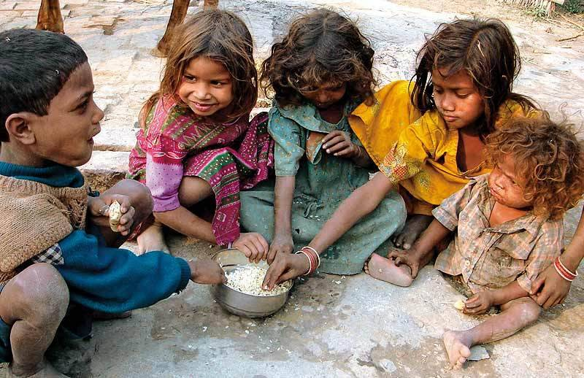
Ask and Ans.

Slide 17
Action: Read silently and note it.
Noun
=
নাম
Pronoun
=
নামের পরিবর্তে যে শব্দ বসে
Verb
=
কাজ
Adjective
=
দোষ, গুন, সংখ্যা, অবস্থা
Adverb
=
দোষ-গুন, সংখ্যা, অবস্থার পরিমান
=
মশলা
Preposition
Conjunction
=
সংযোজক, যে শব্দ দিয়ে যুক্ত করা হয়
Interjection
=
আবেগসূচক শব্দ

Slide 18
Individual Work
Write the name of the kinds of Parts of Speech

Slide 19
Group work
Define the Part of Speech

Slide 20
Evaluation
Rima reads book.
*What is it?
* Has it any name?
* So, it is -----

Slide 21
See you again

Slide 22
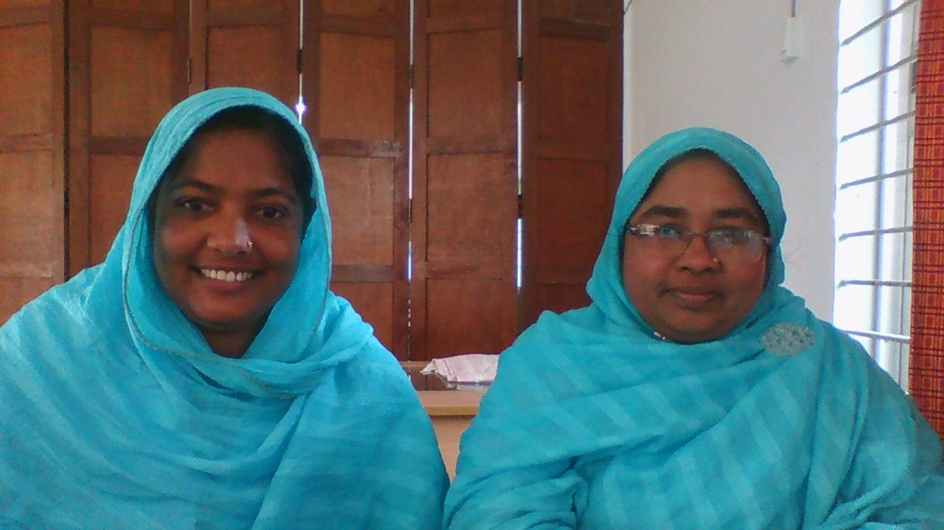
THANK YOU

