Slide 1
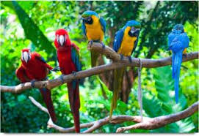

Slide 2


Slide 3

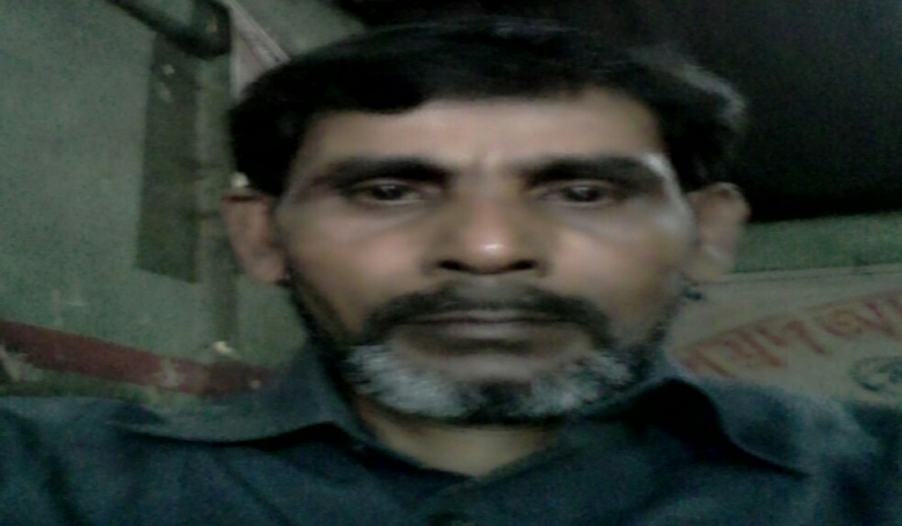
MD ABUL KASHEM
ASSISTANT TEACHER
LAKESHOR DAKHIL MADRASA
CHATAK SUNAMGONJ
MOBILE 01786498922

Slide 4

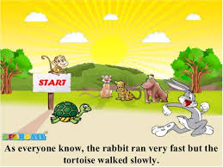

LESSON PIAN
THE HARE AND THE TORTOISE
Lesson-1
UNIT-14
CLASS-FIVE
TIME;50 MINUTES
DATE-04/12/2019

Slide 5

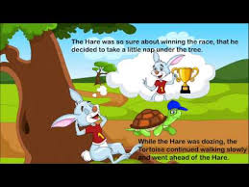
LET US SEE SOME PICTURES

Slide 6

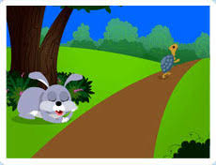
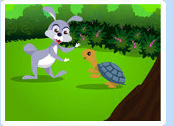
WHAT DID YOU SEE IN THE PICTURE ?

Slide 7

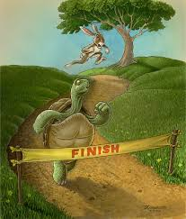
LOOK AT THE PICTURE AND SAY

Slide 8


LET US SEE ANOTHER PICTURE

Slide 9

READ SILENTLY
ONE DAY A HARE WAS WALKING IN THE FOREST WHEN HE SAW A TORTOISE. THE HARE WAS THE FASTEST ANIMAL IN THE FOREST.THE TORTOISE WAS THE LOWEST ANIMAL IN THE FOREST.

Slide 10
Word meaning
Start
আরম্ভ
Fastest
সবচেয়ে দ্রুত
Lowest
সবচেয়ে ধীরগতি
Tortoise
কচ্ছপ
Hare
খরগোশ

Slide 11
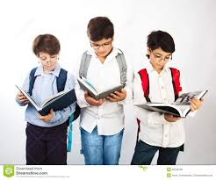
GROUP WORK
What does “Slow and steady wins the race” means ?

Slide 12

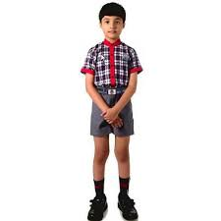
Evaluation
1.What did see the tortoise ?
2.Where did sleep the hare ?
3.How long did he sleep ?
4.Who won the race ?

Slide 13

Home work
Matching the words in column A with in column B
A-----------------------------------B
Angry----------------------------------Begin
Fast----------------------------------------Beside
Start------------------------------------------------Quick
Nap---------------------------------------------------------Furious

Slide 14


