Slide 1


Welcome

Slide 2

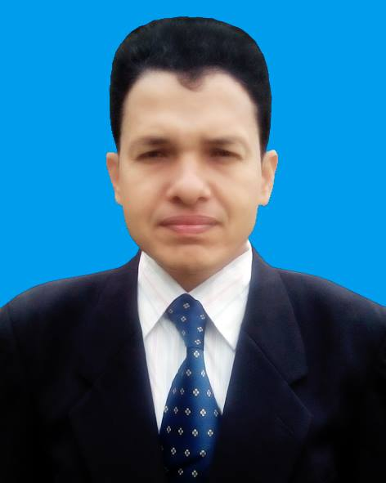
Identity of teacher
Md.Zahidul Islam
Assistant Teacher ICT
Purba Kewabunia Akbaria Dakhil Madrashas,
Master Trainer Of ICT
UITRCE,BANBEIS,Amtali,Barguna.
Mobail no-01718165920
Email no-zahidulislam7994@gmail.com

Slide 3

Class Ten
English 1st Paper
Unit 18
Lesson 5

Slide 4
Objectives:
By the end of the lesson ss will -
Read text and answer questions
Complete a chart
Fill in the blanks without clues.

Slide 5
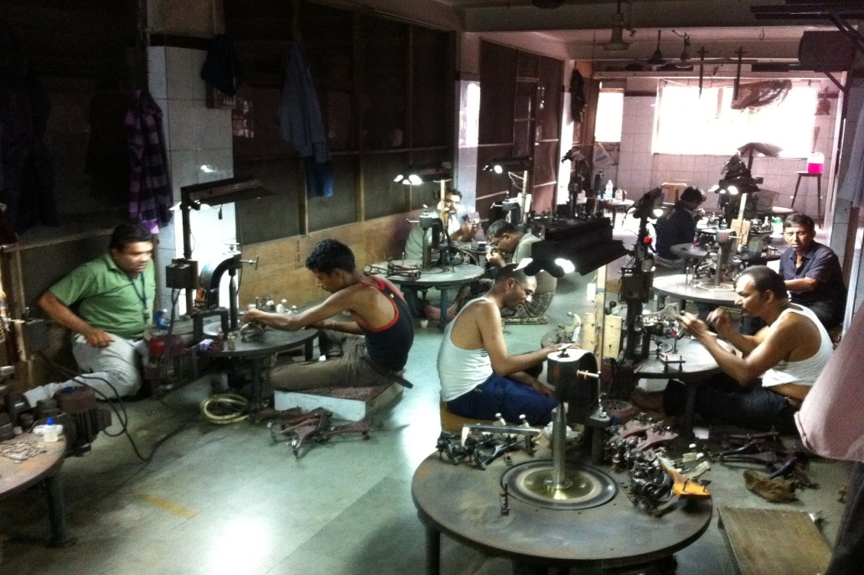
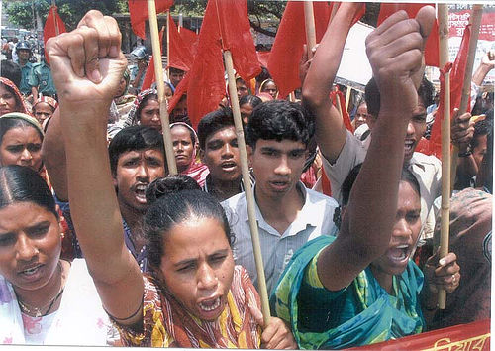
What do you see in the pictures ?

Slide 6
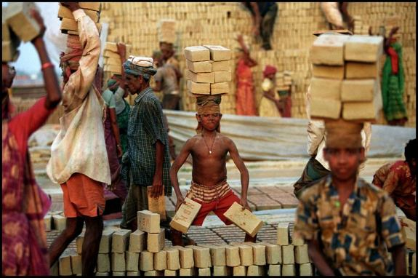
What are these people called?

Slide 7
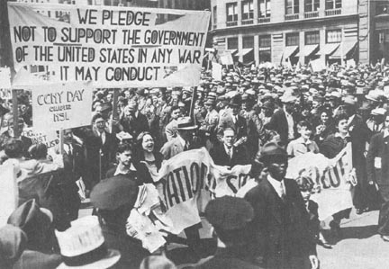
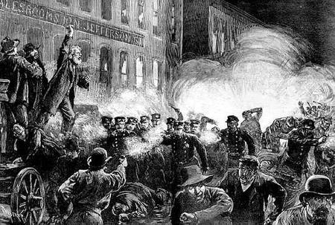
What do you see in the pictures ?

Slide 8
Mention some international days.
Which day is related to workers?

Slide 9

Our today’s lesson is
May Day

Slide 10

A .Ask ss to talk about the picture[in pair]

Slide 11

vocabulary
Minimum-
Panicking-
Trap--
Exploit-
Privilege
Undetermined

Slide 12
Minimum
5 kg, 1 kg, 10 kg
Which one is minimum?
Minimum[adj]-
the lowest quantity

Slide 13
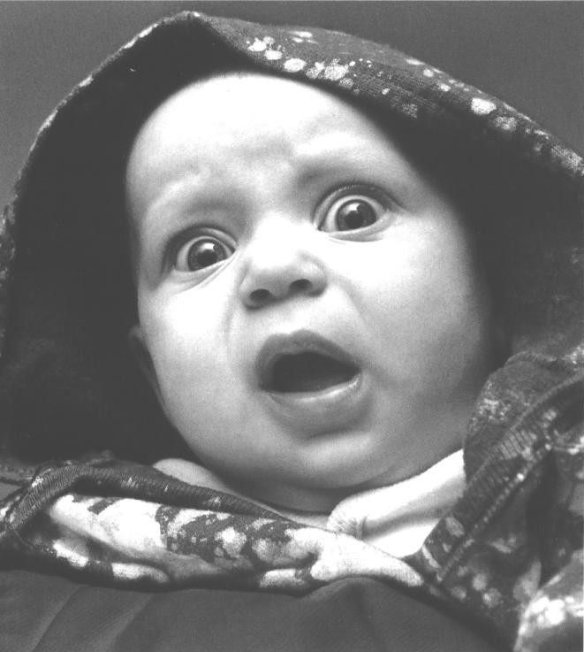
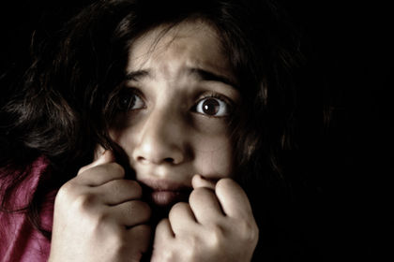
Panicking-
Panicking[adj]-
afraid

Slide 14
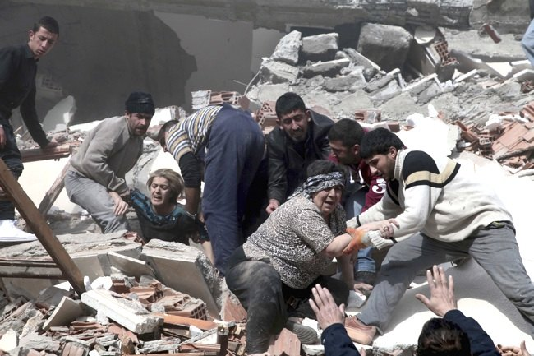
Trap
Trap[verb]
To keep in a dangerous position

Slide 15
Let us match the word meanings:
Exploit[verb]—to take advantage of.
Privilege[noun]-facility.
Undetermined[adj]-unknown.

Slide 16
B. Ask ss to read the passage individually and anwser the following questions in group:
1 Where do you think these two texts are taken from?
2 .What were the workers’ demands?
3. How long did the workers work before 1886?

Slide 17
4 Do you think our workers enjoy the the privileges as referred to text 1?
5.What were the causes that led to the struggle in text 1?
6.In what way were the rights of the workers violated in text 2?

Slide 18
Let us match the answers;
1 . Newspaper/journal/internet.
2. A minimum wage,safety laws and eight-hour work day.
3. Fourteen or even more hours a day.

Slide 19
5. Long working hours and lack of necessary facilities
6. They were working late hours and there was not enough arrangement for safety.

Slide 20
c.Ask ss to tick the chart if our workers enjoy the privileges and cross if they do not enjoy.[individually]
Text 1 given/ denied | privileges | Text 2:given/denied
 | Working hours
 | Safety-laws
 | Minimum wages
 | Better working conditions
 | Better pay
 | Better standard of living

Slide 21
Grammar:
Name of grammar; passive voice
Example; [1] Workers were exploited.
[2] May day is observed worldwide.
Form;Sub+be verb+Past participle of principal verb.

Slide 22

Hometask;
Fill in the blanks.
The struggle of working class people [a]--took place in
the[b]—1886 is an important[c]—in the history of workers.Now May Day is[d]—across the world.It is a day of[e]—importance for the workers.Today a worker
[f]—a lot of[g]—for their sacrifice.The workers[h]—
Out successful sacrificing their[i]--.In our country the
Day is observed with due [j]--.

Slide 23

Thank You

