Slide 1

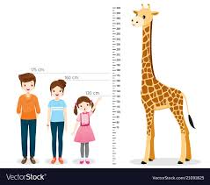
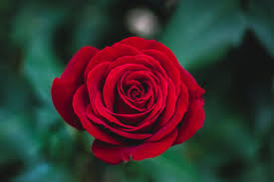


Slide 2


TEACHER’S IDENTITY
NAME:SHAMSUDDIN.
SENIOR TEACHER.
MOBILE:01767264934.
VEDURIA SERAJIA FAZIL MADRASAH.
LALMOHAN,BHOLA

Slide 3
LESSON IDENTITY
Class:Nine
Subject:English Grammar and composition.
Unit: 03
Time:45 minutes.

Slide 4
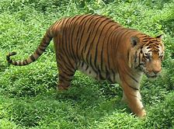
The tiger is a strong animal.It is also furious.

Slide 5
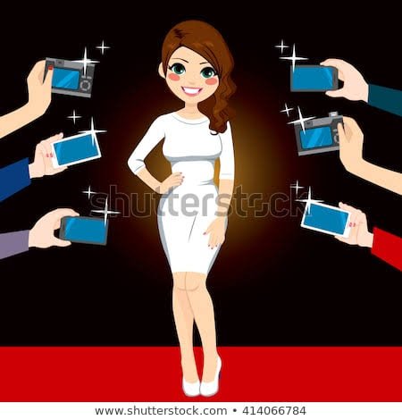
The lady is famous.She is beautiful .She is rich also.

Slide 6


What are the red words in those sentences?
Those are adjectives

Slide 7
Our today’s lesson
ADJECTIVEs
By the end of the lesson students will be able to:
Describe the pictures.
Narrate about adjectives.
Learning outcome

Slide 8
.
Adjectives have three forms:
1.Positives: use of adjective without comparing.
2.comparatives: use of adjectives to compare two things or persons
3.superlatives: comparision among three or more.

Slide 9
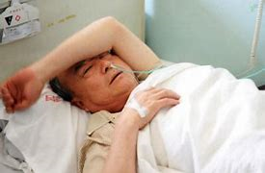
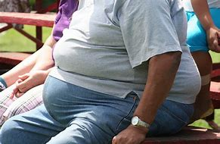

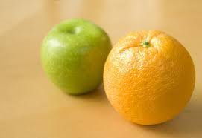
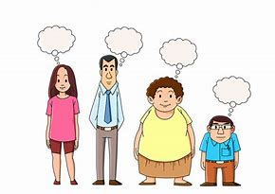

positive
comparative
superlative

Slide 10


1.Positive compare with…………………………
2.Comparative compare with……………….
3.Superlatives compare with………………..

Slide 11
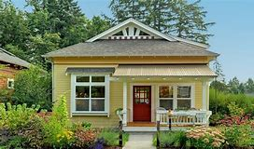
Homework
Write the comparative and superlative form of the following words:
Tall,fat,small,fa-mous,short,long,big,good,bad,in-teresting.

Slide 12
