Slide 1

Welcome

Slide 2
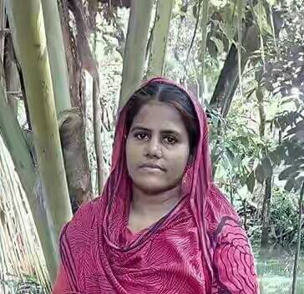
Presented by:
Marzan Afroz
Assistant teacher
06 No Minazdi Government Primary School
Kalkini, Madaripur.
Gmail : marzanbelayet@gmail.com

Slide 3
Lesson introducing
Class : Four
Subject : English
Lesson :1-2
Unit : 19
Page : 38

Slide 4
Dear students let’s watch a video !

Slide 5
Lesson declaration
Dear students let’s learn about
Food and meals

Slide 6
Learning outcomes
By the end of the lesson students will be able to
1.5.1. Read words and sentences with proper pronunciation.
3.1.1. Ask answer Wh questions.

Slide 7
Presentation
Input
Teacher’s acting
Practice
Ss pair work
Ss group work
Task
1. Write another 5 names of fruits.
2. Write 5 names of foods.

Slide 8
Dear students let’s enjoy a game!

Slide 9
Missing game
Strawberry
Papaya
Juice
Coconut
Fried egg
Mixed vegetables
Rice

Slide 10

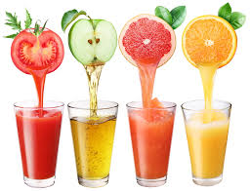
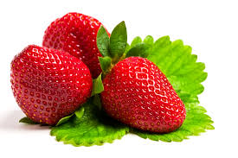
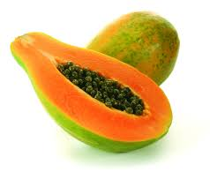
Coconut
Juice
Strawberry
Papaya

Slide 11
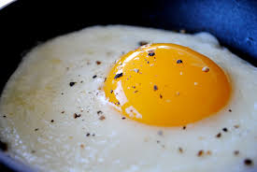
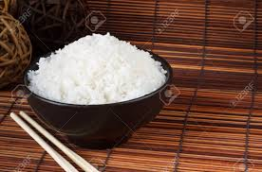
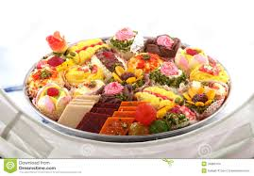
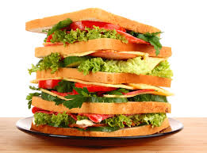
Fried egg
Rice
Mixed food
Sandwich

Slide 12
Dear students let’s Make some Wh Questions!
I eat fried eggs.
Nafiza eat rice.
This is sandwich.

Slide 13

Thanks to all.

