Slide 2
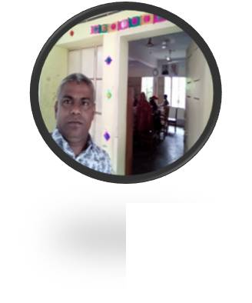
Biplab Chandra paul
Head teacher
Auliabad govt. primary school
Madhobpur,habiganj.

Slide 3
Learning outcome
The students will be able
3.2.1.To understand questions about family and friends of students.
8.1.1 to take part in conversations on simple topics

Slide 4
We live with our parents , grand parents , brothe and sister.

Slide 5
Our todays lesson
Sagar
and
his family

Slide 6
To some students I will ask some question
1 . What’s your name?
2. How old are you?
3 . What class are you in?
4. What’s your father , mother etc.

Slide 7
Students ,open your English book at the page no 30.
I Will read the text loudly.

Slide 8
Dear students read the text silently
Find the unknown word
Iwill help them to finding.

Slide 9
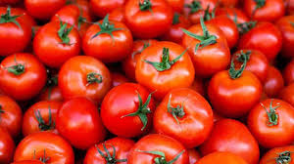
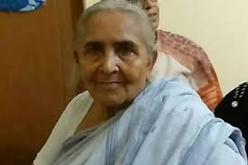
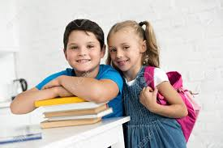
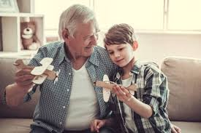
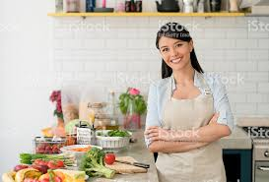
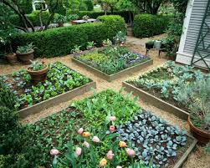
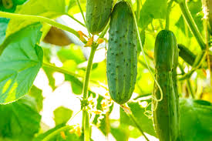
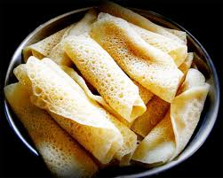
Read the text again with me and underline the word which I say.
tomatoes
grandmother
Brother and sister
Grandfather
House wife
Garden
Doctor
cucumber
Pithas

Slide 10
1.How old is Sagar?
2.What is Sagar parents?
3.What is Sagar grand parents?
4.Who helps Sagar?
5.Who make best pitas?
6.Who helps his mother with the garden ?

Slide 11
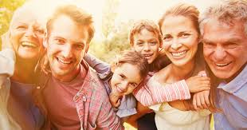
Discuss with your next about Sagar’s family.

Slide 12
Write 5 sentence about your family.

Slide 13
Thankyou.Goodbye

