Slide 1
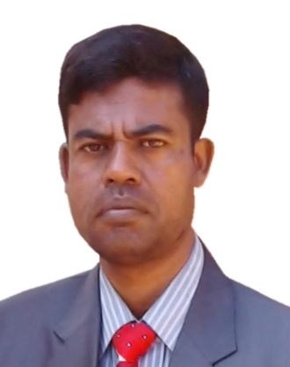
IDENTITY
MD. ABDUR RAZZAK
HEAD TEACHER
DHALAHARA WESTPARA
SECONDARY GIRLS’ SCHOOL
E-mail: abdurrazzakmt@gmail.com
Phone number: 01721588402

Slide 2
TOPIC
CLASS : EIGHT
UNIT: FIVE
LESSON: TWO
TITLE: FLASH BACK
Time : 50 minutes

Slide 3
Note for the teachers:
Implementation of such model content depends on the class room situation and skills of the teachers. If the situation demands please edit it according to Ss’ demands.

Slide 4
LEARNING OUTCOMES
After the end of the lesson the Ss will be
able to –
Talk about the pictures.
Ask and answer questions.
Develop a short composition .

Slide 5
Warm up
5 min.
Dhalahara Westpara Secondary Girls’ School
WELCOME TO MULTIMEDIA CLASS
ENGLISH

Slide 6
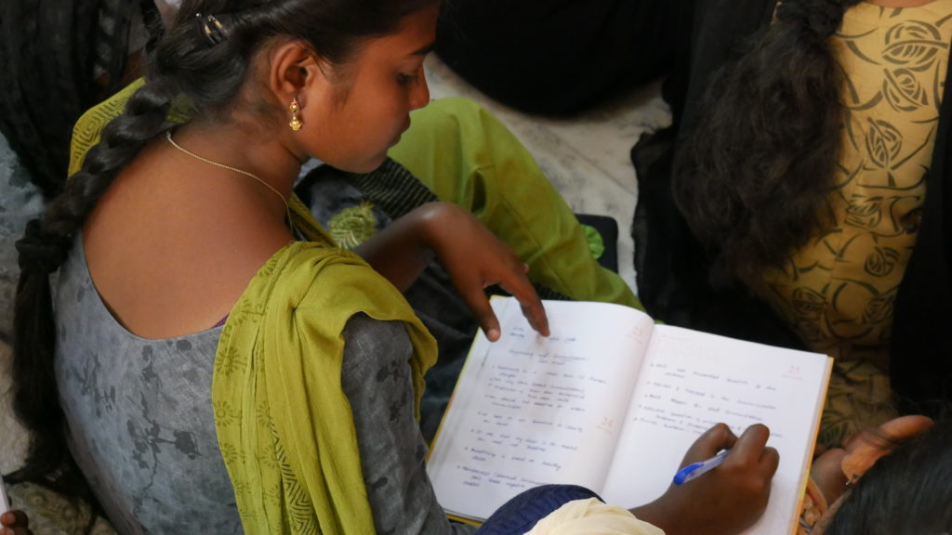
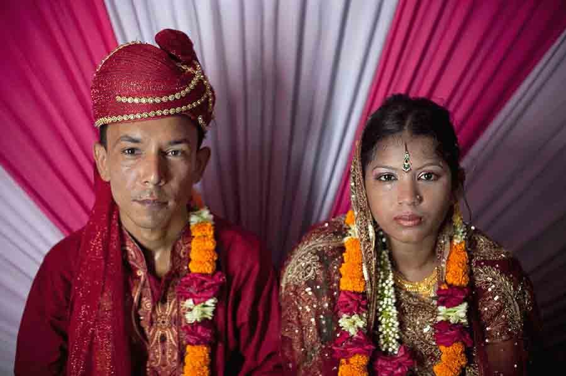
Look at the pictures.
previous Shamima
present Shamima
Flash back

Slide 7
So , What is today’s lesson?
FLASH BACK

Slide 8
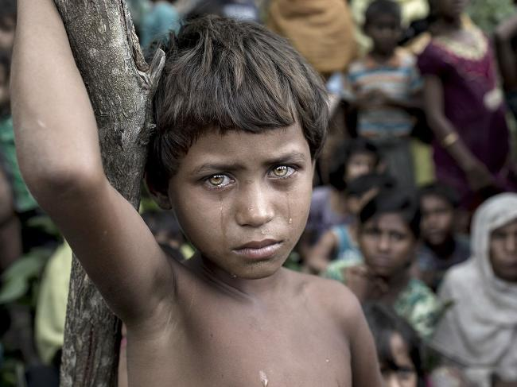
Let’s guise the meaning of some new words.
Stunned means-----
spell bounded/ stopped
Listening to her, we were stunned .

Slide 9
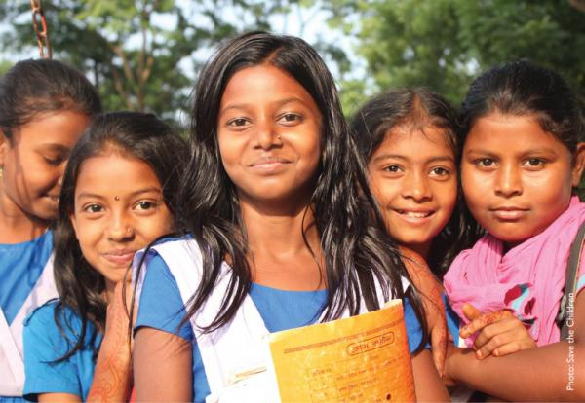
adolescent means-----
Young/ preadult
Shamima had all dreams of an adolescent.

Slide 10
heed means-----
attentive
Shamima did not want to get married. But nobody paid any heed to her.

Slide 11
A. Read the following text silently and take part in activities. 5 min
Shamima started to tell us her story. Listening to her, we were stunned and at the same time our hearts were filled with admiration for her. It was 1995. Shamima was 15 years old. She got promoted to class 8. Shamima had all the dreams of an adolescent. She wanted to bring about a change in her life. She wanted to see happiness in her family too. She knew she could fulfill her dream by completing her education and getting a good job. Fifteen-year old Shamima's dreams were nipped in the bud. Her father wanted to marry her off against her will. Marrying off a girl under 18 is against the law in Bangladesh. Shamima did not want to get married. But nobody paid any heed to her. They arranged her marriage with a man much older than her. All her tears and protests went in vain. Shamima was married off to Kamal Uddin Joardar.

Slide 12
INDIVIDUAL WORK. 5 min
B. Choose the best answer.
1. Shamima's story ......... everyone.
a) Fascinated b) Astonished c) shocked d) worried
2. Shamima thought about the welfare of her ......
a) family. b) friends.
c) Cousins d neighbours.
3. Shamima did not want to get married because she wanted to complete her education but nobody...... her.
talked to b) listened to
c) took care of d) looked after

Slide 13
PAIR WORK. 10 min
1. How long ago did Shamima begin to tell her story?
2. What did Shamima dream of?
3. Did Shamima's dream come true? What happened?
How old is Shamima now?
5. As an adolescent, what are your dreams?

Slide 14
GROUP WORK. 15 min
D. Write about a person who has suffered or struggled like Shamima.
# Use the following phrases :
pay heed to
nip in the bud
in vain

Slide 15
FEEDBACK 5 min.
Answer the following questions-
Who is Shamima?
What was her dream?
What is the cause of her dream breaking?
When she was married off ?
What did she want to see ?

Slide 16
Homework
Develop ten sentences about Shamima’s misery.

Slide 17
Advice
“BE AWARE OF EARLY MARRIDGE”

Slide 18
CLICK
THANKS ALL

