Slide 1



Slide 2

Presented by
Md. Alamgir Hossain
(ICT Teacher)
Rahimapur Fazil Madrasah, Patnitala, Naogaon.
Cell : 01723-626108
E-mail : alamgirchz@gmail.com
Date – 08/12/2019

Slide 3
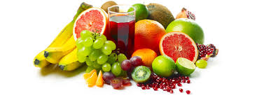

Adjective
some
She is
beautiful.
I will buy fruits.

Slide 4
Lesson Identity
Adjective
Class Six,Seven, Eight,Nine, Ten.
Unit Two
06 December 2019

Slide 5



Nice
Mita is a girl in the class.
Beautiful
The rose is a flower.
Our Headmaster is a
Kind.

Slide 6
Today’s Lesson
Adjective

Slide 7
Learning outcomes
After finishing the lesson, learners will be able to---
Define adjective.
Write their names.
Usages of adjective.
Identify adjectives.

Slide 8
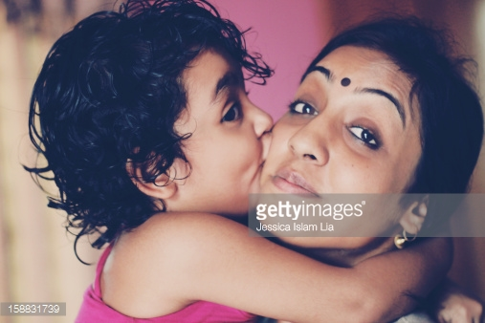
Adjective
যে সকল শব্দ দ্বারা কোন Noun বা Pronoun এর দোষ, গুণ, সংখ্যা, পরিমাণ, অবস্থা ইত্যাদি প্রকাশ করা হয় তাকে Adjective বলে।
Adjectives qualify only Noun and Pronoun. It specifies the quality, number, and size of noun or pronoun. Simply, it describes nouns or pronouns.
NICE
It is a face

Slide 9

Adjective
beautiful
Namira is a .
(এখানে Noun এর গুণ বুঝাচ্ছে)
three
He has red pens.
(Pronoun এর সংখ্যা বুঝাচ্ছে)
ill
Safi is .
(Noun এর অবস্থা বুঝাচ্ছে)

Slide 10
There are 3 Degrees of adjectives.
And these are:-
1. positive adjective
2. comparative adjective
3. superlative adjective

Slide 11
Positive adjective:
Positive adjective দ্বারা কোন তুলনা করা বোঝায় না । সাধারণভাবে noun বা pronoun এর বর্ণনা করে।
A Positive Adjective is a simple adjective, and it is used to describe, not to compare anything.
sick
Akash is .

Slide 12
Adjective
He is a boy.
good
beautiful
It is a garden.
sick
Akash is .

Slide 13

suitable
It is a very scenery

Slide 14
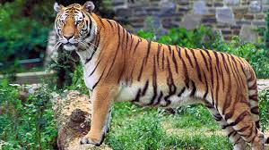
big
This is a very tiger

Slide 15
Comparative adjective:
দুইটি জিনিসের মধ্যে তুলনা বোঝাতে comparative adjective ব্যবহার করা হয়।
This type of adjective is used to compare two things, sometimes the word ‘than’ is used between the two nouns or pronoun.
funnier
He is than her.
(সে তার থেকেও বেশি হাস্যকর)

Slide 16
better
(রহিম করিমের চেয়ে ভাল)
Rahim is than Karim.
more beautiful
(নামিরা সামিরার চেয়ে বেশি সুন্দরী)
Namira is than Samira.
funnier
(সে তার থেকেও বেশি হাস্যকর)
He is than her.

Slide 17
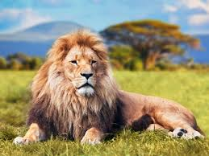
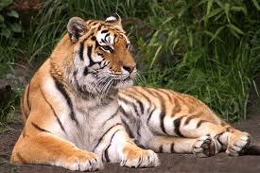
Com:-The Lion is The Tiger
more ferocious than

Slide 18

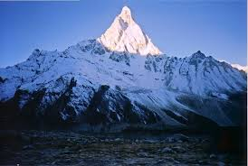
First hill
Second hill
higher than
Com:-The first hill is not the second hill

Slide 19
Superlative adjective:
দুইয়ের অধিকের মধ্যে তুলনা করে সবচেয়ে ভাল/খারাপ/কম/বেশি ইত্যাদি বোঝাতে superlative adjective ব্যবহার করা হয়।
The superlative adjective is used to express that something is the best/most and compares three or more things.

Slide 20
most beautiful
She is the girl in the world.
(সে সারা পৃথিবীর মধ্যে সবচেয়ে সুন্দরী মেয়ে)
funniest
He is the person.
(সে সবচেয়ে মজার মানুষ)
best
This is the lunch in this restaurant.
(এটা এই রেস্টুরেন্টের সবচেয়ে ভাল দুপুরের খাবার)

Slide 21
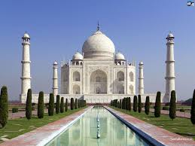
the most beautiful
Sup:-The Taj mahal is one of towers in the world

Slide 22
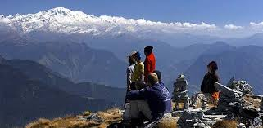
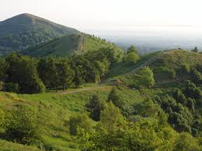
the highest
SUP:- The Himalaya is hill in the world

Slide 23
There are seven types of Adjectives:
These are:
Descriptive adjectives/qualitative adjectives/adjective of quality
Adjectives of number/Numeric adjective
Adjectives of quantity/quantitative adjectives
Demonstrative adjectives
Possessive adjectives
Interrogative adjectives
Distributive adjectives

Slide 24
Descriptive adjective:
Descriptive Adjective সাধারণত noun বা pronoun এর quality বোঝায় এবং তার সম্পর্কে বর্ণনা করে।
The descriptive adjective is used to express the qualities of noun or pronoun. It is also used for the description of someone or something.
যেমন:
Nice,
good,
bad,
beautiful,
charming,
nice,etc.

Slide 25
Descriptive adjective:
great
He told me about a moment of his life.
good.
She is looking
bad
You are a boy.

Slide 26

This scenery is
charming

Slide 27
Adjectives of number/Numeric adjective:
Noun বা pronoun এর সংখ্যা বা ক্রম বোঝাতে numeric adjective ব্যবহার করা হয়।
The numeric adjective is used to express the number or order of noun or pronoun.
যেমন:-
Two,
Three,
four,
First,
Second,
Third,
Single,
two
She can drink cups of tea at a time.

Slide 28
Adjectives of number
first
He is the boy in the class.
two
She can drink cups of tea at a time.
The owner of the house does not rent the room to the
single

Slide 29
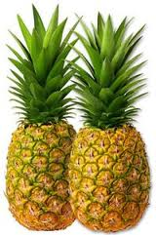
two
There are pineapples.

Slide 30
Adjectives of quantity/quantitative adjectives:
Noun বা Pronoun এর পরিমাণ বোঝাতে quantative adjective ব্যবহার করা হয়।
The quantitative adjective is used to express or indicate the quantity of a noun or pronoun or something.
যেমন:-
Some,
enough,
many,
little,
much,
whole,
sufficient,
all,
enough
I have money.

Slide 31
enough
I’ve money.
whole
The country is happy today.
some
Give me peanuts.

Slide 32
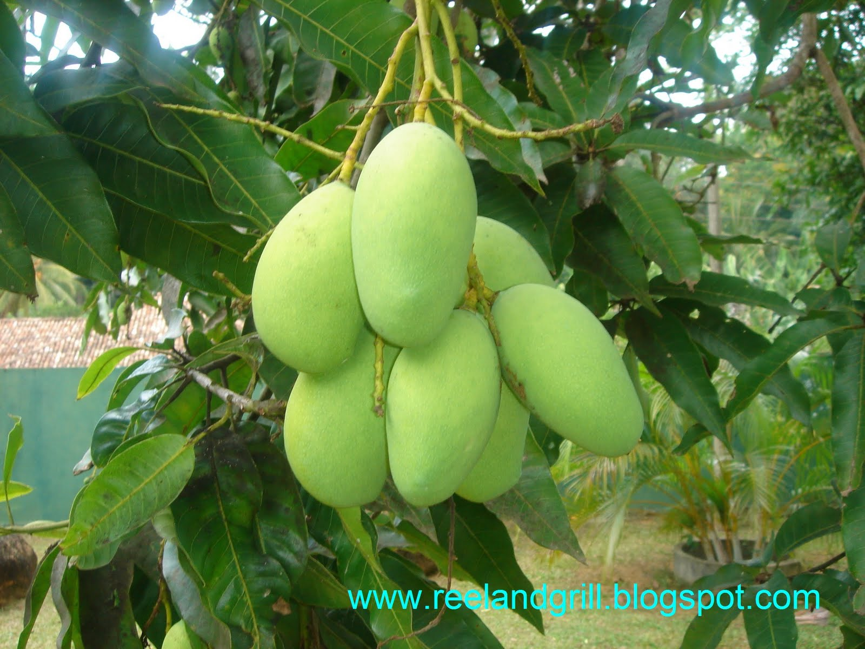
some
There are mangoes .

Slide 33
Demonstrative adjectives:
Noun বা pronoun কে নির্দিষ্ট করে বোঝাতে demonstratives ব্যবহৃত হয় ।
Demonstratives are used to specify the noun or pronoun.
যেমন:-
This,
that,
those,
these,
etc.
That
is his room.
(এটি তার কক্ষ)

Slide 34
Demonstrative adjectives:
This
book is mine.
(এই বইটি আমার)
That
is his room.
(এটি তার কক্ষ)
These
notes should be followed.
(এই নোট গুলো অনুসরণ করা উচিৎ)

Slide 35
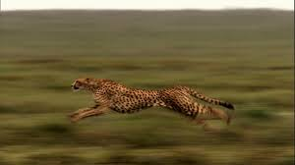
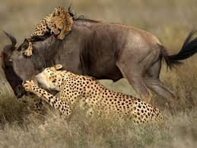
This
chita is faster than most other animals

Slide 36
Possessive adjectives:
বাক্যে মালিকানা বা নিজস্ব কোন সম্পদ বোঝাতে possessive ব্যবহার করা হয় ।
Possessives are used to show the possession or belongingness in the sentence.
Such as - my, her, their, our, your, etc.
Their
house is very big.
তাদের
( বাড়িটি অনেক বড়)

Slide 37


my
This is house.
our
This is flag.

Slide 38
Interrogative adjectives:
Interrogative adjectives সাধারণত Noun বা pronoun কে প্রশ্নের মাধ্যমে modify করে।
An Interrogative adjective modifies nouns or pronouns and forms a question.
Such as -
whose
What,
Which,
are known as interrogative adjectives.
Which
subject do you want to teach?

Slide 39
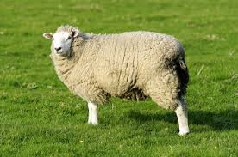
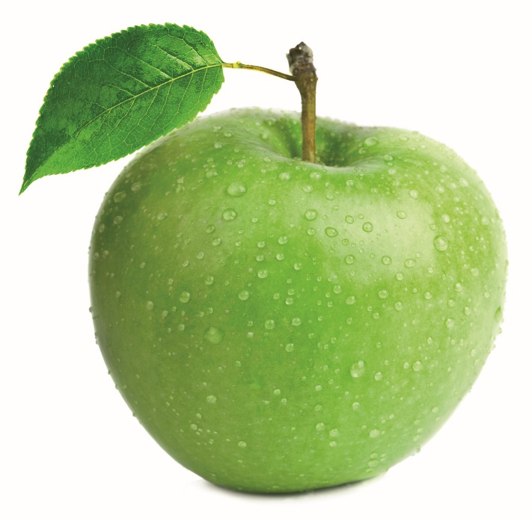
Whose
sheep is this?
What
Is this

Slide 40
Distributive adjectives:
কোন group এর কাউকে নির্দিষ্ট করে বর্ণনা করতে Distributive Adjective ব্যবহৃত হয়।
The distributive adjective is used to describe a specific member out of a group.
যেমন:-
Each, any, every, either, neither, etc.

Slide 41
Any of you can eat the apple.
(আপনাদের মধ্যে যে কেউ আপেলটি খেতে পারেন)
Each of the students will get money.
(প্রত্যেক ছাত্রই টাকা পাবে)
Every man has to go outside for a job.
(প্রত্যেকটি মানুষেরই চাকরি করার জন্য বাইরে যেতে হয়)

Slide 42

Group Work.
Answer the following questions.
1. What is adjective?
2. Find out at least five adjective from your classroom.
3. Make sentences with adjective.

Slide 43
Evaluation:
What is Adjective ?
How many kinds of Adjective ?
What is the difference between Positive, Comparative & Superlative Adjective ?
What is comparison of Adjective ?

Slide 44
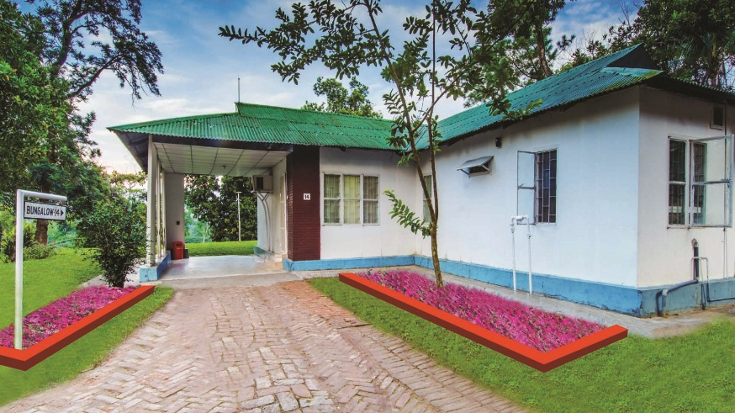
Home Task
Write the classification of adjective and its examples

Slide 45


END THE CLASS.

