Slide 1
WELCOME

Slide 2
Presented by
Shahrina Bin Sweety
Assistant Teacher
Chormonai Madrasha Govt. Primary School
Barishal Sadar
Barishal.

Slide 3
Lesson Identity
Class : Five
Subject : English
Unit : 1 - Hello
Lessons : 4 – 5 ( E )
Page : 4

Slide 4
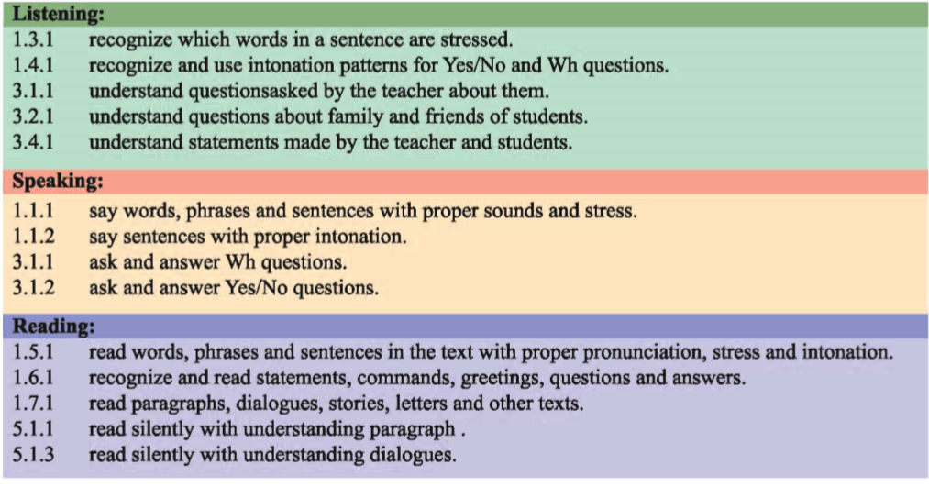
Learning Outcomes
By the end of the lesson the students will be able to -

Slide 5
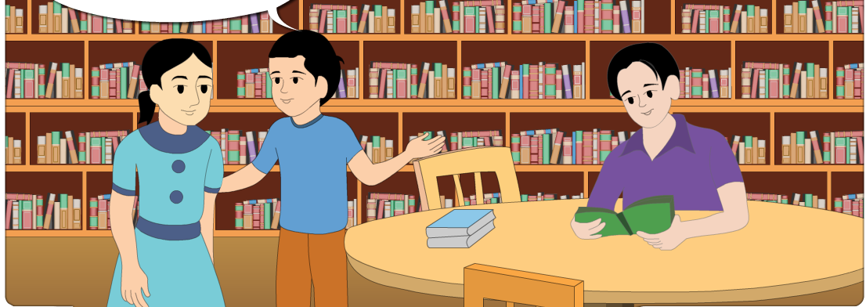
Dear students, look at the picture.
There are 3 persons in the picture.
What are they doing ?
They are talking.
What do you see in the picture ?

Slide 6
Our Today’s Lesson is
Hello !

Slide 7
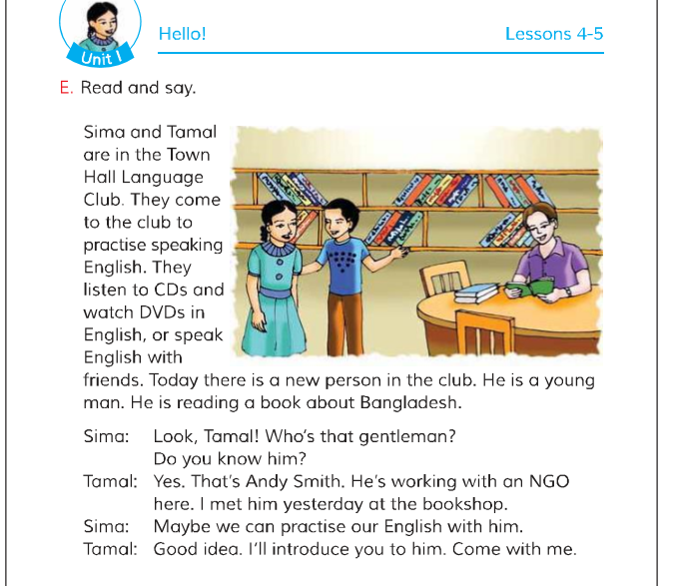
Dear students, open your English book at page no. 4
Point your finger at the first line and listen what I read.

Slide 8
Now, find out the new words from the text.
Town Hall
New person
Gentleman
Young man
Language Club
NGO

Slide 9
Town Hall
What is Town Hall ?
A place where people gather.

Slide 10
New person
Who is new person?
An unknown person.

Slide 11
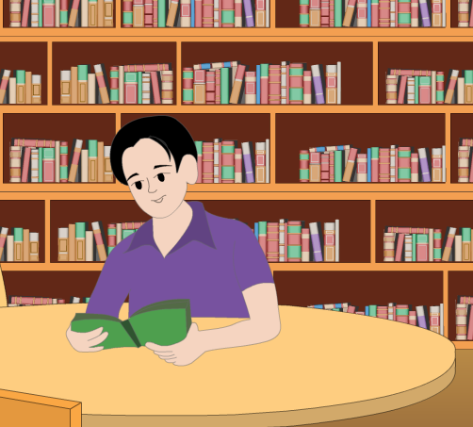
Gentleman
A noble man

Slide 12
Young man
Under 25 years.

Slide 13
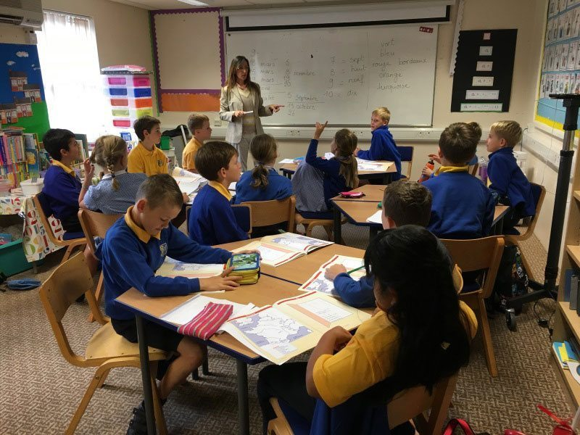
Language Club
Where people come to practice speaking any language

Slide 14
NGO
What do you mean by NGO ?
Non Government Organization

Slide 15
Group Work
I’ll divide them into 4 groups and tell them to read the text.

Slide 16
Who – a person
Where – a place
How – in what way or manner
What – which thing or action
Why – reason, cause
Read the following words
Who
Where
How
What
Why
We can use these words for making questions.

Slide 17
Pair Work
Ask and answer the following questions.
Where are Sima and Tamal ?
Why do they go there ?
Who is the new person ?
What is he reading ?
Where did Tamal meet the new person ?

Slide 18
Open your English book at page no. 4
Read the passage carefully. If you couldn’t then ask me.

Slide 19
Checking Learning
Make WH questions with the following statements.
Sima and Tamal are in the Town Hall Language Club.
There is a new person in the club.
They come to the club to practice speaking English.
He is reading a book about Bangladesh.
Tamal met him at the bookshop.

Slide 20
Home Work
Write 5 sentences about “Language Club.”

Slide 21
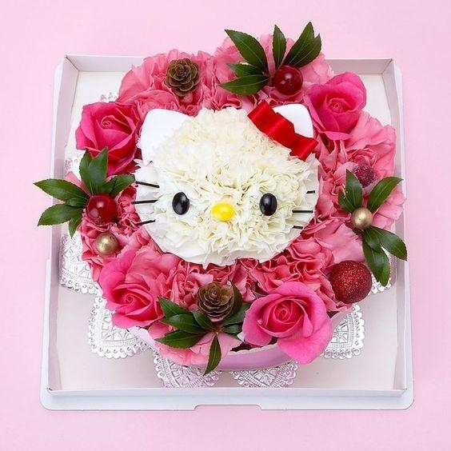
T
THANK YOU.

