Slide 1
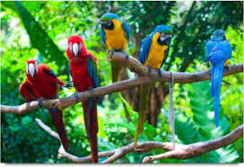

Slide 2
WELCOME TO ALL

Slide 3
MD ABUL KASHEM
ASSISTANT TEACHER
LAKESHOR DAKHIL MADRASA
CHATAK SUNAMGONJ
MOBILE 01786498922

Slide 4
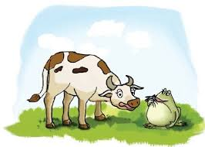
LET US SEE THE PICTURE
THE COW AND THE FROG

Slide 5
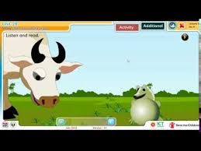
WHAT DID YOU SEE IN THE PICTURE ?

Slide 6
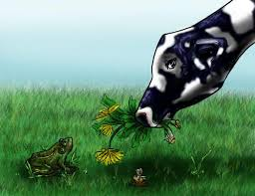
WHAT DID THE FROG LOOKS AT THE COW AND THINKS ?

Slide 7
What did you see in the picture ?
The frog grows bigger.

Slide 8
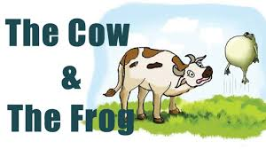
What did you see in the piture ?
The frog is flying away.

Slide 9
The lesson of the day
The cow and the frog
Lesson-1-2
Unit-28
Class-Three
Time:50 minute
Date:08/12/2019

Slide 10
Word meaning
Frog
ব্যাঙ
Eating
খাচ্ছে
Cow
গরু
Grass
ঘাস
Think
চিন্তা করা

Slide 11
Read loudly
The cow thinks, ‘’How strange. The frog is flying away !”

Slide 12
Correct pronunciation
Eating , Grass , Frog , Bigger , Strange , Think ,

Slide 13
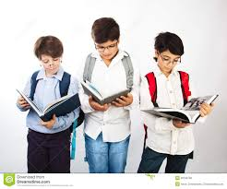
Group work
1.Which animal is big ?
2.What does the cow think ?
3.Why does the frog grow bigger ?

