Slide 3
Teacher introduction
Md Abul Kashem
Assistant teacher
Lakeshor dakhil madrasa
Chatak Sunamgonj
Mobile 01786498922

Slide 4
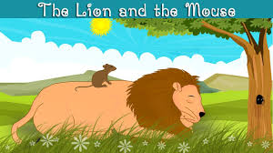
Let us see some pictures

Slide 5
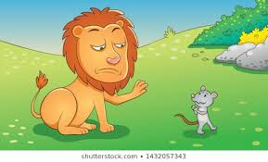
What did you see in the picture ?

Slide 6
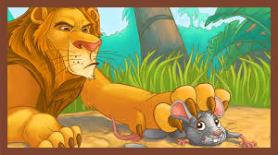
What did you see in the picture ?

Slide 7
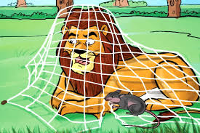
Was the lion in the net ?

Slide 8
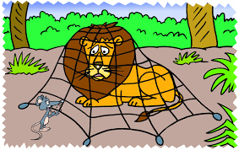
What did mouse do ?

Slide 9
Read loudly
One day, a lion was sleeping in the forest. The lion was big and strong.The mouse was playing near the lion.

Slide 10
Correct pronounciation
Sleeping, Forest, Strong, Lion, Mouse, Playing, Feared

Slide 11
Let us see the picture

Slide 12
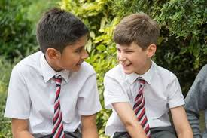
Pair works
1.What was the lion doing at the beginning of the story ?
2.What was the mouse doing at the beginning of the story ?

Slide 13
Look at the picture
The lion was angry.
The mouse was cutting the net.

Slide 14
Evaluation
1.Why was the lion angry with the mouse ?
2.How did the mouse cut the net ?

Slide 15
Home work
What is the moral of the story ?
1.Little friends are as good as big friends.
2.Strong friends are more helpful than little friends.

