Slide 1
Welcome to my English Class

Slide 2
Introduction
Class : Six Subject : English 1st paper Lesson : 22 Title : Wonders of the world Time : 45 minutes
Md. Monirul Islam
Assistant Teacher (English)
Edgah Mult. High School & College
Hathazari,Chittagong

Slide 3
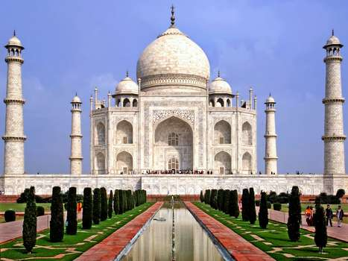
Can you name any wonder of the world?
The Taj Mahl.

Slide 4
Learning outcomes:
At the end of the lesson, we will be able to-
ask and answer questions
read and understand text through silent reading
Write a short paragraph

Slide 5
Our today’s lesson is
The Tajmahal

Slide 6
Individual Work
Complete each sentence with a suitable word.
We all know the………..behind the building of the Taj Mahal. The Taj has an………..of about 1003 acres or 405 hectares.The Taj Mahal is the finest example of Maghal………..It combines the art of Parsia, Turkey and India.It took 21 years and thous ands of……….and craftsmen…………The Taj Mahal.
Answers: Reality, Area, Architecture, Artisans, To complete.

Slide 7
GROUP WORK
write true or false beside the following statements. If false give the correct statement.
(a) Momtaj died in 1620.
False.
Correct Ans. Momtaj died in 1631.
(b) The Tajmahal was built for final resting place of Momtaj.
True.
(c) The Tajmahal was built on the river Jamuna.
True.
(d) The total height of the monument is 108 feet.
True

Slide 8
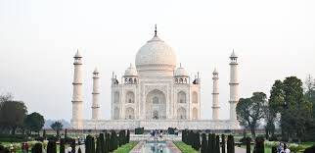
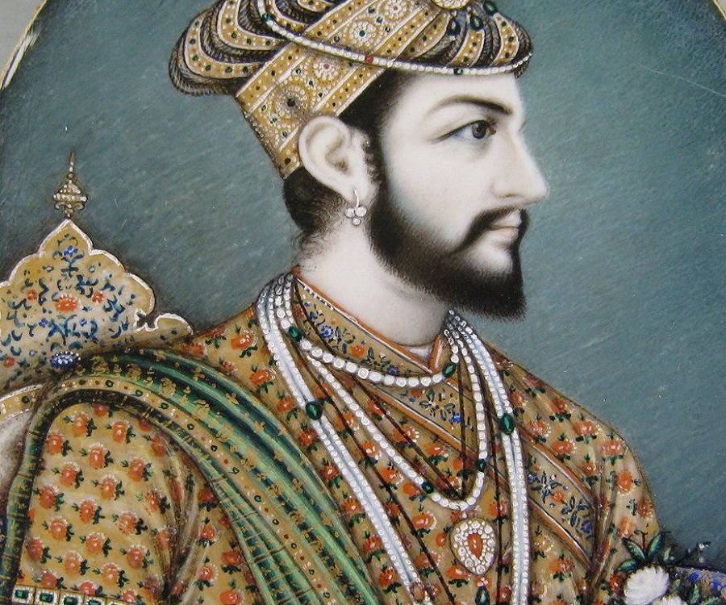
Read the text and answer the questions that follow.
Taj Mahal is one of the wonders of the world. It was built by Emperor shah Jahan.

Slide 9
Evaluation
a. Where is it located?
b. What is the Taj Mahal knownas also?
c. How did Shah Jahan love his wife?
d. Who built the Tajmahal?

Slide 10
Home work
Write short paragraph about’Taj Mahal.

Slide 11
Thans all

