Slide 1
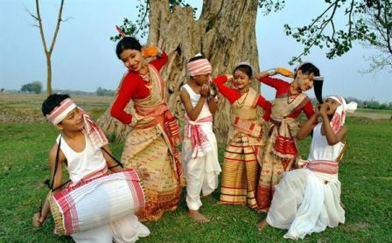


Welcome

Slide 2
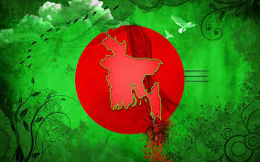

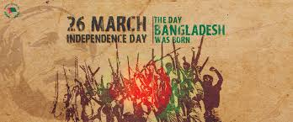

Introduction
Md. Monirul Islam
Assistant Teacher (English)
Edgah Mult. High School & College
Hathazari,Chittagong
Class : 9-10
Subject : English 1st paper
Lesson : 5,Unit-3
Title :INDEPENDENCE DAY

Slide 3
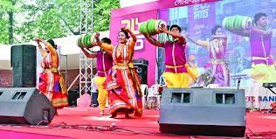
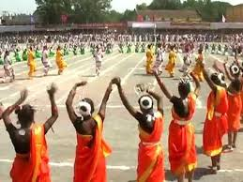
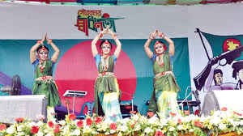
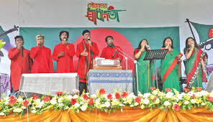
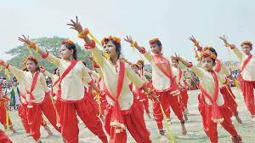
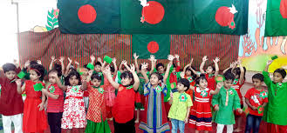
Look at the picture

Slide 4
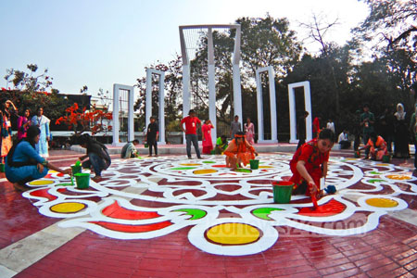
Look at the picture

Slide 5
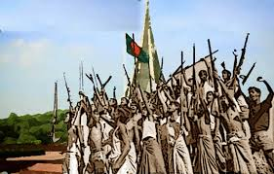
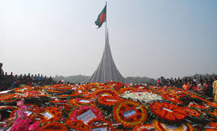
Look at the picture

Slide 6
Learning outcomes
After we have studied this lesson, we will be able to…
Read and understand texts. through silent reading
ask and answer question .
fill in the gaps.
Write short compositions.

Slide 7

INDEPENDENCE DAY

Slide 8
Reading the passage (Siltent reading)
26 March, our Independence Day, is the biggest state festival. All offices, educational institutions, shops and factories remain closed on this day.The day begins with 31 gunshots
All offices, Educational Institutions,Shops and factories remain closed this day.

Slide 9
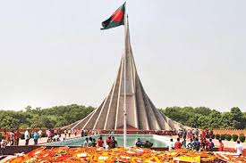
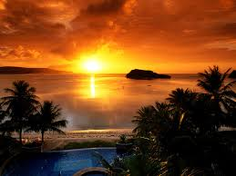
Early in the morning the President and the Prime Minister on behalf of the nation place floral wreaths at the National Mausoleum at Saver.

Slide 10
Individual Work
Answer the following questions
What is the biggest festival of our country?
How does the day begin?
What does Bangla Academy arrange?
Where is the National Parade Ground situated?
Where is the National Mausoleum situated?

Slide 11
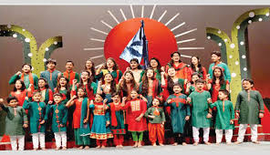
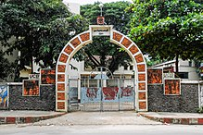
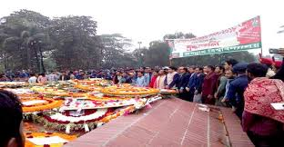
26 March, our Independence Day, is the biggest state festival.
শিপ্লকলা একাডেমি

Slide 12
Group Work
Fill in the gap with a suitable word
Glorious (a)---- Day is the biggest state festival. The day is observed (b)----the country. The celebration of Independence Day (c)---- with gun salute. People(d)---- at Saver to place floral wreaths and (e)----cultural programmes are held through the country highlighting the significance of the day.
Ans:a) Independence,b) across, c) begins, d) gather, e) various.

Slide 13
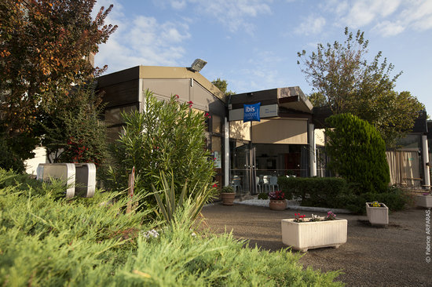
HOME WORK
write a short composition about ‘Victory Day’

Slide 14
Thanks all

