Slide 1

Good Morning

Slide 2
Teacher Introduction
Lesson Introduction
Name: Md. Akim Uddin
Designation: Assistant Teacher
School: Mohonpur Government Primary School.
Mohonpur, Mangalpur, Birol, Dinajpur.
Class: 5
Subject: English
Lesson: Happy Birth day
Lesson Part: A (A person’s... the candles.)
Time: 40 minutes
Date: 22/05/2019

Slide 3


Learning Outcomes
Listening:
Students will able to
4.2.1 understand and enjoy simple stories.
Reading:
Students will be able to
1.7.1 read paragraphs, dialogues stories, letters and other texts.
5.1.1 read silently with understanding paragraph .
5.1.2 read silently with understanding stories.

Slide 4

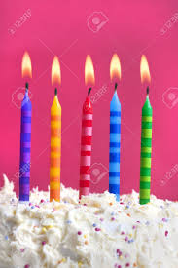
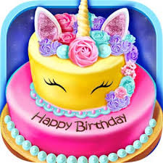
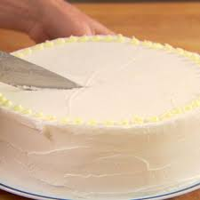

Happy Birthday
Candles
Cake
Cake Cut
When we use these?

Slide 5
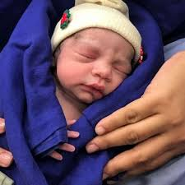

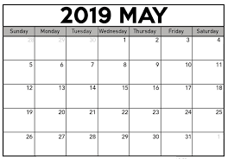
New Words from Text Book
Birthday
The day of a person's birth.
Date
A particular day of the month.

Slide 6
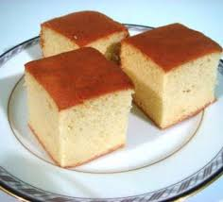

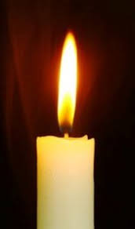
New Words from Text Book
an item of soft sweet food made from a mixture of flour, fat, eggs, sugar, and other ingredients, baked.
Cake
Candle
A kind of lamp made by wax.

Slide 7
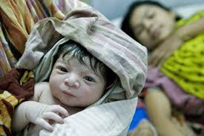
Happy Birthday
A person’s birthday is a special day.

Slide 8
Happy Birthday
This is the date when the person was born.

Slide 9
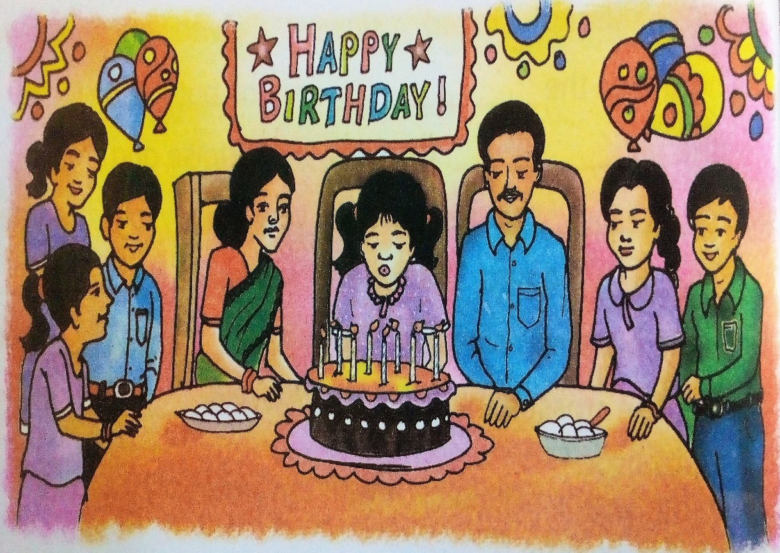
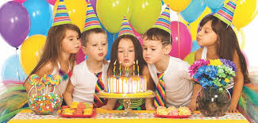
Happy Birthday
People around the world celebrate birthdays in different ways.

Slide 10
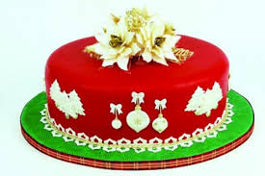
Happy Birthday
In many countries, people celebrate with a cake.

Slide 11
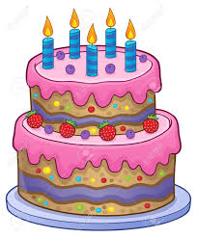
Happy Birthday
There are candles on the cake.

Slide 12
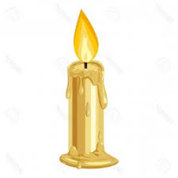
Happy Birthday
There is one candle for each year of the person’s life.

Slide 13
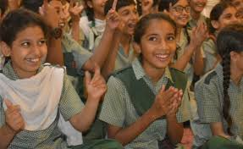
Happy Birthday
People sing a song for the person.
Click to Listen to the song

Slide 14
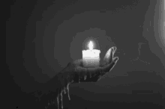
Happy Birthday
At the end of the song, the person blows out the candles.

Slide 15

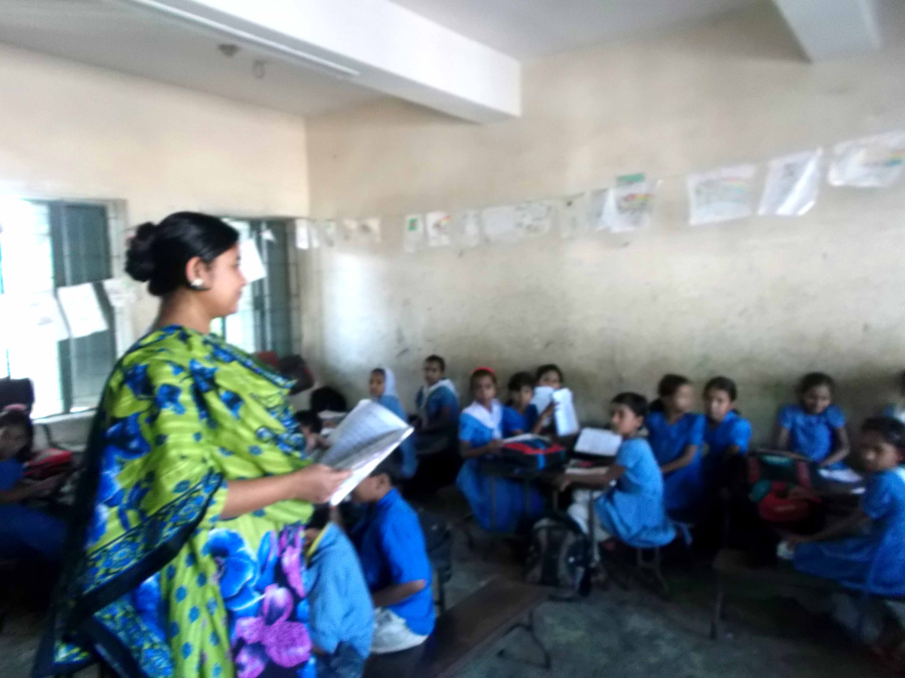
Teacher’s Reading

Slide 16

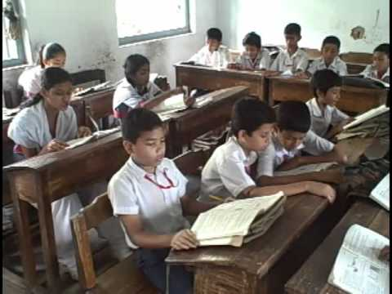
Student’s Reading

Slide 17
Pair Work
Every two students will listen and read the paragraph one after another.

Slide 18
Group Work
Every four students will discuss about Birthday party jobs and materials.

Slide 19
Evaluation
What is birthday?
What things are we use on birthday?

Slide 20


