Slide 1
Welcome

Slide 2
Teacher’s Identity
Sultan Ahmed Miazi
Assistant teacher
Balia Kajir Bazar D.N. Dakhil Madrasah,
Chandpur .
Mob-01817106106.

Slide 3
Lesson Identity
Class-Seven
English 1st paper
Unit-6,Lesson-5
Time -40 minutes.

Slide 4
Learning Outcomes
The Students will be able to-
say about a train journey.
make a list of some new words.
write a dialogue.

Slide 5
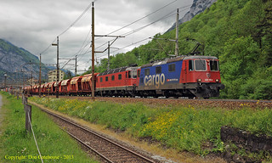
Travelling by train ( 2)
What do you see in the picture?

Slide 6
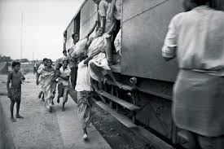
Vocabulary
Departure
N
Go away
It is the time of the departure of the train.

Slide 7
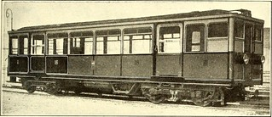
Empty
Adj
Vacant
The compartment of the train is empty.

Slide 8
Print out
To produce a composed copy
Adj
We use this machine for print out.

Slide 9
Compartment
N
Room of a train
This is a rail –compartment.

Slide 10
Model Reading

Slide 11
Pair Work
Match the words with similar words.
Departure Empty
Similar Start
Vacant go away
Begin Sight
Scene Same as

Slide 12
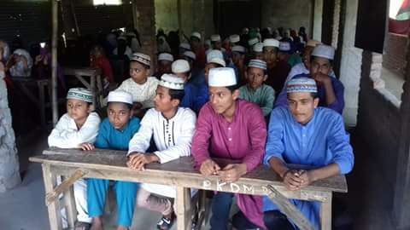
Silent reading

Slide 13
Group Work
Write down five sentences about train journey.

Slide 14
Evaluation
Where did Jishan sit?
Where was the train going?
What was julie doing from her seat?

Slide 15
Home Work
Write a dialogue between two friends about two friends.

Slide 16
Thank You

