Slide 1

WELCOME

Slide 2
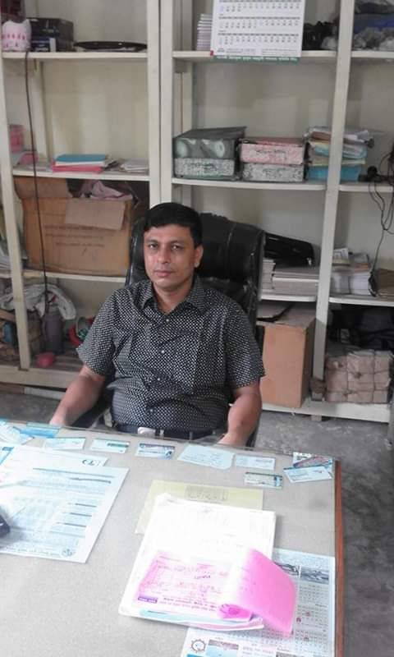

The Identity of Teacher and Class
Sultan Ahmed miazi (MA.Bed)
Balia Kajir Bazar D.N. Dakhil Madrasah, Chandpur Sadar,Chandpur.
Mobile: 01817106106. Email: sultanshapdi@gmail.com
Class : Six
English For Today
Unit/Lesson : 9

Slide 3

Look at the picture
What do you see in the picture ?
A healthy man.
Notes:
Teacher will show the slide for eliciting lesson declaration.

Slide 4
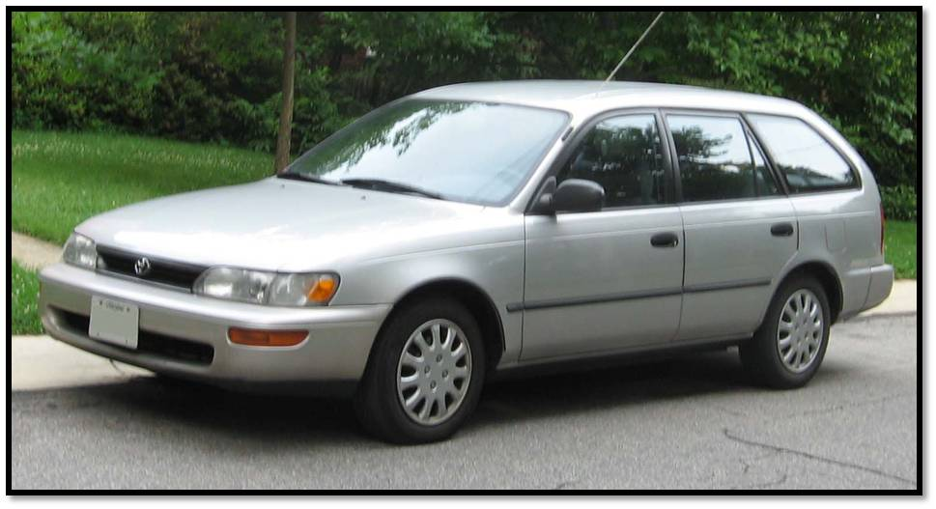

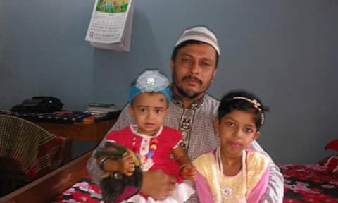

Look at the pictures
Car
House
Ornaments
Cash
What do you see in the picture ?
These are wealth.
Notes:
Teacher will show the slide for eliciting lesson declaration.

Slide 5
Lesson Declaration
So, today we `ll discuss about
Health is wealth
( Lesson – 9 )

Slide 6
Lesson outcomes
By the end of this lesson students will be able to -
Familiar with some rules of good health;
Follow their personal hygiene;
Take balanced diet;
Keep cleaning household;
Take regular exercise. Sleep and rest;
Write paragraph, dialogue , ect;

Slide 7
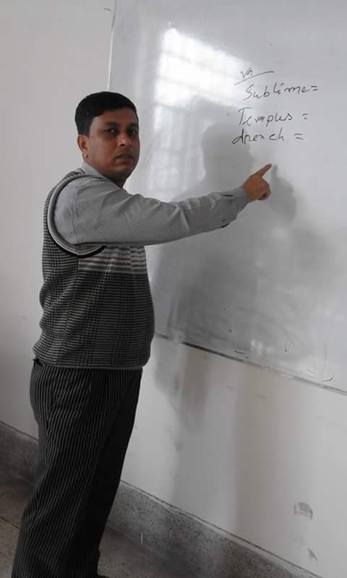
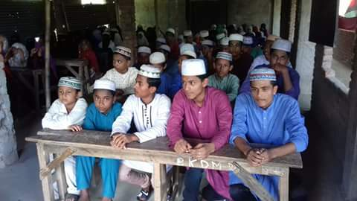

Model reading by the teacher.
Listen to me attentively then answer the following questions.
What do you mean by hygiene?
What are essential for good health?
What do we mean by balanced diet?
What are the rules of personal hygiene?
Notes:
With reading teacher can discuss the topics.

Slide 8
Let`s watch a video clip
Click here
What are they doing?
They are taking exercise.

Slide 9
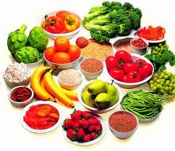
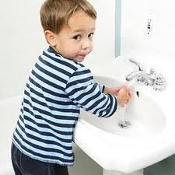
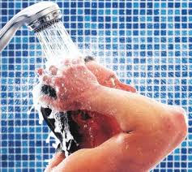
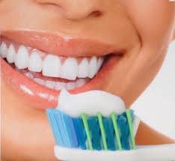
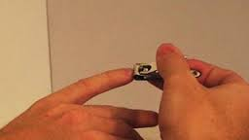
Some important rules of good personal health are as follows.
Balanced diet :
Our food should contain correct proportion of carbohydrates, fat protein, vitamins minerals and water in it.
b. Personal hygiene :
We should follow the personal health practices, such as,
wash your hands before eating.
Bathe regularly and wear clean cloths.
Brush your teeth regularly.
Brush hair, clean eyes, ears and nails.

Slide 10


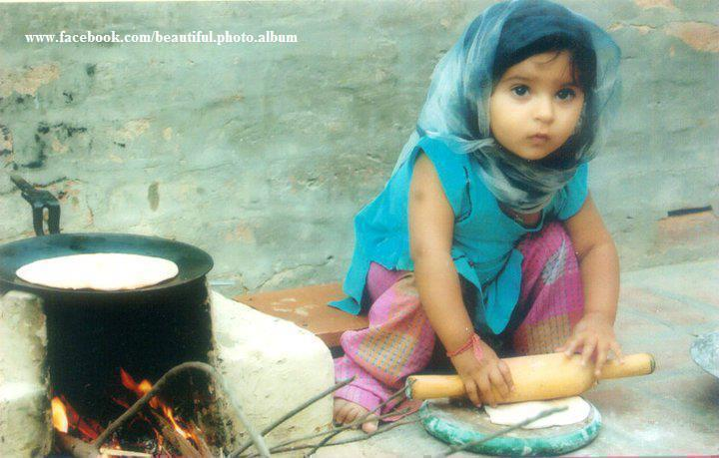


C. Cleaning household :
We should keep our household and environment clean.
d. Taking clean food and water :
Our food should be fresh, clean and properly cooked and water should be pure.

Slide 11
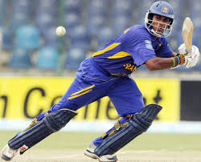
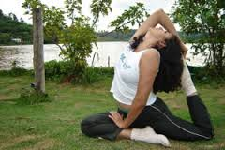
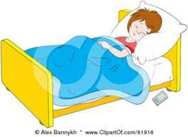
e. Taking regular exercise :
We should take part n games and sports and take physical exercise regularly.
f. Taking regular sleep and rest :
We should sleep properly and take proper rest.

Slide 12
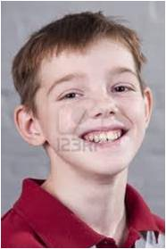
Key Word
Try to say the meaning of this word and make a sentence.
Healthy
In good physical shape
Sagor is a healthy boy.
Notes:
First, the word will be shown, SS will be asked to pronounce the word. If it needed teacher will help. Then the picture will be shown and asked to guess the meaning. After that the meaning will be shown. Then they will be asked to make sentence. Teacher will show the students for the feedback. Slide 12,13,14,15 and 16.

Slide 13

Key Word
Try to say the meaning of this word and make a sentence.
Cheerful
Jolly/ happy/ joyful condition.
Minu is very cheerful today.

Slide 14

Key Word
Try to say the meaning of this word and make a sentence.
Wealth
In good physical shape
Money, car, house are our wealth.

Slide 15
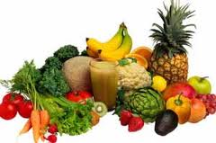
Key Word
Try to say the meaning of this word and make a sentence.
Fresh
Clean / new / unsullied
We should eat fresh vegetables

Slide 16
Key Word
Try to say the meaning of this word and make a sentence.
Hygiene
Practices of keeping good health.
The rules and practices of keeping are called hygiene.

Slide 17
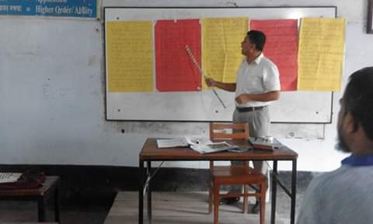
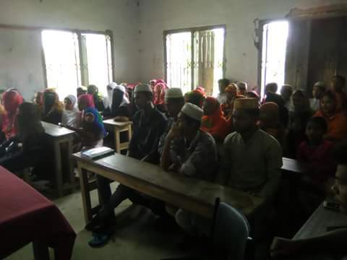
Go to section –F, listen to the conversation and practise saying it in groups.
Notes:
After reading the conversation teacher will call 6/8 groups for practise, then ask to play the conversation in the whole class.

Slide 18
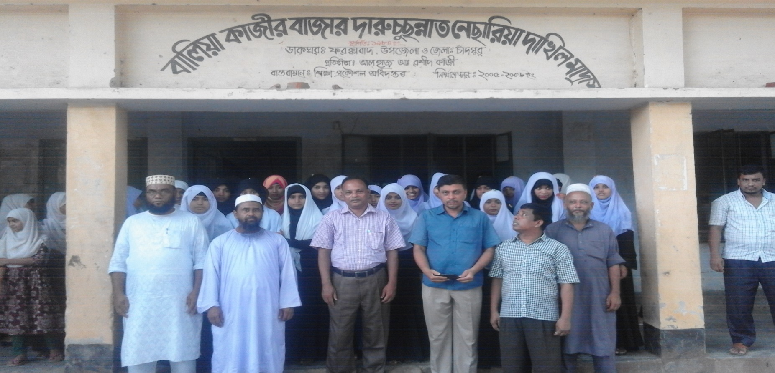
Silent reading
Go to section –F2 and read what Sumon says about his physical exercise program e.
Now write about what you usually do or would you like to do to keep yourself fit.
Notes:
Teacher can give this task for individual or pair works.

Slide 19
Pair Works
Choose the best answer :
“Health is wealth’’. Who many noun are there ?
i. one ii. Two iii. Three iv. No noun is there.
b. An unhealthy person is full of ----
Dream ii. Happiness iii. Disease and anxiety iv. Tension
c. Body organs are ------ related to good health ?
i. Not ii. Much iii. Directly iv. Nicely
d. Who are inactive, cheerless and unhappy ?
i. healthy people ii. Unhealthy people
iii. Hygienic people iv. Bad people.
e. Personal hygiene means -----
A. keeping oneself neat and clean B. Keeping household clean
C. having physical exercise
Which of the above answers is/are correct ?
i. A and B ii. B and C iii. A, B and C iv. A.

Slide 20
Individual Work
Make five sentences from the substitution table:
A healthy man | Can | An indispensible part of good health.
He | Implies | Be practiced strictly.
Hygiene | Should | Free from disease and anxiety.
It | Is | Also be helpful for society.
 |  | The rules and practices of good health.
Answer:
A healthy man is free from disease and anxiety.
He can also be helpful for society.
Hygiene is an indispensible part of good health.
It implies the rules and practices of good health.
e. It should be practiced strictly.

Slide 21
Home work
Write a short paragraph on the rules of good health.

Slide 22
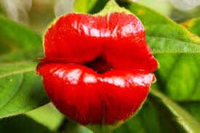
THE END

