Slide 1
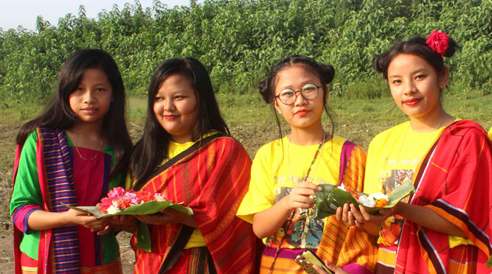
Welcome

Slide 2
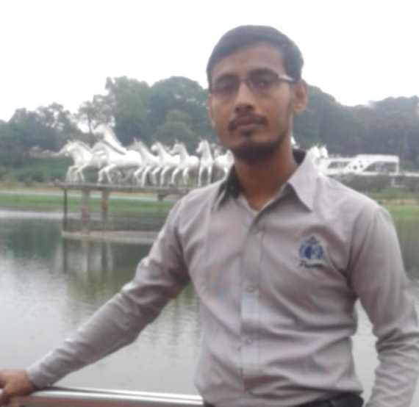

IDENTITY
SIFAYAT ULLAH
Assistant Teacher (English)
Class: Eight
Subidpur O.S.Dakhil Madrasha,
Subidpur,Faridgonj, Chandpur.
Subject: English
Time: 45 minute

Slide 3
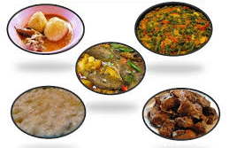
Foods of special group of people

Slide 4
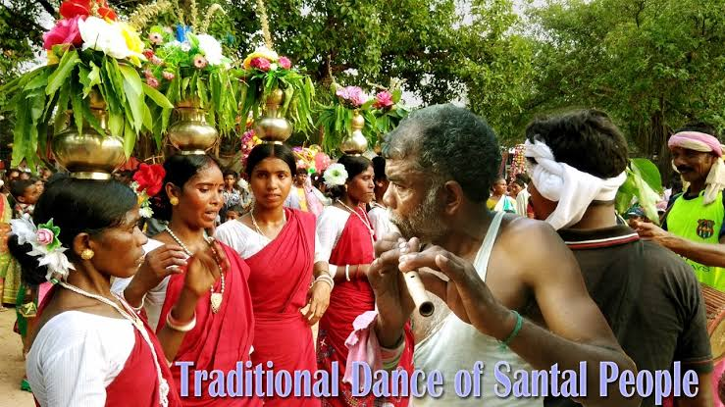
Today’s lesson is ‘Our ethnic friends-2’

Slide 5
Learning outcome
After finishing the lesson students will be able to-
answer to the questions about the ethnic people
Describe the lifestyle of ethnic people
Write a short composition on ethnic people

Slide 6
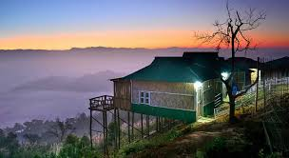
House of ethnic people on bamboo or wooden platform

Slide 7
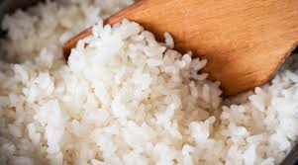
Staple food of ethnic people
Rice

Slide 8
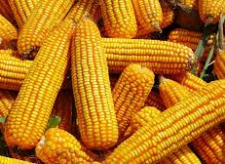
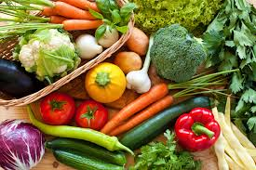
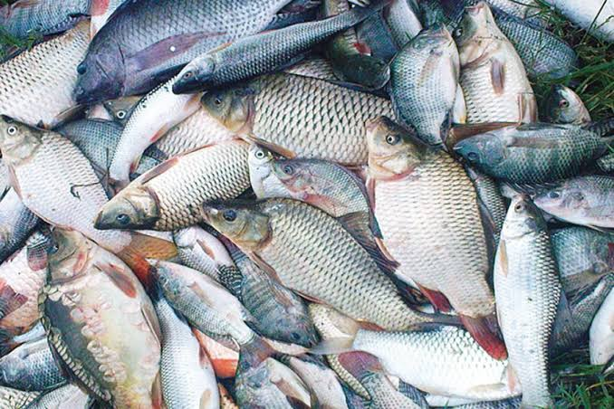
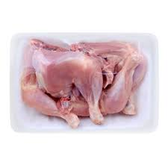
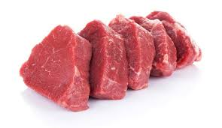
Maize
They like to eat
Vegetables
Fishes
Poultry
Meat

Slide 9
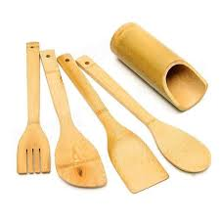
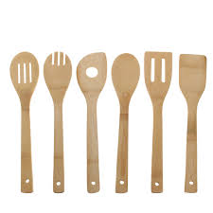
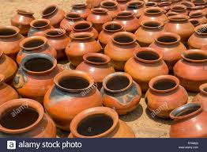
Made of bamboo
Made of wood
Their kitchen utensils
Made of earth

Slide 10
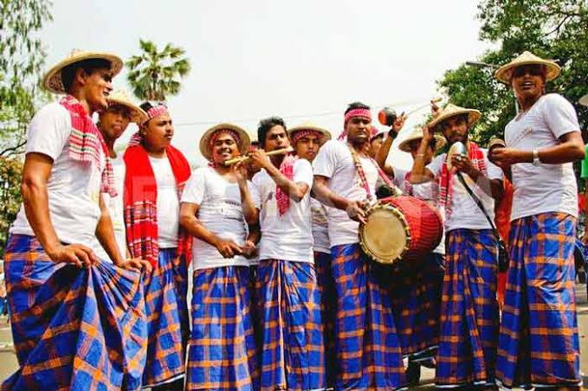
Men dresses
Lungis

Slide 11
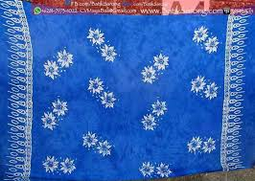
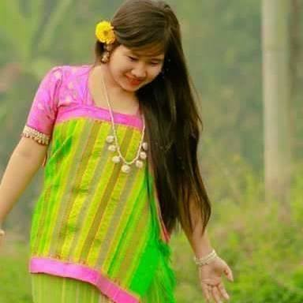
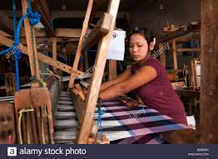
Women dresses
Thamy or sarong
Angy
Women weave their clothes
Weaving clothes

Slide 12

Individual Work
Fill in the gaps with correct words.
The tribal people follow their (a)...........
The platform they build their houses on is called (b)............... Men wear (c).........
Women (d)..........their own clothes. Their staple food is (e)..........
Time: 7 minutes

Slide 13
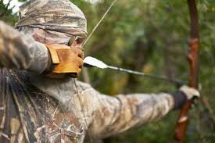
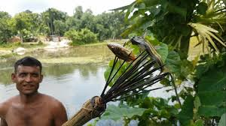
Favourite pastimes
Hunting
Fishing

Slide 14
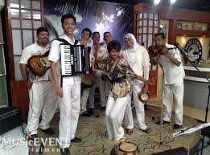
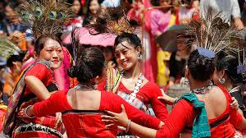
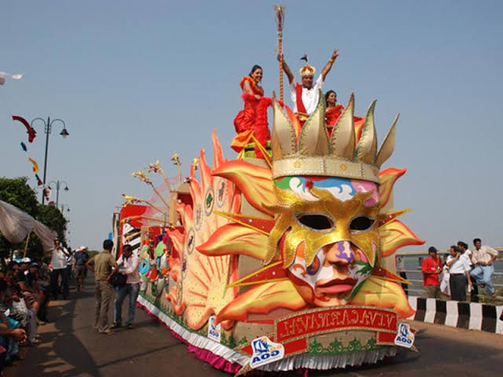
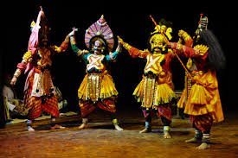
Music
Songs
They are fond of
Dances
Fairs
Theatre

Slide 15
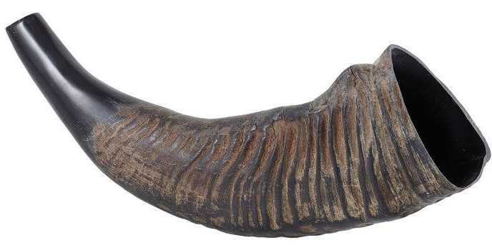
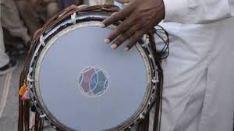
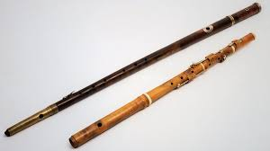
Bugle made of
buffalo horn
Drum
Traditional musical instruments
Bamboo flutes

Slide 16
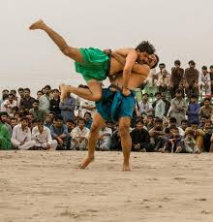
Popular sport
Wresling

Slide 17
Let's see some key words
Characteristics=
Community=
Maize=
Traditional=
Feature
Society
Millet
Consecutive

Slide 18
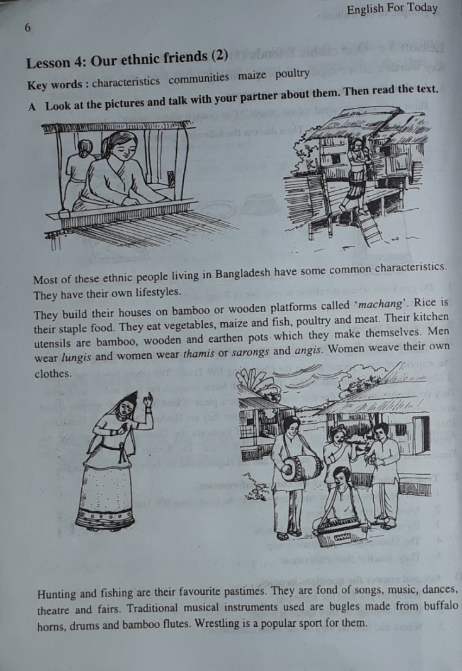

Open your text book at page-6 and read silently
Time: 8 minutes

Slide 19

Group work
Answer the questions in groups.
Where do the ethnic people build their houses?
What are their kitchen utensils?
What do they like to eat?
Time: 10 minutes

Slide 20
Evaluation
What are their favorite pastimes?
What is a bugle?
What is their staple food?

Slide 21
Home Work
Write a short composition on ethnic people.

Slide 22

THANK YOU FOR YOUR ATTENTION

