Slide 1
Welcome

Slide 2
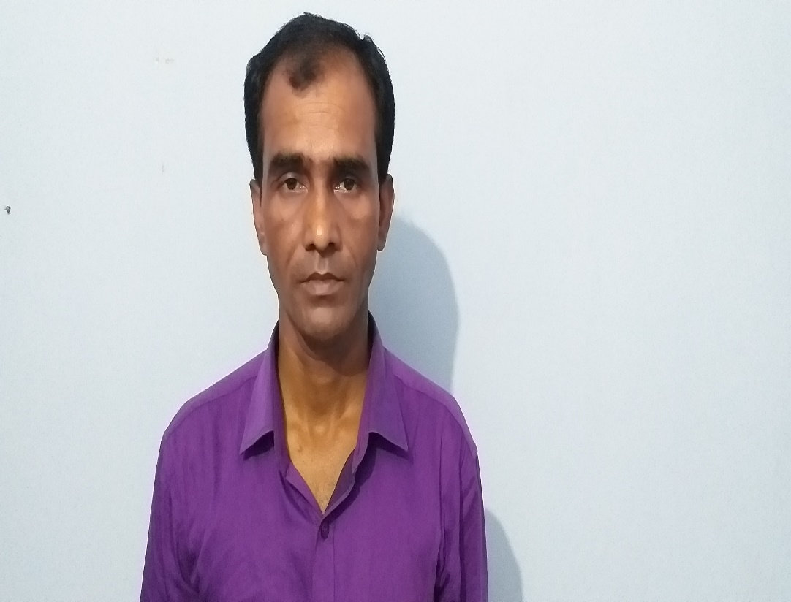
Md.Rashidul Islam
Head teacher
Nalukabari gps.
Badalgachi,Naogaon

Slide 3
Lesson's Identity
Class: Five
Subject: English
Lesson: The Liberation War Museum
Time: 45 minute

Slide 4
Learning Outcomes
Students will be able to :
4.2.1 understand and enjoy simple stories.
1.1.1 say words, phrases and sentences with proper
sounds and stress.
1.5.1 read words, phrases and sentences in the text
with proper pronunciation, stress and
intonation.
3.1.3 write words , phrases and sentences using
cursive capital letters.

Slide 5
The Liberation War Museum

Slide 6
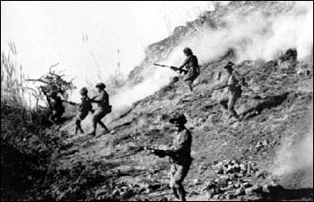
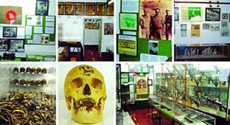
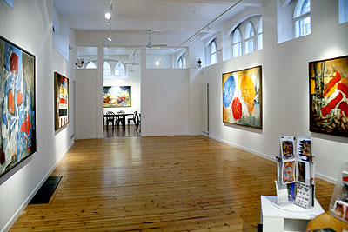
Let’s Learn New Words
Liberation
The act of freeing someone from another's control
We got our liberation in 1971.
War
An armed conflict
We do not want war.
Museum
A place where works of art, scientific specimens, or other objects of are kept and displayed.
I shall visit the Liberation war museum.
Gallery
A room or building for the display.
The museum has 6 galleries .

Slide 7
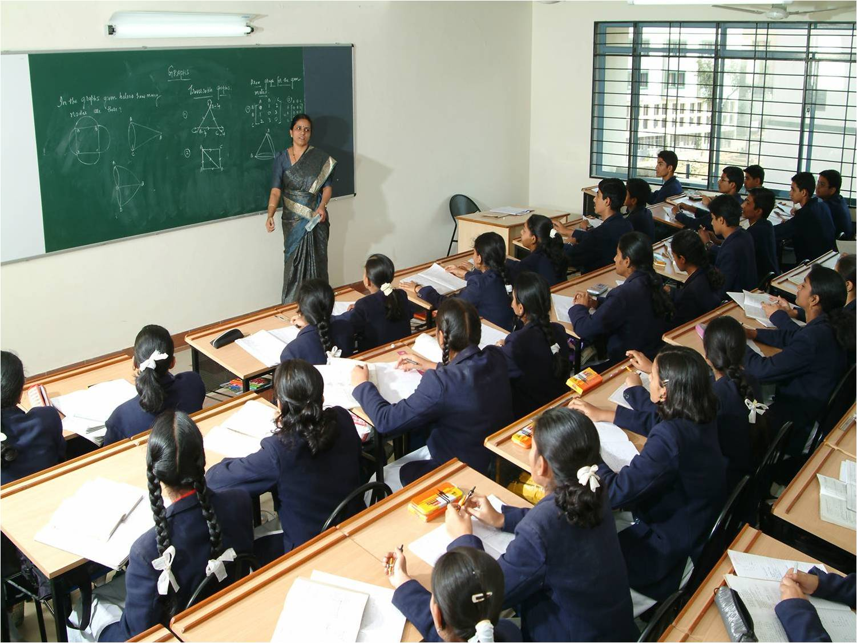
Teacher’s loud reading

Slide 8
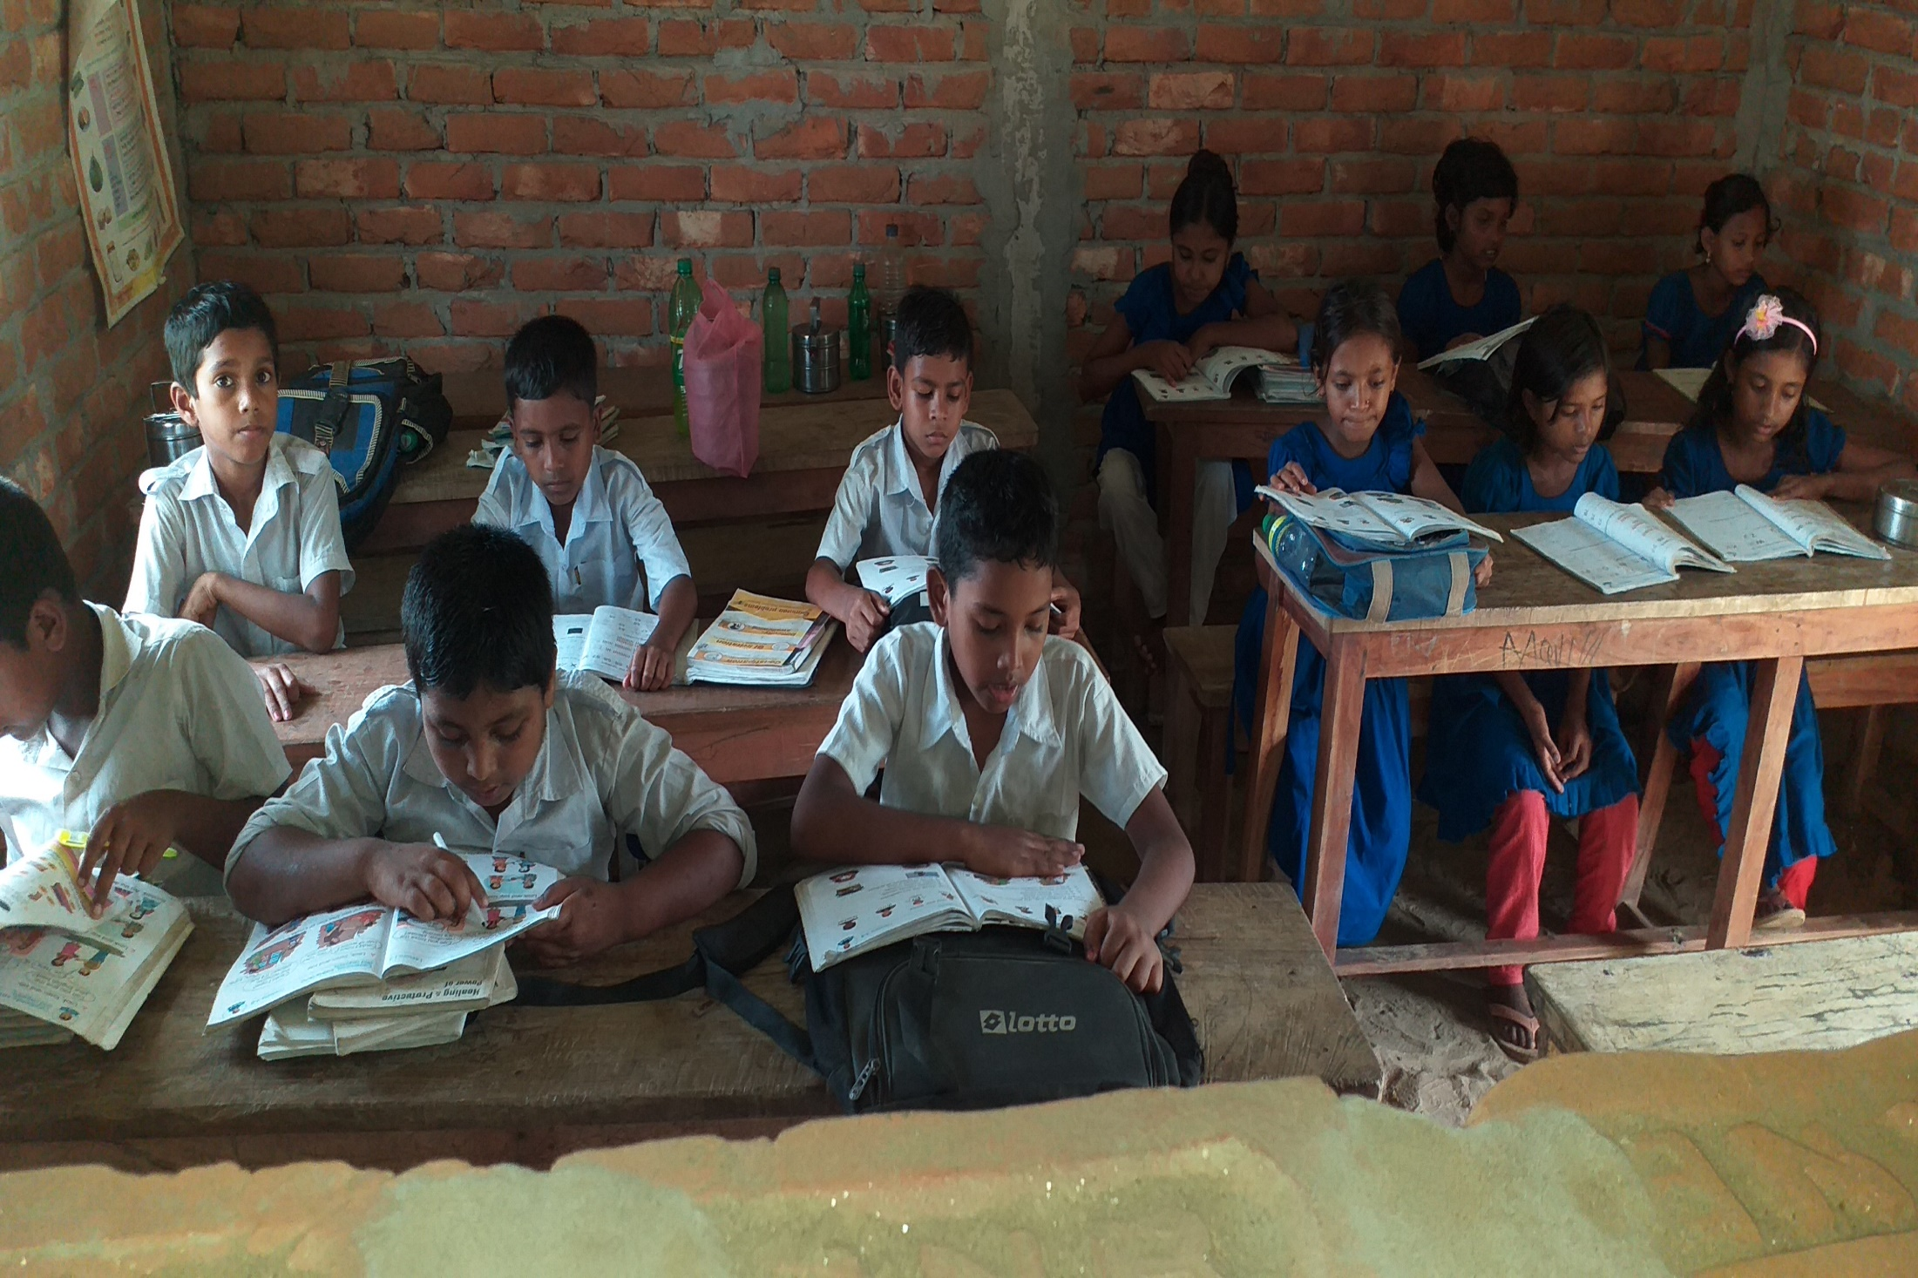
Student’s loud reading

Slide 9
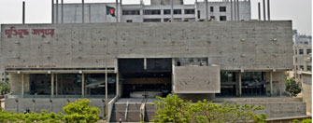

Slide 10
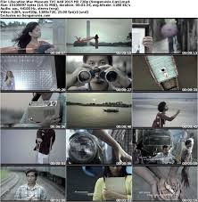
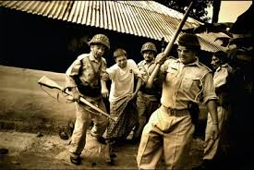
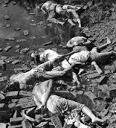
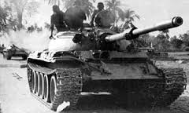
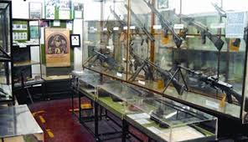
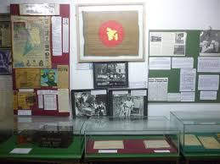
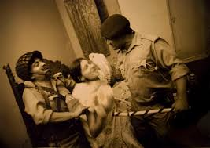
Let’s see some pictures
of
The Liberation War Museum

Slide 11
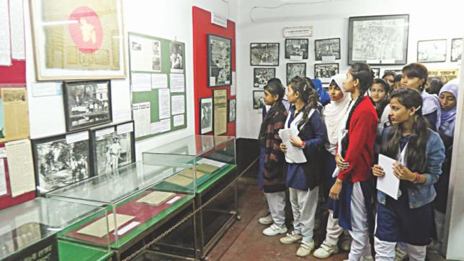
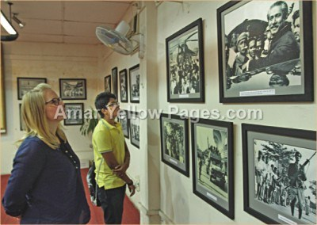
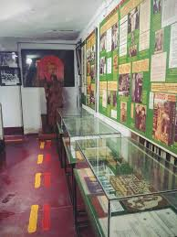

Slide 12
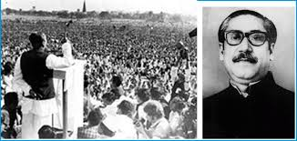

Slide 13
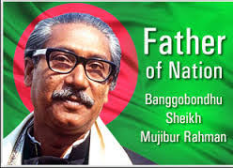
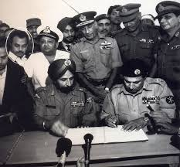

Slide 14
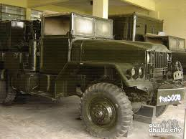
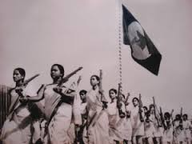
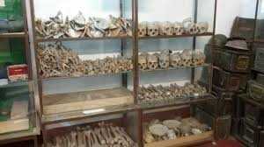
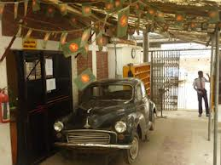

Slide 15
Practice
Let’s play kims game s
Liberation
War
Museum
Gallery

Slide 16
Group Work
Make sentences with the following words
Liberation | War
Museum | Gallery

Slide 17
Pair Work
Match column A with column B
Column A
Column B
A place where works of art, scientific specimens, or other objects of are kept.
Liberation
War
A room or building for the display.
Museum
The act of freeing someone from another's control
Gallery
An armed conflict

Slide 18
Student’s Silent Reading

Slide 19
Task
Make five sentences about “Our Liberation War” in your own words.

Slide 20
Thank you

