Slide 2
IDENTITY
Manik Chandra Majumder
Senior Teacher (English)
Gazirhat High School
Senbag, Noakhali
Mobile No: 01717155169
Email: manikmajumder01@gmail.com
Class : Nine-Ten
Subject : English 1st paper
Time : 50 Minutes
Date : 00/00/2019

Slide 3
What are the images about?
How are you?
I’m fine.
I’m from Chittagong.
I’m. from Dhaka
The images are about making dialogue .

Slide 4
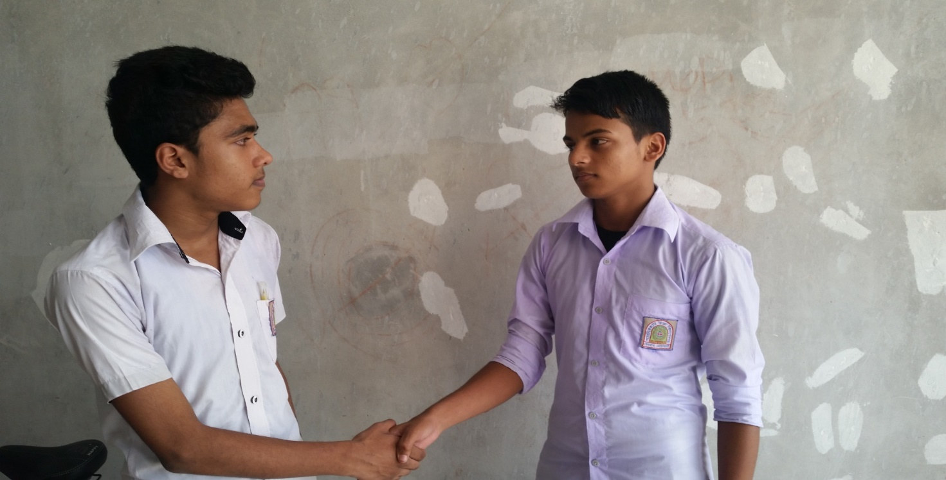
What are two friends doing here.
Two friends are making dialogue.

Slide 5
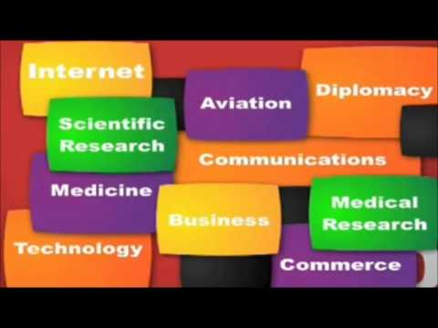
Look!
What is the dialogue topic about?

Slide 6
Our Today’s Lesson is-
A dialogue “ Importance of Learning English”

Slide 7
Learning Outcomes
By the end of the lesson, learners will be able to :
a) ask and answer questions,
b) make dialogue,
c) take interview,
d) describe about the importance of learning English.

Slide 8
Good morning, Sohan.
Good morning, kamal.
How are you?
I’m fine & you?

Slide 9
I’m fine too.
Where are you going?

Slide 10
I’m going to discuss with you about.
What about?
About importance of learning English.
It’s really an important topic to discuss.

Slide 11
Actually English is essential to our every walk of life.
Can you tell me why English is so important ?
Sure, It’s an international language and widely used all over the world.
Please tell me clearly.

Slide 12
Sure, It’s an international language and widely….
Please tell me clearly.
It’s essential for higher education.
But how ?

Slide 13
All the books of higher education are written or translated in English. If you want study in foreign university you must know English.
Anything more.

Slide 14
Of course, International trade and commerce entirely depends on English.
Please tell me.
Listen, If you want to get a good job in home or abroad you must have a good command over English.
Oh I see, the importance of English can’t be described in a word .

Slide 15
Right you are. English can give us an international visa for visiting abroad.
Yes I think so. From now all of us should learn English.
Of course. Thank you very much for your understanding.
You are also welcome.

Slide 16
Gr0upwork
Now write five sentences about the importance of learning English.

Slide 17
Pair work
Two students make a pair and practice between them
about importance of learning English.

Slide 18
Evaluation
Which language is used as common language?
Why is English called the global language ?
c) Why is English learning so important?

Slide 19
HOME WORK
Suppose you are Tamim and your friend is Tareq . He does not know about the importance of learning English. Now write a dialogue between two of you about the importance of learning English.

