Slide 2
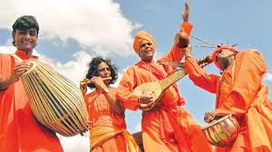
Welcome

Slide 3
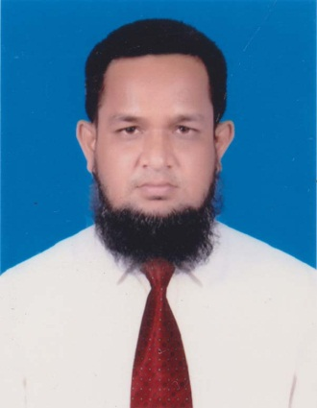
IDENTITY
MD.ABDUR ROUF
Lecturer in English
Khalna Islamia Fazil(Degree) Madrasah
Patnitala,Naogaon.
Cell-01767650169
E-mail-rouf301285@gmail.com
English For Today
Class-XI-XII And Alim

Slide 4
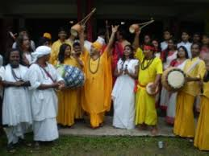
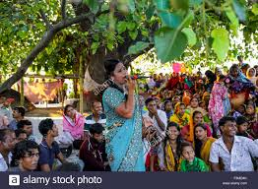
Let’s see some picture
What type of song they sing?
Folk songs

Slide 5
Let’s heard the song
https://www.youtube.com/watch?v=otJrSEkSY4o

Slide 6
Our todays lesson
Folk music
Unit: 14(Art and Music)
Lesson: 02(Folk Music)

Slide 7
Learning outcomes
By the end of the lesson Ss' will be able to---
Define the Folk Music;
About the variety of folk songs;
Say the name of folk singers.

Slide 8
What is folk songs?
Folk music means the type of ancient music which springs from the heart of a community, based on their natural style of expression uninfluenced by the rules of classical music and modern songs.
It is pure musical reflection of native culture.
Example-Baul,Batiwali etc.

Slide 9
Single task
Write down the definition of folk music with example.

Slide 10
Let’s know the variety of folk songs
Folk music has great variety in our country
Variety of folk music
Baul
Bhatiyali
Bhawaiya
Gambhira
Folk music is the complete reflection of our native culture and the natural beauty of our country.

Slide 11
Characteristics of folk music
Composed by rural folk
Uninfluenced by classical or modern music
Sung in group or individually
Regular practiced is not required
Composed and performed by illiterate or semi-literate people
Both words and tunes are appealing

Slide 12
Depends upon nature and rural environment
Use of local dialect
Uses of natural and simple rhythm
Explicit manifestation of joys and sorrows of daily life
It contains a strong expression of human love and separation

Slide 13
Let’s introduce some folk singers in our country
Lalon Shah
Hasan Raja
Sufia Kagalini
Abbas uddin

Slide 14
Abdul Alim
Bari siddiqi
Fakir Alamgir
Abdul Kuddus

Slide 15
Akkas Dewan
Faridal Farvin
Momtaz Begum
Sofi Mondal

Slide 16
Group Work
Group
A
Write 4 characteristics of folk music.
Group
B
Write down the name of 5 our folk singers.

Slide 17
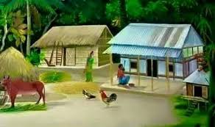
Home work
Write a paragraph on about “Folk Music”.

Slide 18
