Slide 2
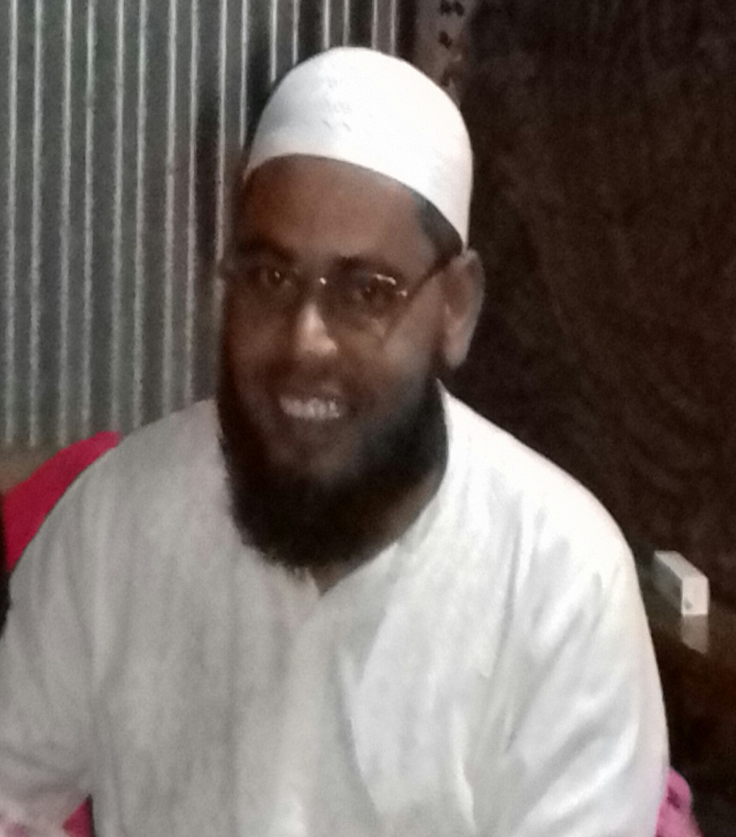
Teacher’s Identity
Md. Eunuse Ali
Assistant Teacher
Charan High School
Kalihati, Tangail.
Email-eunusali223@gmail.com

Slide 3
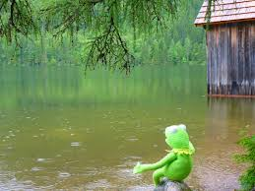
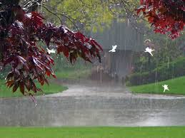
What can you see in these pictures ?
These are the pictures of “Rainy Day”

Slide 4
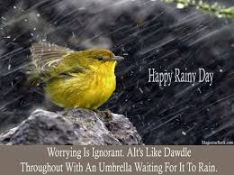
Today our topic is paragraph on :
A Rainy Day

Slide 5
Learning outcomes
After we have studied this TEXT , we will be able to
Answer the multiple choice questions.
Ask & answer questions.
Fill in the gaps with suitable words.
Listen the pronounciation of the text.
Write a paragraph on “ A Rainy Day ”.

Slide 6
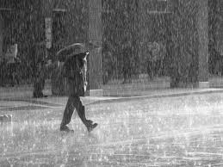
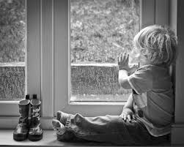
Gloomy
Dull
A rainy day is dull and gloomy.

Slide 7
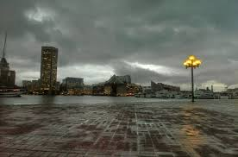
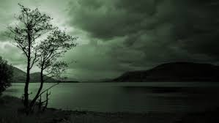
Cloudy
The sky remains cloudy all day long.

Slide 8
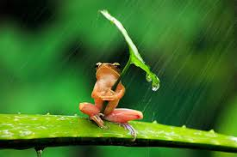
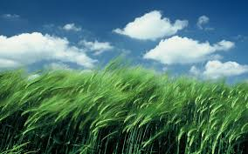
Drizzle
Gust wind
Sometimes it rains heavily ; sometimes it drizzles and sometimes gusts of wind blow.

Slide 9
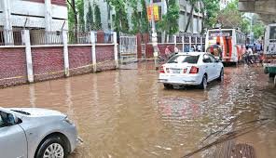
The road goes under water.

Slide 10
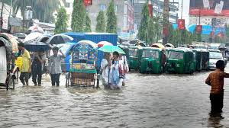
Drench
The heavy rains drench the passers-by.

Slide 11
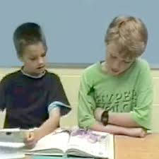
Choose the best answer ( in pair )
1.How is a rainy day? (a) Exciting (b) Pleasant (c) Cheerful (d) Boring
2.How does the sky look in a rainy day?
(a) Fresh (b) Blue (c) Dark (d) Sunny
4.The roads go under water in a ------- (a) Summer day (b) Rainy day (c) Autumn day (d) Winter day
4.How does the wind blow? (a) Slowly (b) Wildly (c) Gently (d) Politely
4. People suffer ---------- . (a) A lot (b) A Few (c) Little (d) Less

Slide 12
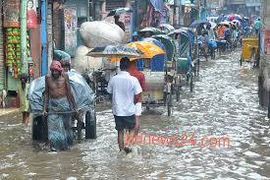
People suffer a lot.

Slide 13
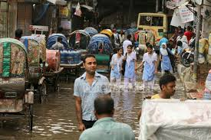
Rickshaws and taxis are not available.

Slide 14
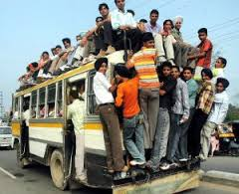
The buses are crowded.

Slide 15
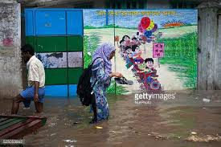
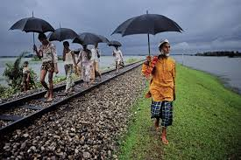
Shoes in hand
Folded up clothes
So many people can not get on the bus and walk along the road with shoes in hand and clothes folded up.

Slide 16
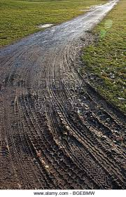
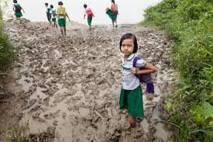
Muddy road
Slippery
The muddy roads become slippery.

Slide 17
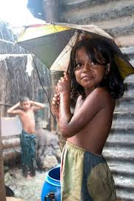
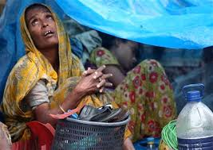
A rainy day is bad for poor people.

Slide 18
Answer the following questions (in pair):
1. Q . Who suffer a lot ?
1. Ans: People .
2. Q. Which are not available ?
2. Ans: Rickshaws & taxis .
3. Q. How are the buses ?
3. Ans: Crowded .
4. Q. Which roads become slippery ?
4. Ans: Muddy roads .
5. Q. For whom a rainy day is not pleasant ?
5. Ans: Poor people .

Slide 19
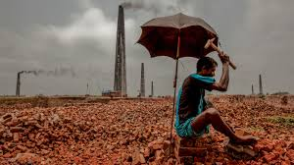
They can not go out to earn their daily bread.

Slide 20
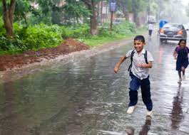
However , students enjoy a holiday at home.

Slide 21
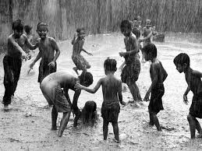
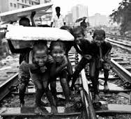
The street and village children are seen running deep water here and there.

Slide 22
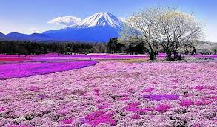
Besides , the environment becomes neat and clean.

Slide 23
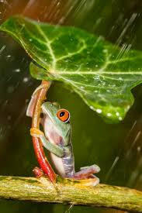
In a rainy day the frogs are singing songs.

Slide 24
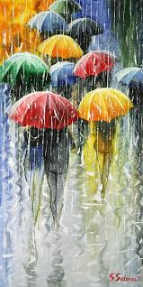
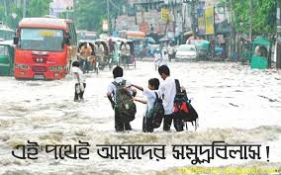
Even so , it is true that a rainy day is a suffering for almost all the people.

Slide 25
Fill in the gaps with suitable words
( In group )
Poor people can’t go out to (a)------------- their daily bread .
Students enjoy a (b)--------------- at home . The village children
Are ©------------- running in water . The environment becomes
(d)------------- and clean . It is true that a rainy day is a
(e)------------------------ for all the people .
earn
holiday
seen
neat
suffering

Slide 26
Home work
Write a paragraph on
“A Rainy day”

