Slide 1
Welcome to my class

Slide 2
Presented by:
Md.Azharul Islam Khan.
Assistant teacher.
Dhala Govt, Primary School.
Tarail,Kishoreganj.

Slide 3
Let’s watch a video.
What can you see in the video?

Slide 4
Train.
Where does a train stop?

Slide 5
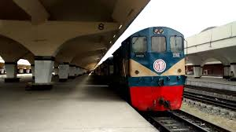
A
A railway station.

Slide 6
Today’s lesson.
Class-Five,Sub:English
Unit-1,Lesson-1,Part-A
Time:35 minutes.

Slide 7
Learning outcomes:
At the end of the lesson student will be able to-
Speakng 2.1.Exchange greetings, farewells & makes introductions-How are you? Nice to meet you.
Speaking 8.1.Take part in conversation on appropriate topics.

Slide 8
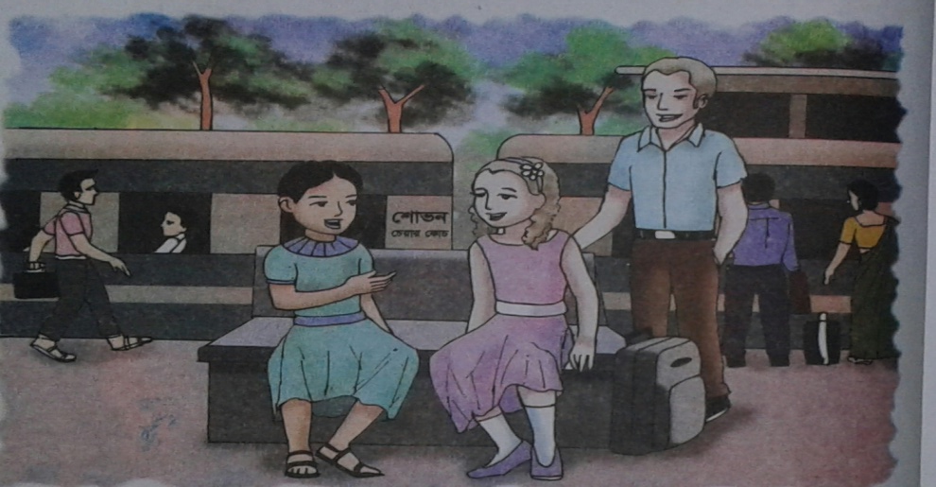
Look at the picture & think about it.
What can you see in the picture?

Slide 9
Two girls & a man at the railway station.

Slide 10
Dear students, now open at page 2 & read after me.

Slide 11
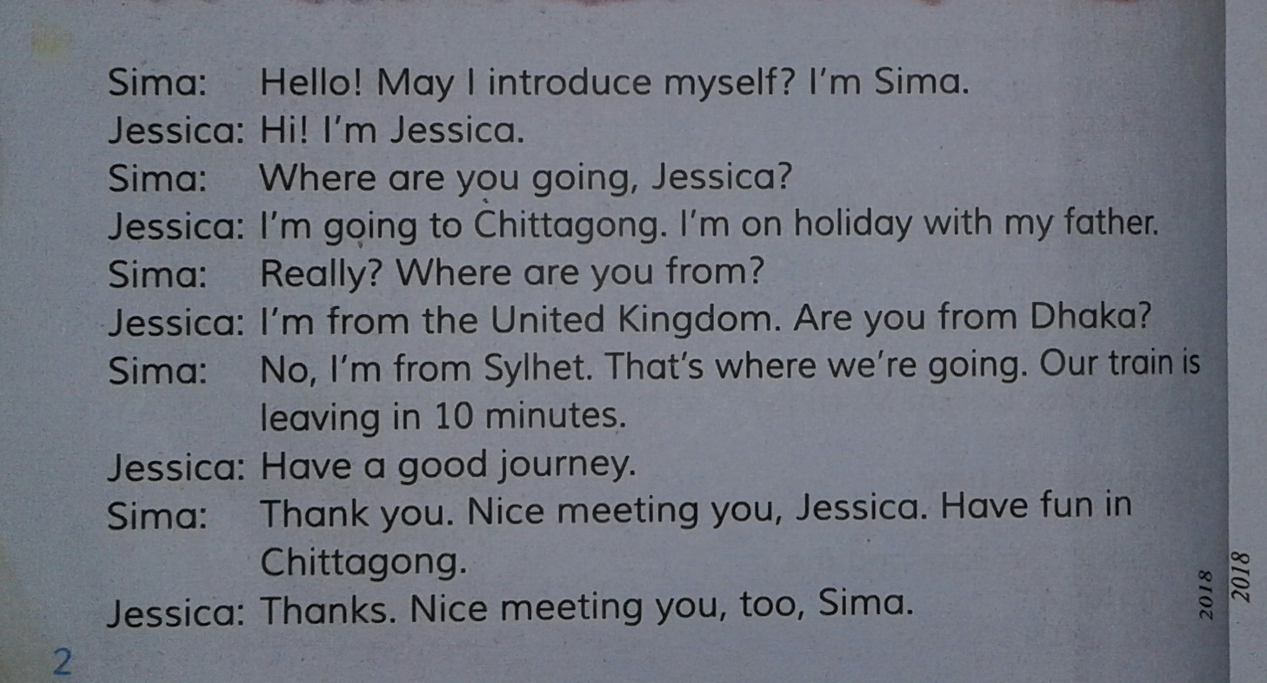
Teacher will read the text loudly.After that he will read the text using spotting mistakes techniques.

Slide 12
New words(sound,spelling & meaning).
Introduce-To be familiar with someone.
Holiday-A day of vacation.
Journey-An act of traveling from one place to another.
Fun-A joke or amusement.

Slide 13
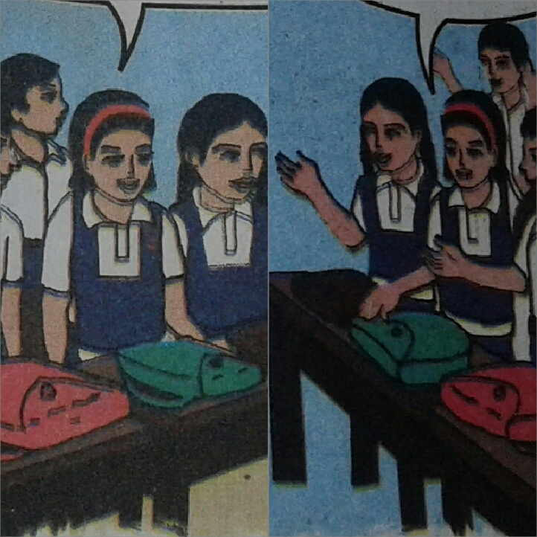
Group work
Divide the class into two large group to act as Sima & Jessica.

Slide 14
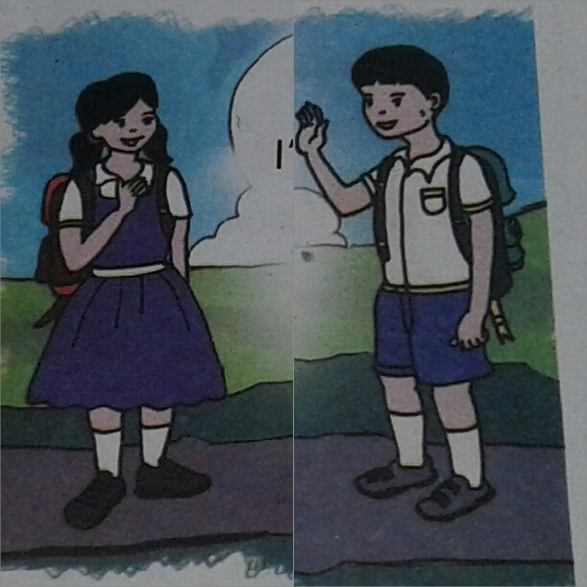
Pair work
Act the dialogue

Slide 15
Evaluation
Now introduce yourself.

Slide 16
Thanks all.See you next time.

