Slide 2
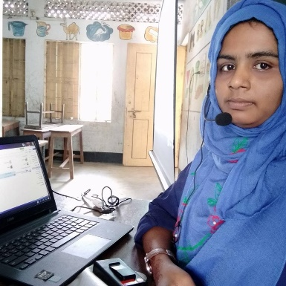
Mst.poli khatun
ASISSTANT TEACHER
PAIKOSHA GOVT. PRIMARY SCHOOL
Sub: English
Class: Two
Lesson : Lucky the circle.
Parts of the lesson: Activity-B
Page No-42

Slide 3
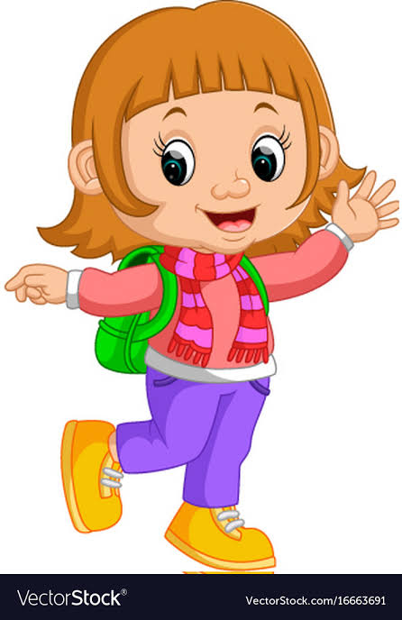
Safety environment by greetings song.
Hello! Hello! How are you?
I’m well, I’m good.
I’m great, I’m wonderful.
Hello! Hello! How are you?
I’m fine! I’m great today.

Slide 4
Checking home work and Justify the previous lesson.

Slide 5
Our today’s lesson is too--
Lucky the circle
Activity-B

Slide 6
LEARNING OUTCOMES
By end of the lesson students will be able to-------
Listening: 3.1.2 understand simple questions and statements about familiar objects.
Speaking: 1.1.2 say simple words and phrases with proper sounds and stress.
3.1.2 understand simple questions and statements about familiar objects.

Slide 7
Who is she?
What kind of shape is Lucky?
Lucky
is round.

Slide 8
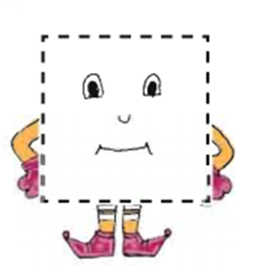
Who are they?
What kind of shapes are Sumon and salam?
Sumon
and
Salam
are square.

Slide 9
Let’s recite the rhyme “Lucky the circle.”

Slide 10
Open your English book at page-42 and see the Activity-B
What shape is Lucky?
What kind of sides are Sumon and Salam?
How many sides are Sumon ?
How many sides are Salam ?

Slide 11
Read and say.
My name’s Lucky.
I like you!
I am round! .
Colour me blue .
We’re Sumon and Salam.
Our sides are straight
Now count them
from 1 to 8!
Identifying weak students and taking to cure.

Slide 12
One day one word
Read and say.
with
সাথে
Spell out the word - SGW

Slide 13
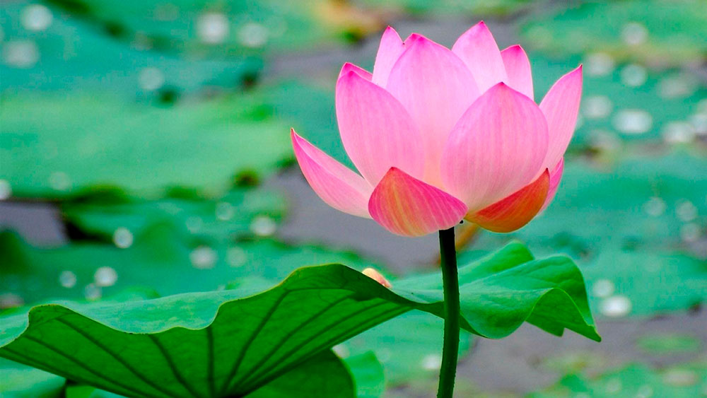
Find out the letters that are made by the word -----.
n
w
r
m
i
x
t
k
c
h
Find out the correct word------.
weth
wath
with
whit

Slide 14
Say the missing letter.
w-th
wit-
wi-h
-ith
Write the word to your notebook.
তারিখঃ ০০/০০/০০
with
উইথ
সাথে

Slide 15
Home work
Page 33 will be well read and written.

Slide 16
That’s all for today. Goodbye. See you tomorrow.

