Slide 1
WELCOME

Slide 2
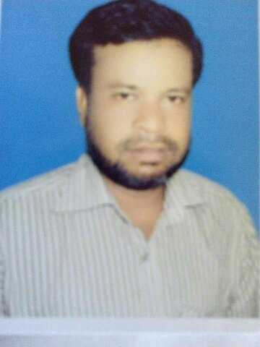
Introducing
Md. Mukul Mia Asst.teacher(English)
M.A.Sattar Adasha High School.Kurigram.
E-mail:mukul1999@hotmail.com.
Class-Ten
Subject-English 1st Paper
Unit-5, Lesson-2
Date-19-06-2017

Slide 3
Pollution

Slide 4
Pollution

Slide 7
Learning Outcome
After this lesson ss will able to-
tell about elements of environment.
mention about cause of air/water pollution.
explain affect of air/water pollution.
describe how to save from this problems.

Slide 8
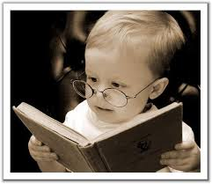
Read The Test Loudly (Every Student)
05 min.

Slide 9
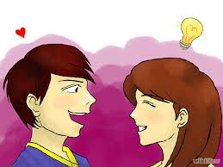
pair work
a)What are the elements of environment?
b)From where we get air and water?
c)How do they help us to live?

Slide 10
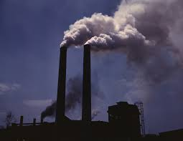
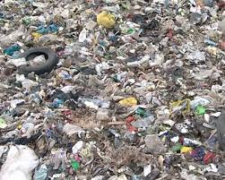
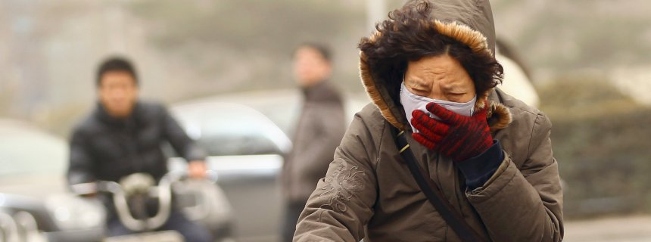
P0llution=Something Unhealthy
Waste=poison,harmful things
Suffer=Trouble

Slide 11
Air Pollution
Carbon-di-oxide
petrolium
Greenhouse gas
Brick kilns
Industrial and vehicles gas
Air pollution

Slide 12
water pollution
Industrial wastes
fertilizer
pesticides
Household
wastes
Water Pollution

Slide 13
Group Work
Write the causes of air pollution in group.

Slide 14
Evaluation
a)How can we protect air pollution?
b)How can we protect water pollution?
c)Mention two bad effect of environment pollution?

Slide 15
Home Work
Decribe how we can save our “ENVIRONMENT”(10 Sentences)

Slide 16
Thanks a lot of.
Thanks a lot

