Slide 1
Welcome

Slide 2
Teacher’s Information
Md. Shamsul Alam
BA(Hons.)MA in English.
Assistant Teacher( English)
Nabodoy Girl’s High School
Shailkupa, Jenaidah.
Phone:01917-452052,01722-922691
Email:shamsul101085@gmail.com

Slide 3
Our Today’s Lesson is-
A Thirsty Crow
Subject : English First Paper
Class : Nine
Learning Areas: Story Writing
Duration : 50 Minutes

Slide 4
OBJECTIVES OF THE LESSON
By the end of this lesson the students will be able to ---
* talk about pictures.
* listen and understand a story.
* tell the meaning of the following words ___
Slip, Weep, Glad, Grief and Dive.
* write a story about “Where there is a will, there is a way”.

Slide 5
Look at the picture & Guess
A crow is flying in the sky under hot sunny day.

Slide 6
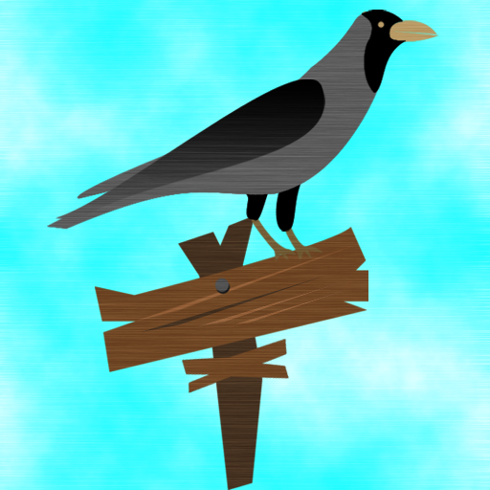
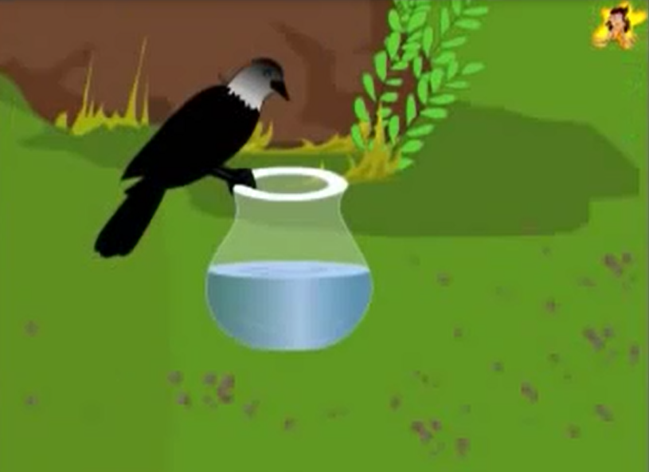
What do you see in these pictures ?
We see a crow & a jar/pitcher in a forest.

Slide 7
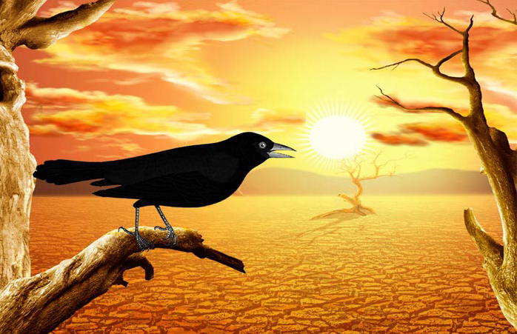
Once a crow sat on a branch of a tree in a forest.

Slide 8
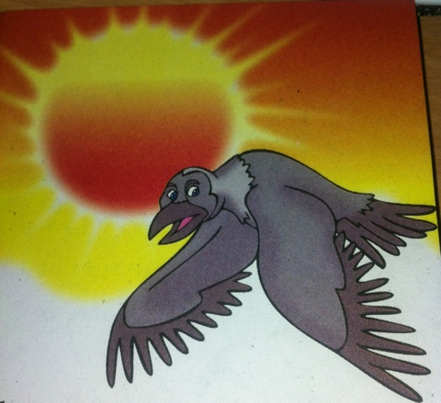
The day was very hot and it felt very thirsty.

Slide 9
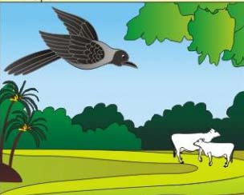
It tried to find out a source of water.

Slide 10
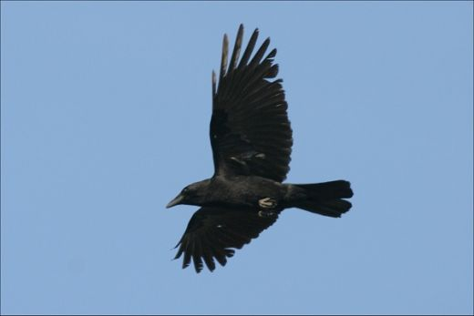
It looked here and there but could not find out water.

Slide 11
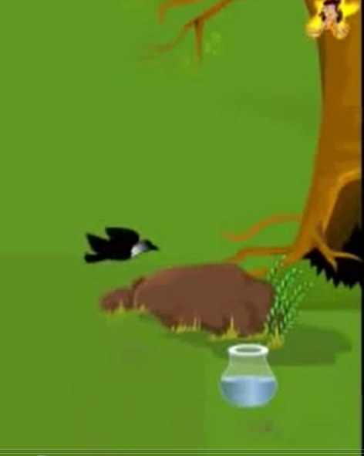
At last it saw a pitcher near a tree.

Slide 12
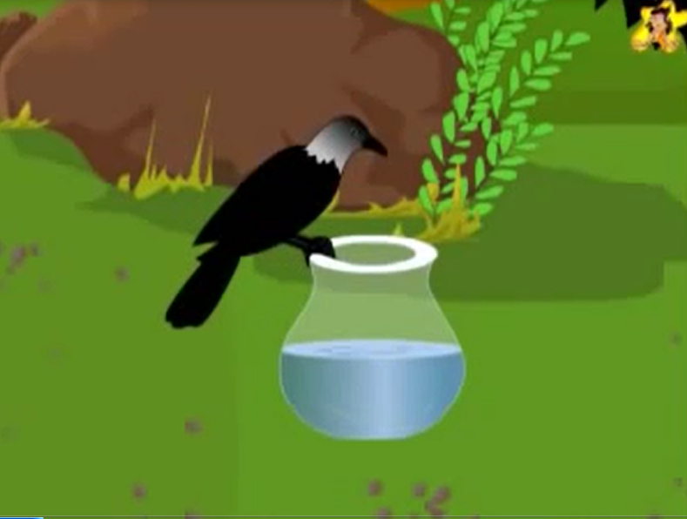
It flew to the pitcher at that moment hoping for water.

Slide 13
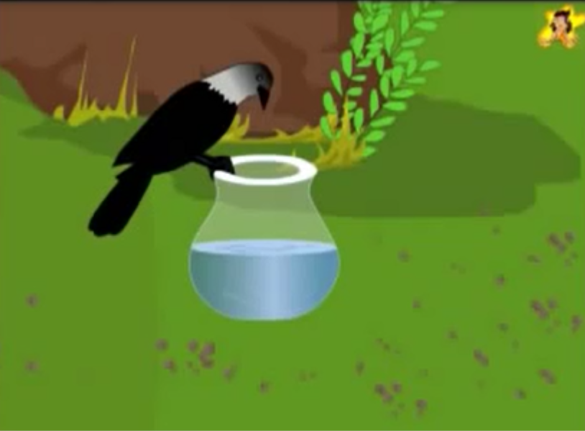
It sat on the top of pitcher.

Slide 14
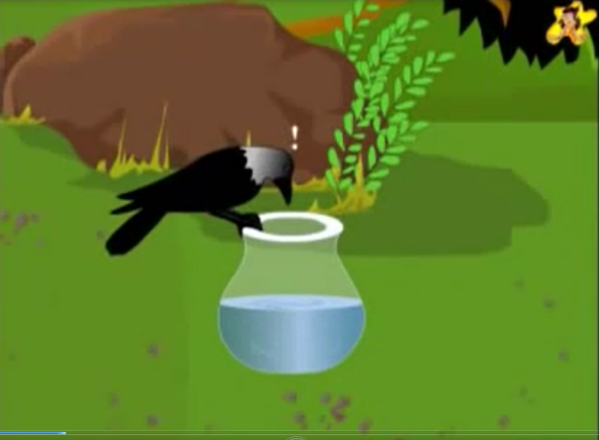
It found a little water at the bottom of the pitcher.

Slide 15
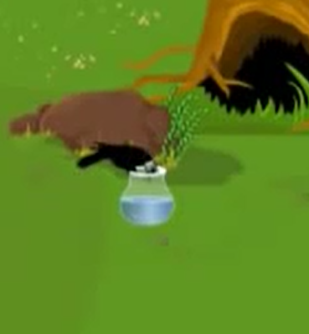
It tried heart and soul to drink the water by using it’s beak.

Slide 16
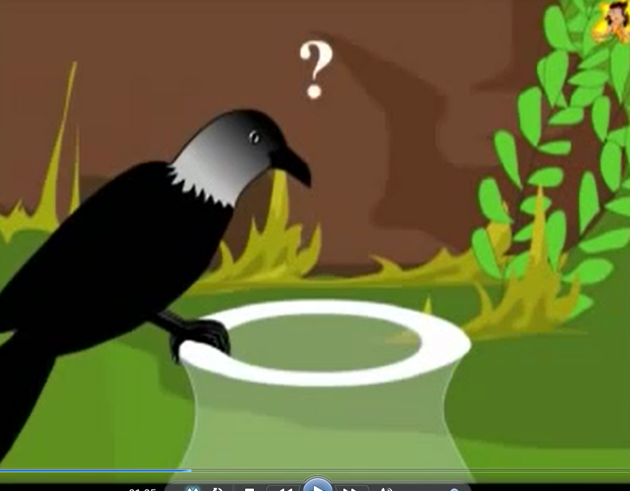
But could not drink water as it’s beak could not reach there. Then it tried to overturn the pitcher.

Slide 17
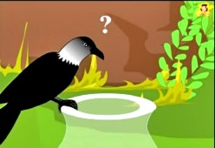
It thought and thought but could not find a way out.

Slide 18
It thought sometime and made a plan. It flew near stones.

Slide 19
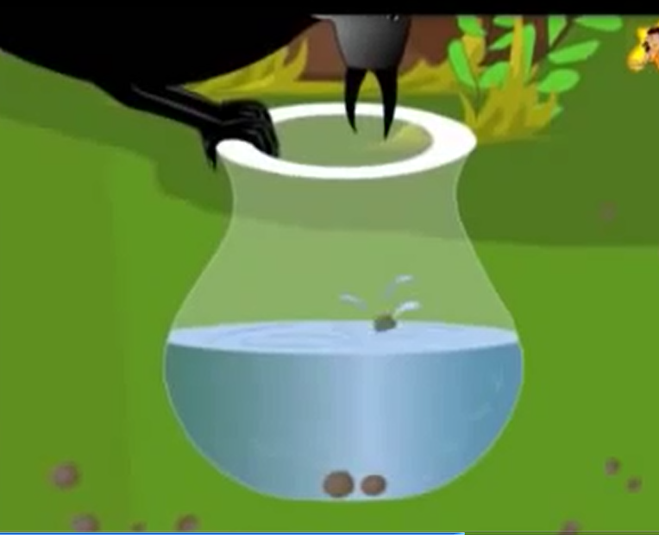
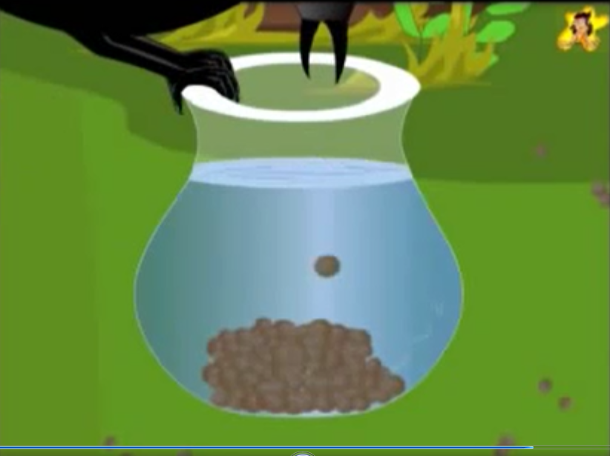
The crow continued its work in hot weather until the water level rose up.

Slide 20
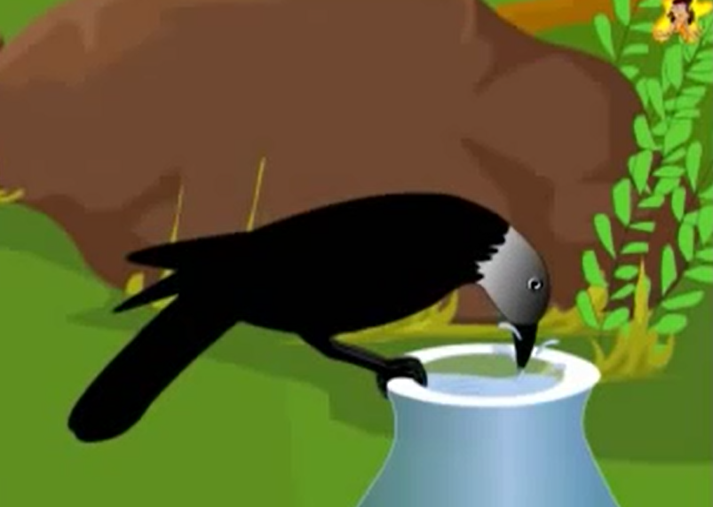
At last the crow drank water with its heart content.

Slide 21
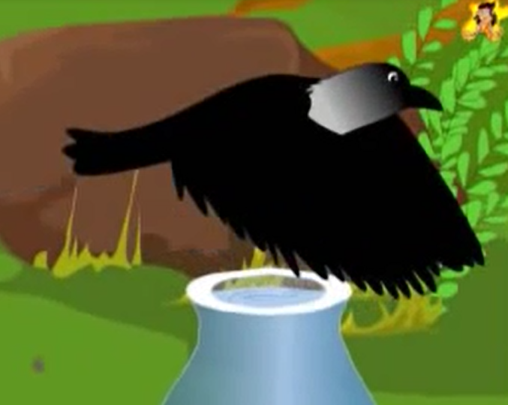
After drinking water, the crow flew away into the forest.

Slide 22
Match with their synonyms:
Despair | Result
Pebble | Look for
Search | Again and again
Effect | Stone
Over and over | Hopelessness

Slide 23
Enjoy the video!
To see the video click here https://youtu.be/WPktMBW2k98

Slide 24
Fill in the gaps:
It was ____ hot summer day.
A crow was very ____.
He _____ about here and there looking ___ water.
He saw a ____ with water.
He went ____ to the pot.

Slide 25
Fill in the gaps:
He looked _____.
He saw some _____.
He had an _____.
He picked up the pebbles one ____ one and dropped them ___ the pot.

Slide 26
Rearrange
As each pebble went down, the water in the jar rose up little by little.
It flew from one place to another in search of water and at last found a jar in a garden.
Then it decided to fly away in despair.
The crow tried to turn the jar over and over again but it had no effect.
Then it dropped the pebbles into the jar.

Slide 27
A crow was very thirsty and wanted to drink water.
There was some water in the jar but it was too low down and out of reach.
As it was leaving the jar, it noticed a heap of pebbles nearby.
He hit upon a plan then and took some pebbles.
When the water came to the mouth of the jar, the crow drank it.

Slide 28
A thirsty crow
1 | 2 | 3 | 4 | 5 | 6 | 7 | 8 | 9 | 10
f | b | g | d | c | h | i | c | a | j

Slide 29
Evaluation
Where was the crow flying?
What did the crow want to drink?
How can it find a pitcher?
What did it do by stones?

Slide 30
The Thirsty Crow
Once a crow sat on a branch of a tree in a forest. The day was very hot and it felt very thirsty. It tried to find out a source of water. It looked here and there but could not find out water. At last it saw a pitcher near a tree. It flew to the pitcher at that moment hoping for water. It sat on the top of pitcher. It looked down to see the level of water. It found a little water at the bottom of the pitcher. It tried heart and soul to drink the water by using it’s beak. But could not drink water as it’s beak could not reach there. Then it tried to over turn the pitcher. It could not overturn it. It thought and thought but did not find a way out. At last the crow decided to fly away loosing it hope. At that time, it saw some stone near the pitcher. It thought sometime and made a plan. It flew near stones. It took one stone and flew to the pitcher. Then it dropped the stone into the pitcher. The crow dropped stones one after one into it. The crow continued its work in hot weather until the water level rose up. At last the crow drank water with its heart content. After drinking water, the crow flew away into the forest.

Slide 31
Morality
Where there is will, there is a way.

Slide 32
Good Bye

