Slide 1


Welcome to my dear students

Slide 2

INTRODUICE
Md. Saidul hoque
Assistant teacher
Enayetpur Rahamotia Alim Madrash
Senbag, Noakhali.
English for Today
Dakhil
Class seven. Unit-3, Lesson-1.

Slide 3
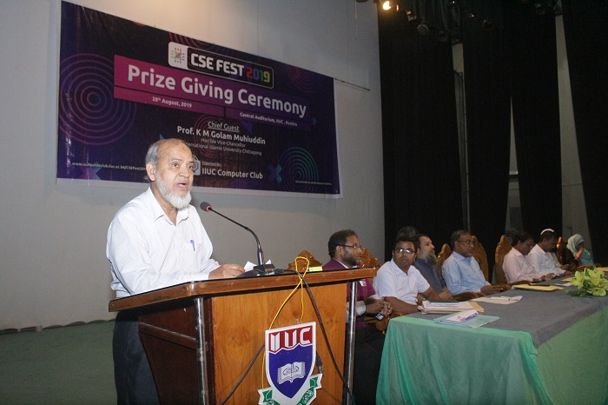
What do you understand by looking at these picture?

Slide 4

Our todays lesson is—
Prize giving day at Madrasah

Slide 5

LEARNING OUTCOME
After we have studied this lesson we will able to---
The two friends will be able talk about the madrasah prize giving ceremony.
The replacement table can tell about fill in the blanks.
Can tell the meaning of word.

Slide 6
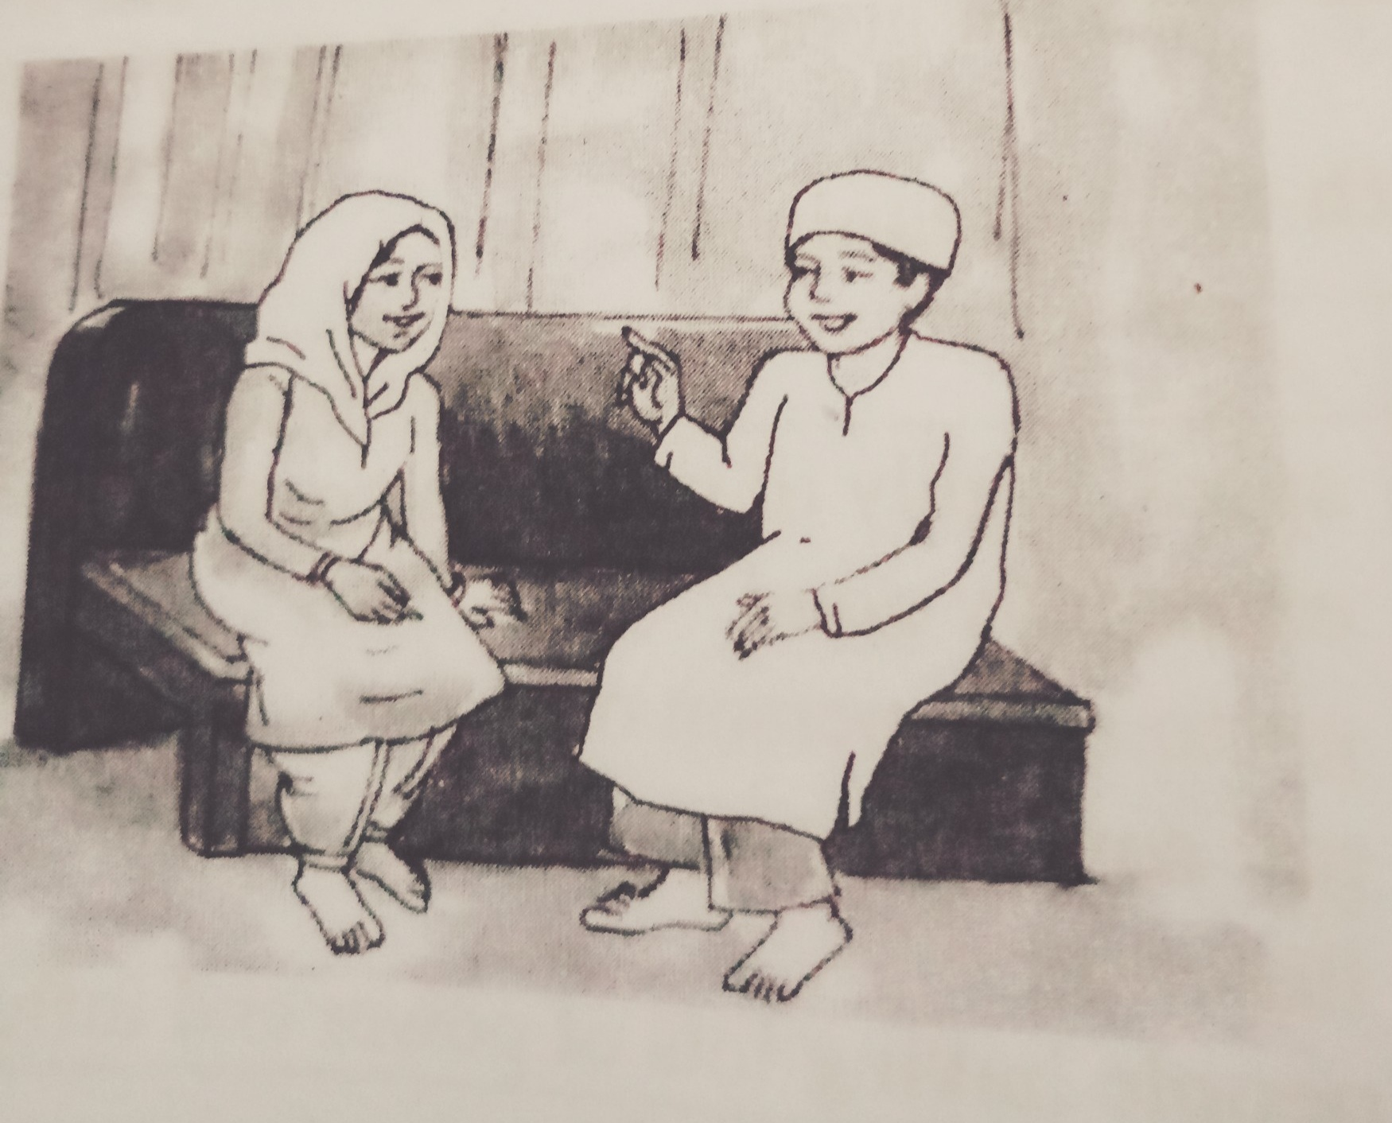
These are two friends name is farabi and flora discuss about prize giving ceremony.

Slide 7

Ask and answer in pairs. Make question and then choose answers from this table.
Questions Answers
How |  | The prize-giving function held? | The principle of DS madrasah.
What |  | The auditorium decorated? | In the madrasah auditorium.
who |  | The chief guest at the function? | Read out the annual report.
where |  | The superintendent do at the beginning of the function? | Brightly.
Was
did

Slide 8

Question and answer of the table below:
Click to right answer
1. How was the auditorium decorated?
2.What did the superintendent do at the beginning of the function?
3. Who was the chief guest at the function?
4. Where did the prize-giving function held?
Brightly
Read out the annual report.
The principle of DS madrasah.
In the madrasah auditorium.

Slide 9
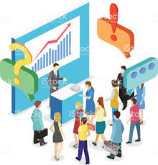
visit
Meaning: speak highly of something or somebody
Inspect
Tour
trip

Slide 10

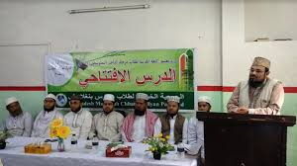
Ceremony
Occasion
Party
parade
Meaning: a formal act performed on a religious occasion

Slide 11
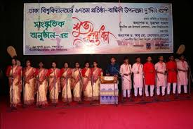
Outstanding
Meanings: Function
0peration
ceremony

Slide 12

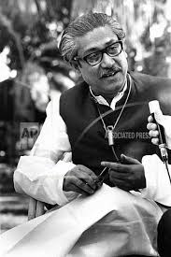
Eminent-
Meanings: go to see a person or famous and respected.
Celebrated
prominent

Slide 13

Substance--
Farabi’s best friend, Flora, comes to visit his house on a holiday. They are talking. Flora wants to know about the prize giving ceremony of farabi’s madrasah. Farabi give a description of the prize-giving ceremony of his madrasah. It was held yesterday. Farabi also says that he got two prizes.

Slide 14
Evaluation
Complete the passage with the verbs in the box. Give there correct forms.
Click to here for answer
be | Sing | speak | stage
was
At the end of the prize-giving function there a cultural show.
The students songs, danced and a one-act play.
It was so good that every highly of it.
sang
staged
spoke

Slide 15
Home work
Do you have a sports day at your madrasah? You will be write about it in your notebook.

Slide 16
Thanks all are my dear student.
God bless all you.

Slide 17

Acknowledgement
We would like to express our cordial gratitude to the Ministry of Education, Directorate of Secondary & Higher Education, NCTB, A2i and the panel of honorable editors ( Md. Jahangir Hasan, Assistant Professor (English) TTC, Rangpur, Ranjit Poddar, Associate Professor (English) TTC, Dhaka, and Urmila Khaled, Assistant Professor (English) TTC, Dhaka, to enrich the contents.

