Slide 1

Introduction
welcome

Slide 2
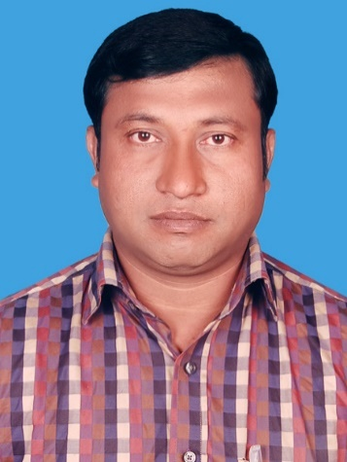
Introduction
Abul kalam rubel
Assistant Teacher (commerce)
Shaheed alauddin High School
Mirzapur, Pakundia, Kishoreganj
Class: Six Time: 40 Minutes
Contact # 01712276872

Slide 3

Class Introduction
Subject: English Grammar
Class: Six
Lesson: One
Time: 45 minutes
Today’s Lesson
NOUN

Slide 4
Learning Outcome
1. Students will able to say what is noun.
2. Students will able to say what’s name is noun.

Slide 5
Noun is name.
Noun is a naming word.
Noun is name of anything.
What Name?
Which Name?
Whose Name?

Slide 6
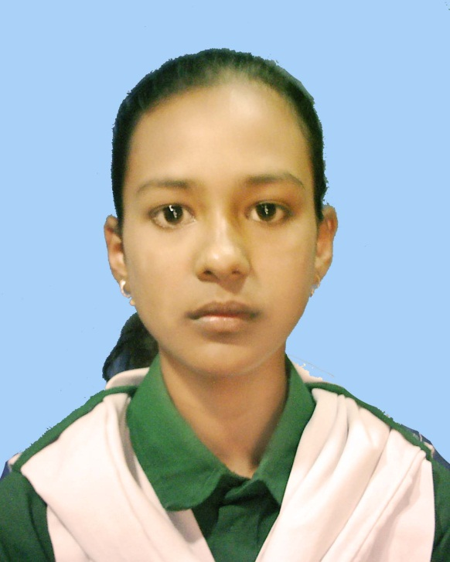
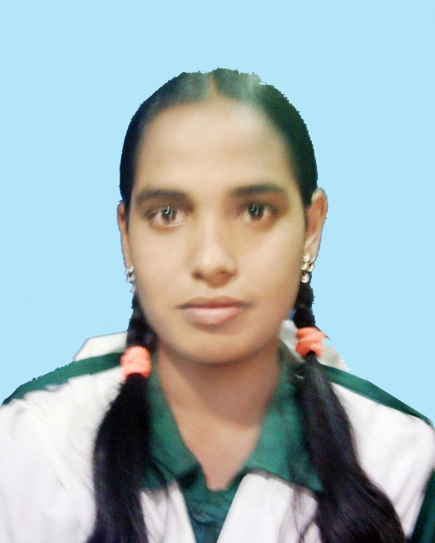
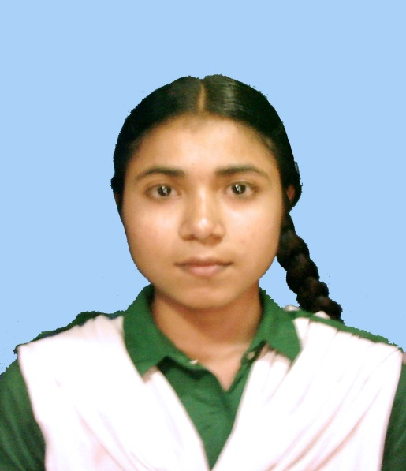
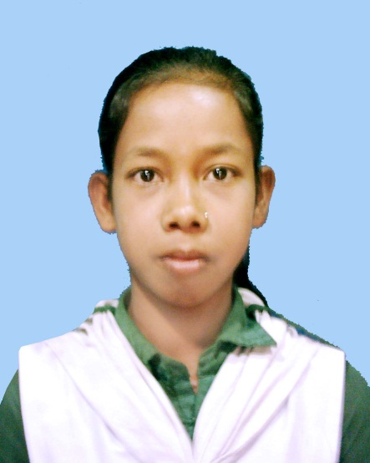
Name of Person
Rina
Nazma
Rubina
Adori

Slide 7
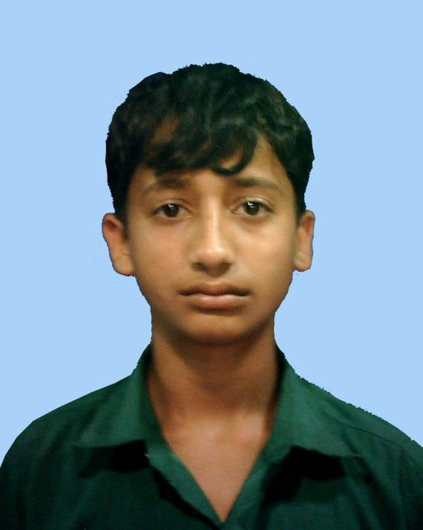
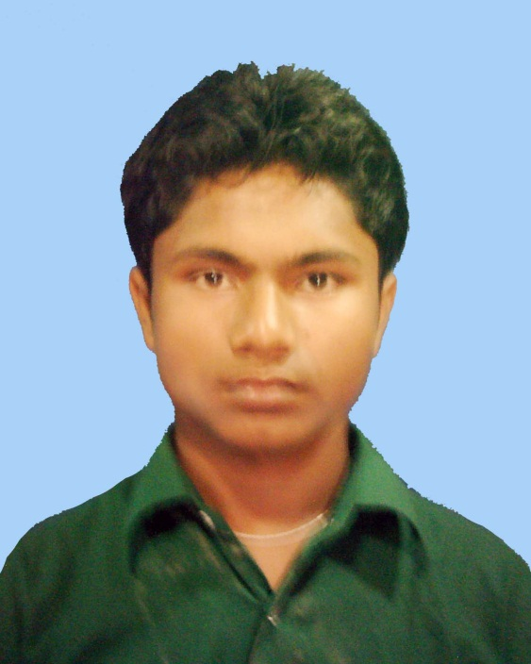
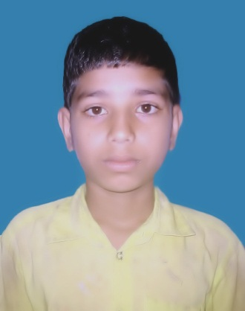
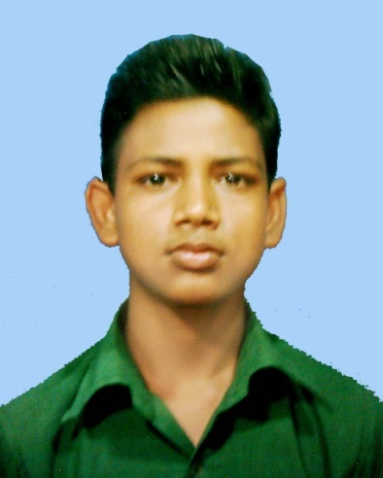
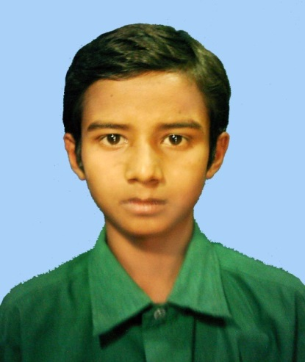
R
A
B
N
U
r
M
I
L
O
n
R
a
n
a
Name of Person

Slide 8
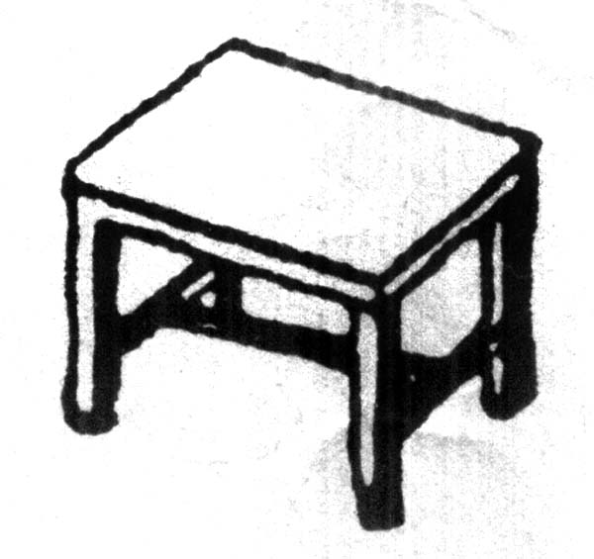



Name of Things

Slide 9




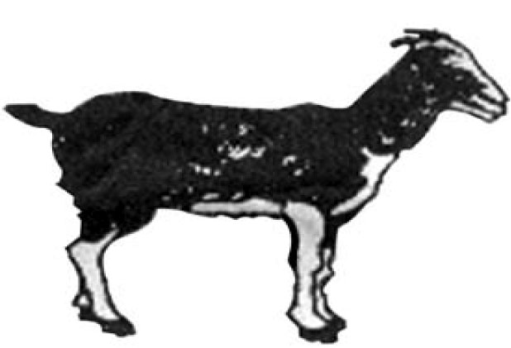
Name of Animals

Slide 10


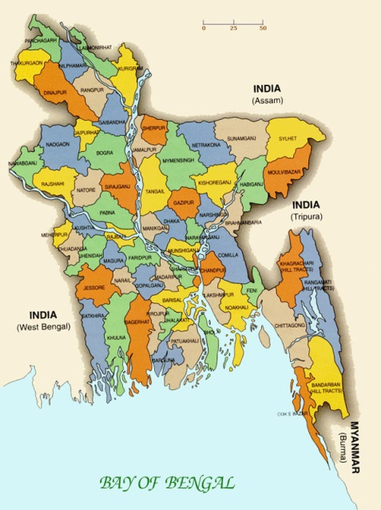
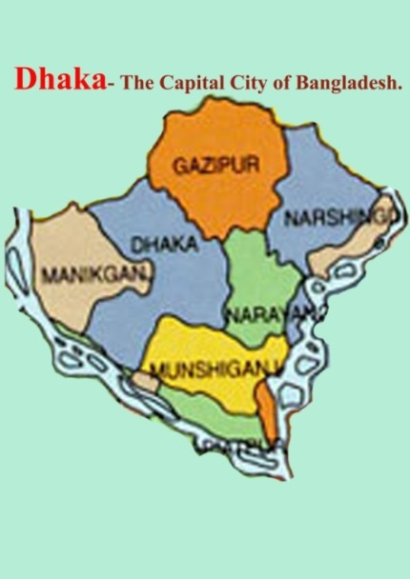
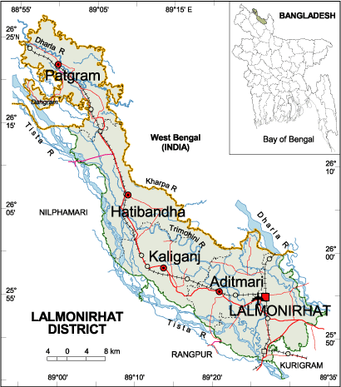
Name of Place
Asia
The Earth
Dhaka
Lalmonirhat

Slide 11
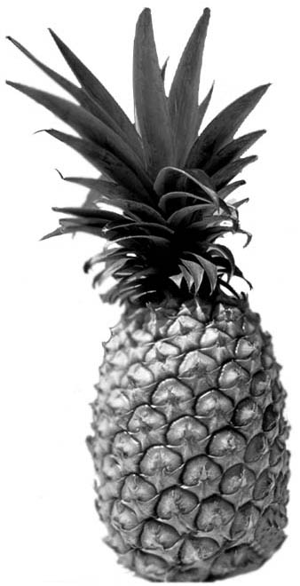
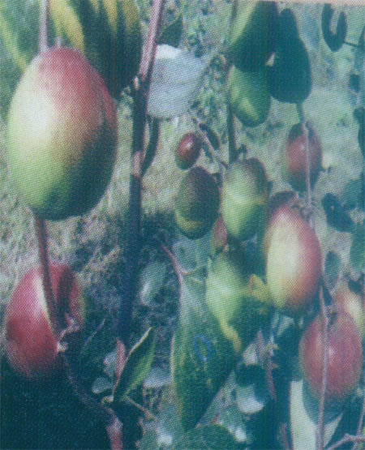


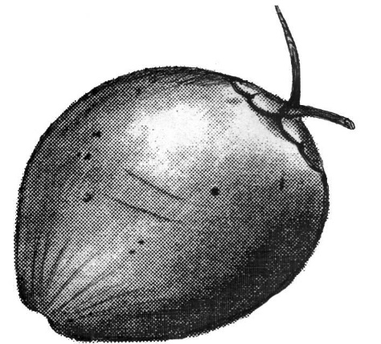
Name of fruits

Slide 12


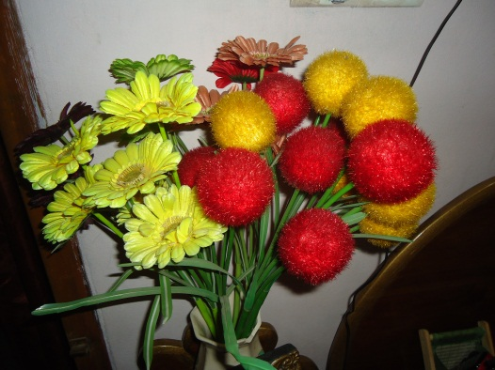
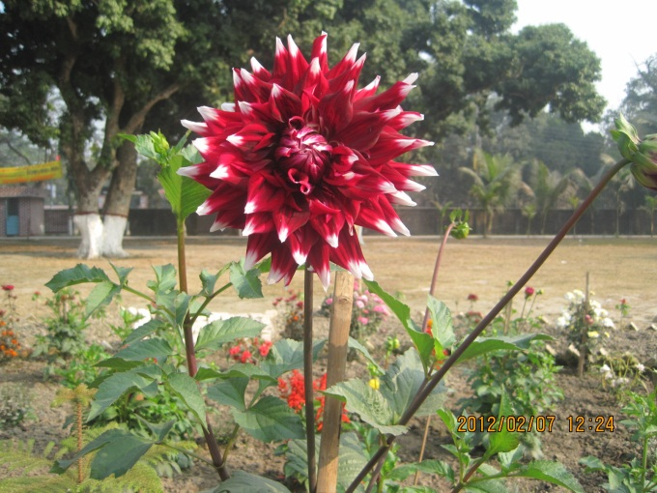
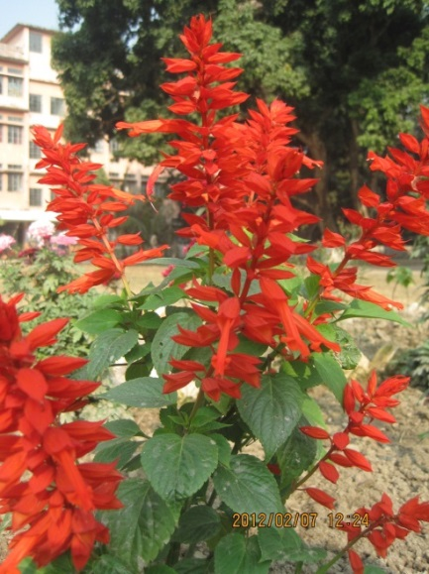
Name of flowers

Slide 13
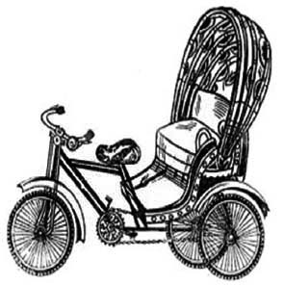
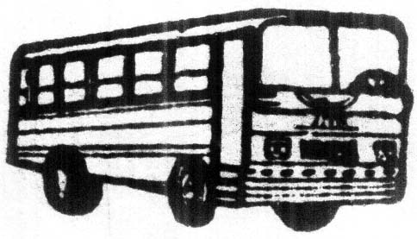


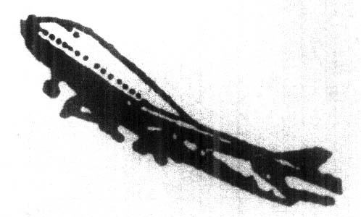
Name of vehicles

Slide 14
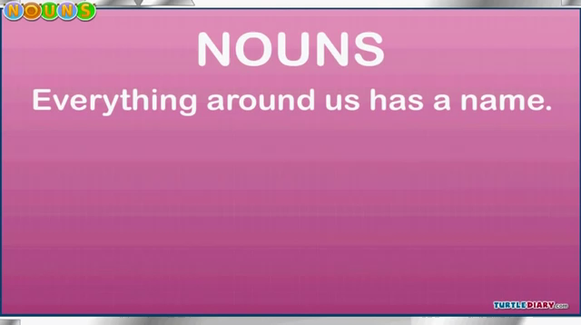

Slide 15

Pair Work
Write at least
ten functions of NOUN.

Slide 16
Name of Person
Name of Things
Name of Animals
Name of Place
Name of Action
Name of Idea
Name of Quality
Name of Quantity
Name of Manner
Name of Condition

Slide 17
Evaluation
Fill in the gaps using noun.
Rana
1. ………………….. Is a good boy.
Runa
2. ………………….. Is a good girl.
Tiger
3. ………………….. lives in Sundarbans.
Bangladesh
4. ………………………………..………….. Is our motherland.
water
5. We drink …………………...

Slide 18
Home Task
Make a sort of Noun.
Write the job of Noun.

Slide 19

THANKS TO ALL

