Slide 1
Good morning
ALL THE STUDENTS

Slide 2
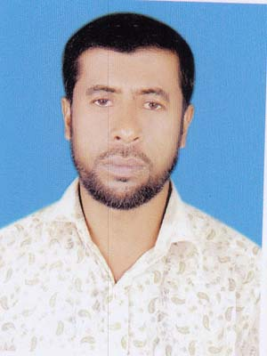
MD. NESAR UDDIN
ASSISTANT TEACHER.
KOLA GOVT. PRIMARY SCHOOL
ATNESARUDDIN@GMAIL.COM

Slide 3
Class - Two
Subject: English
Lesson - 4
Lesson unit: How many? (number 6 - 10 in figures & words)
Time: 45 minutes.

Slide 4
Students will be able…
to recognize & say the cardinal numbers 6—10.
to read & write cardinal numbers 6-10 both in figures and in words.

Slide 5
Let’s see the video

Slide 6
Declaration of the Title:
Numbers

Slide 7
Input
20 minutes

Slide 8
Look, listen and say:
6
six

Slide 9
Look, listen and say:
7
seven

Slide 10
Look, listen and say:
8
eight

Slide 11
Look, listen and say:
9
nine

Slide 12
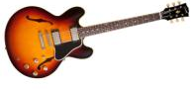
Look, listen and say:
10
ten

Slide 14
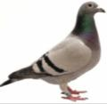
Look, listen and say:
Picture
Figure
Word
6
six
7
seven
8
eight
9
nine
10
ten

Slide 15
How many mobiles?
9
nine

Slide 16
How many bats?
seven
3
5
7

Slide 17
Practice
15 minutes

Slide 18
Match the numbers with words:
Number
Word
7
six
9
eight
6
nine
8
ten
10
seven

Slide 19
Write the missing numbers by using pictures:
6
7
8
six
seven
eight
10
9
ten
nine

Slide 20
Write in words & re-arrange the numbers:
Numbers
Words
8
eight
6
six
7
seven
10
ten
9
nine

Slide 21
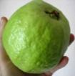
eight
Rearrange the words with pictures:
eight
six
Checking learning
nine
seven
ten

Slide 22
9
1
8
4
6

