Slide 1
Good morning
ALL THE STUDENTS

Slide 2
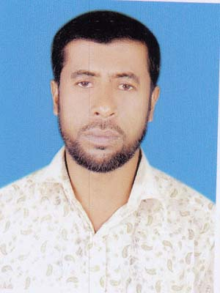
Md. Nesar uddin
Assistant teacher.
Kola govt. primary school
atnesaruddin@gmail.com

Slide 3
Class - Two
Unit - 1
Lesson – 2 (Life every day)
Lesson - A, B, C
Page - 57

Slide 4
1) listen the lesson the attentively.
2) read the lesson with correct pronunciation.
3) tell about the routine in the afternoon and in the evening.
4) to enrich there vocabulary and write answers.

Slide 5
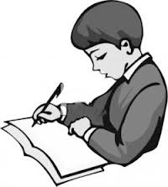
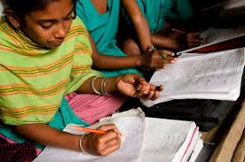
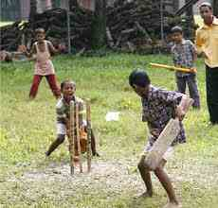
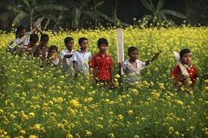
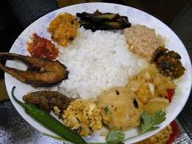
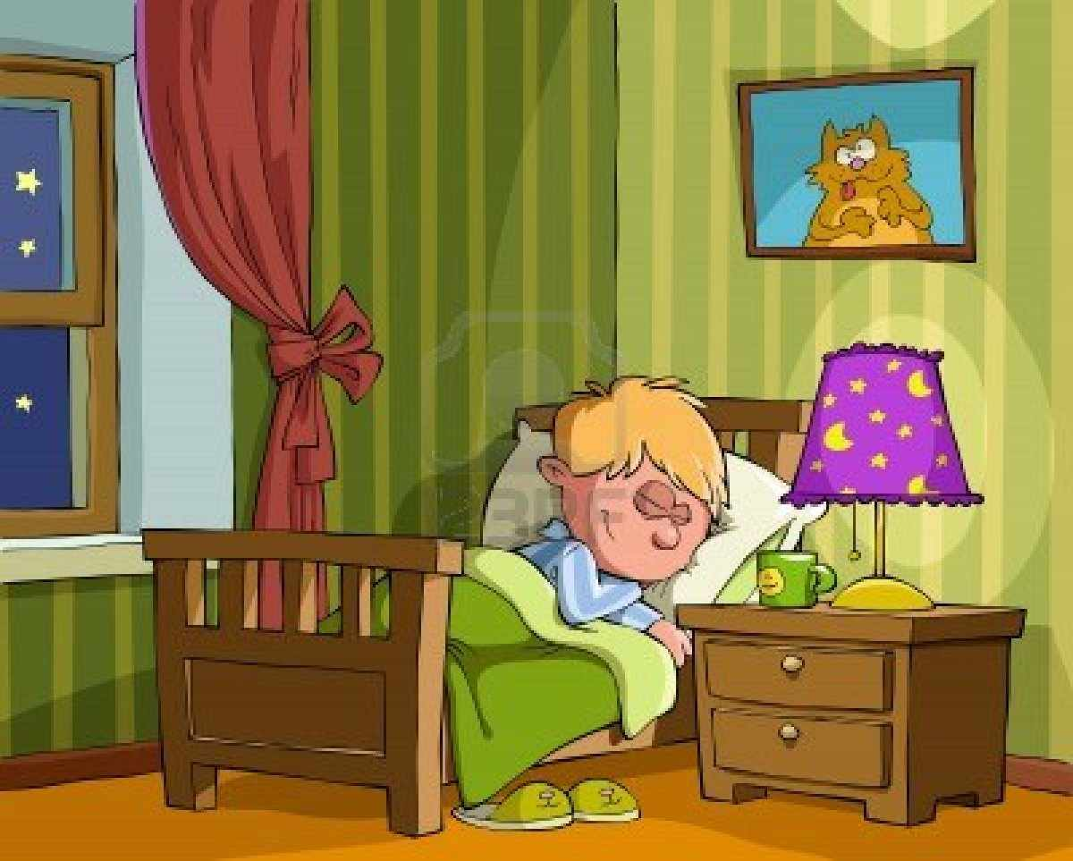
In the afternoon and in the evening
Lesson declaration
And creat emotions

Slide 6
In the afternoon
In the afternoon ,I do my home work

Slide 7
Then I play with my friends.

Slide 8
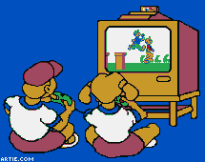
Then I watch TV.

Slide 9
After supper,I go to bed.

Slide 10
Word meaning
Home work
It means to read and write at home.

Slide 11
Play
It means to do enjoyable anything with friends.

Slide 12
Supper
It means to eat food at nignt.

Slide 13
Group work
Group-A
Group-B
Look at the picture and tell about this.
Look at the picture and tell about this.

Slide 14
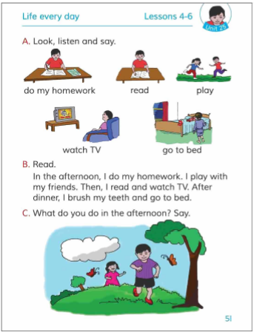
Open your book page no 57

Slide 15
Pair work
Say and write the meaning
Home work
Supper
Play

Slide 16
Matching both side
1)In the afternoon
2)Play with friends
3) Watch TV
4)Take supper

Slide 17
Pair work
Discuss in pairs
What do you do in the afternoon and evening?

Slide 18
Indivisiual work
Tell me the answers and write these.
Q1:When does Raihan’s do his homework?
Q2:What does he do after finishing homework?
Q3:What does he do in the evening?

Slide 19
Thanks

