Slide 1
WELCOME
WELCOME
TO
English Class.

Slide 2
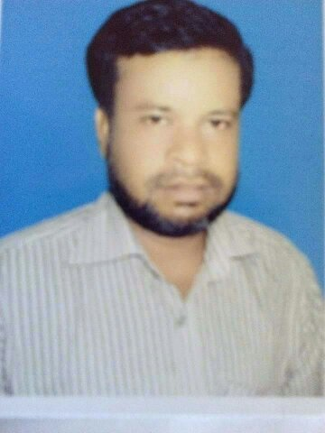
Topic-Narration
Class- viii, ix & x
Prepared By
Md. Mukul Mia M.A in English, B.Ed
English Teacher
M.A Sattar Adarsha High School,Kurigram.

Slide 3
Learning Outcomes
By the end of the lesson, the learners will be able to…
1.Speak about the rules of Narration.
2. Practise the exercise of Narration.
3. Apply it in real life.

Slide 4
Narration
Direct Narration
Indirect Narration
Stated by Speaker Himself
Stated by Others

Slide 5
Reporting Verb
Eg- Direct :
He said to me, “ I am reading a book.’’
Speaker
Listener
Reported Speech
Linker
Tense
Indirect:
He told me that he was reading a book.
Reporting Verb
Person

Slide 6
Step-1 (Reporting Verb Changing & Linker Set up}
Sentences | Reporting Verb | Linker
Assertive | told/said | That
Interrogative | asked | If/WHQ
Imperative | Ordered/requested/advised/forbade/proposed/said | To/that
Optative | Prayed/wished | That
Exclamatory | Exclaimed with joy/sorrow/wonder | that
Eg- Direct: She said to me , “ Are you reading the book?”
Indirect: She asked me if I was reading the book.

Slide 7
Step-2 {Person Changing}
Person | Nominative Case | Objective Case | Possessive Case
1st Person | I we | Me us | My Our
2nd Person | You | you | your
3rd Person | He She They It | Him Her Them it | His Her Their its
1. R.S এর ভিতর 1st Person থাকিলে R.V এর Speaker অনুসারে Person Change হবে

Slide 8
Eg-Direct: He said to me , “ I am writing a letter.’’
Indirect: He told me that he was writing a letter.
2. R.S এর ভিতর 2nd Person থাকিলে R.V এর Listener অনুসারে Person Change হবে
Eg-Direct: I said to her, “ You have done the work.”
Indirect: I told her that she had done the work.
3. 3rd Person Change হবে না
Eg- He said , “They are reading a book.”
Indirect: He said that they were reading a book.

Slide 9
Step-3 {Tense Changing}
Direct Narration | Indirect Narration
Present Indefinite | Past Indefinite
Present Continuous | Past Continuous
Present Perfect | Past Perfect
Present Perfect Continuous | Past Perfect Continuous
Past Indefinite | Past Perfect
Past Continuous | Past perfect Continuous
Past Perfect | No Change
Past Perfect Continuous | No Change

Slide 10
Eg-Direct: He said to me, “ I am writing a letter.”
Indirect: He told me that he was writing a letter.
Direct: The boy said to her, “ Are you reading the story book?”
Indirect: The boy asked her if she was reading the story book.
N.B: Tenses don’t change in Imperative Sentence and if R.V is Present/Future Tense
Eg-Direct: The teacher said , “ Do the sum.”
Indirect : The teacher ordered to do the sum.
Direct: He says to me, “ You know the news.”
Indirect: He tells me that I know the news.

Slide 11
Step-4{ Modal Verb Changing}
Direct Narration | Indirect Narration
Shall | Should
Will | Would
Can | Could
May | Might
Must | Had to
Need | Needed
Dare | Dared
Eg- The girl said , “ I will do the sum.”
Indirect: The girl said that she would do the sum.

Slide 12
Step-5{Some Nearest & Distant Words Changing }
Direct Narration | Indirect Narration | Direct Narration | Indirect Narration
Here | There | Thus | So
Now | Then | Tomorrow | The next day
Ago | Before | Yesterday | The Previous day
This | That | Last night / week / month /year | The Previous night / week /month /year
These | Those | To night | That night
Come | Go | Next week | The following week
Eg: The boy said to me , “I saw him yesterday.”
Indirect: The boy told me that he had seen him the previous day.

Slide 13
Exercise
1.My father said to him, “We are going there tomorrow.”
2.He said to me, “Do you know my friend?”
3.The teacher said to Mina, “ Read this book.”
4.My mother said to me, “May Allah bless you.”
5.I said to her, “ What a nice girl you are!”
My father told me that they were going there the next day.
He asked me if I knew his friends.
The teachers ordered Mina to read that book.
My mother wished that Allah might bless me.
I exclaimed with joy that she was a very nice girl.

Slide 14
THANK YOU.

