Slide 1
Welcome to
TOday’s English Class.

Slide 2
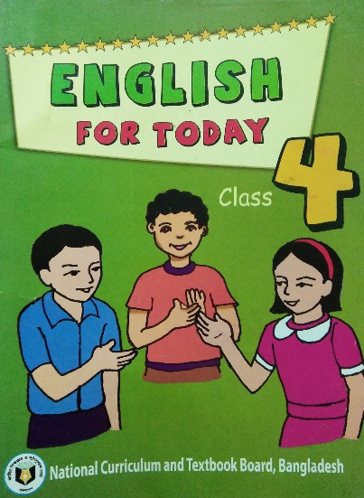
Mallika Paul
Assist. Teacher,
Gopalganj Sadar, Sadar, Gopalganj.
mpaul29024@gmail.com
Class-Four
Sub.-English
Unit-28
Date-15-11-2019

Slide 3
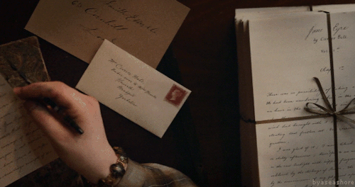
Lets look some pictures &
discuss about these picture..

Slide 4
Title
“Letter to a friends”
(Dear Ismail,………..your friend, Kajol )

Slide 5
Learning Outcomes:
1.4.1 read words, phrases & sentences in the text
with proper punctuation, stress & intonation.
1.5.1 read silently with understanding paragraphs,
Stories and other texts.
1.7.1 read short paragraphs, dialogues and simple
letters.
5.1.2 read with knowing the parts of a personal
letter.
Reading

Slide 6
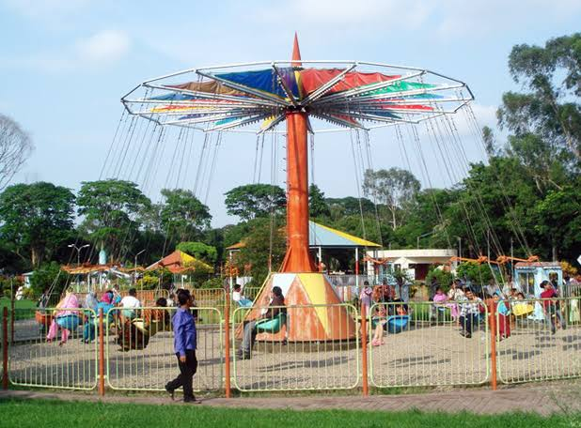
Keyword
Park
Recreation ground
Together
With each other.

Slide 7
26th April, 2016
Dear Ismail,
Sumon is my new friend at school. He is from Bogura. Everyday
after school we play in the park. We play cricket together on the
weekends.He can run very fast! Sumonn has a sister.Her name is
Mira.
How are you? Write soon!
Lets look ,read & try to understand the letter..
Your friend,
Kajol

Slide 8
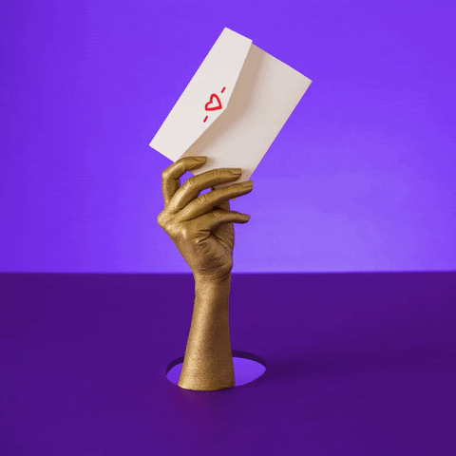
A personal letter has 5 parts.
1. Heading (Date)
2. Greeting.
3. Body.
4. Closing.
5. Signature (name).

Slide 9
Greeting
Heading/Date
26th April, 2016
Dear Ismail,
Sumon is my new friend at school. He is from Bogura. Everyday
after school we play in the park. We play cricket together on the
weekends.He can run very fast! Sumon has a sister.Her name is
Mira.
How are you? Write soon!
Lets look the letter again and
try to identify these five parts from the letter.
Closing
Body
Your friend,
Signature/name
Kajol

Slide 10
How many parts of a personal letter?
Five parts.

Slide 11
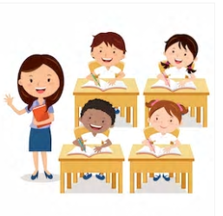
Now lets listen the
Audio attentively..

Slide 12
Read with/after me.

Slide 13
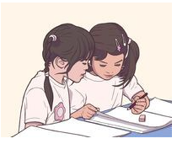
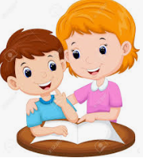
Read in pair.

Slide 14
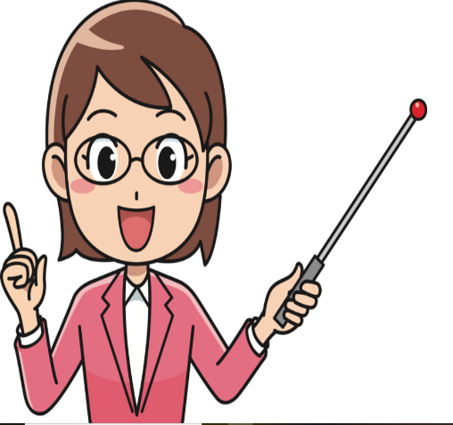
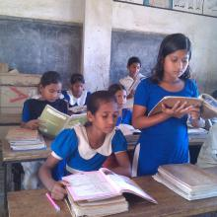
One by one.

Slide 15
Thanks All.Bye Bye….

