Slide 1

W
E
L
C
O
M
E

Slide 2
INTRODUCTION
Md.REZAUL KARIM
Assistant Teacher (English)
PalashbarI High School.
SUBJECT: English
CLASS: Eight

Slide 3

Here is an audio clip. Let us hear a song.
Ques:
What did the singer do?
Ans:
She sang a song.

Slide 4

How much do you like flowers?
I like flowers very much.

Slide 5


What is the parts of speech of the words in the circles?
1.She sang a song.
2.I like flowers very much.
Verb

Slide 6
Today Our Topic
Right forms of verbs

Slide 7
Learning Outcomes
After this lesson the students will be able to-
write the sentences using right forms of verbs.
fill the gaps with right forms of verbs (with clues).
correct mistakes and re-write the passage with right forms of verbs.

Slide 8

If the sentence is Universal truth or Habitual fact, it will be Present Indefinite tense.
The sun rises in the east.

Slide 9
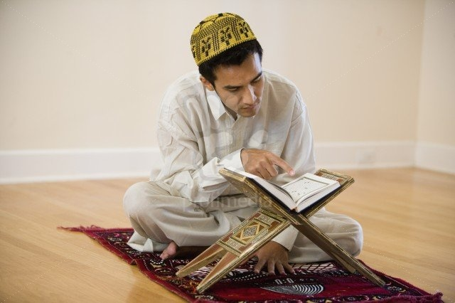
If in the sentence there is everyday//always/regularly/
occasionally/usually/often/sometimes/
generally , the sentence will be Present Indefinite tense.
He reads the Holy Quran everyday.

Slide 10
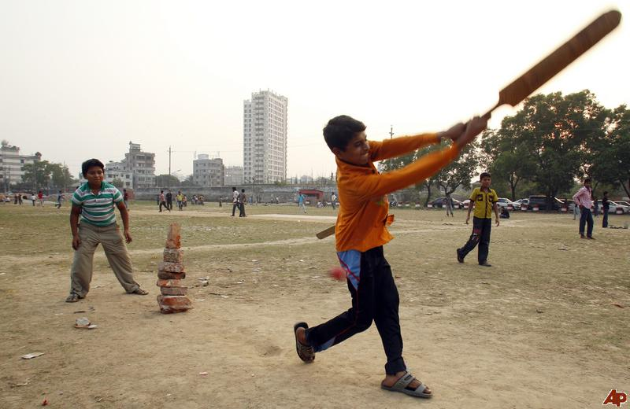
If in the sentence there is now/at this moment/at this time , the sentence will be Present Continuous tense.
Rana is playing cricket now.

Slide 11
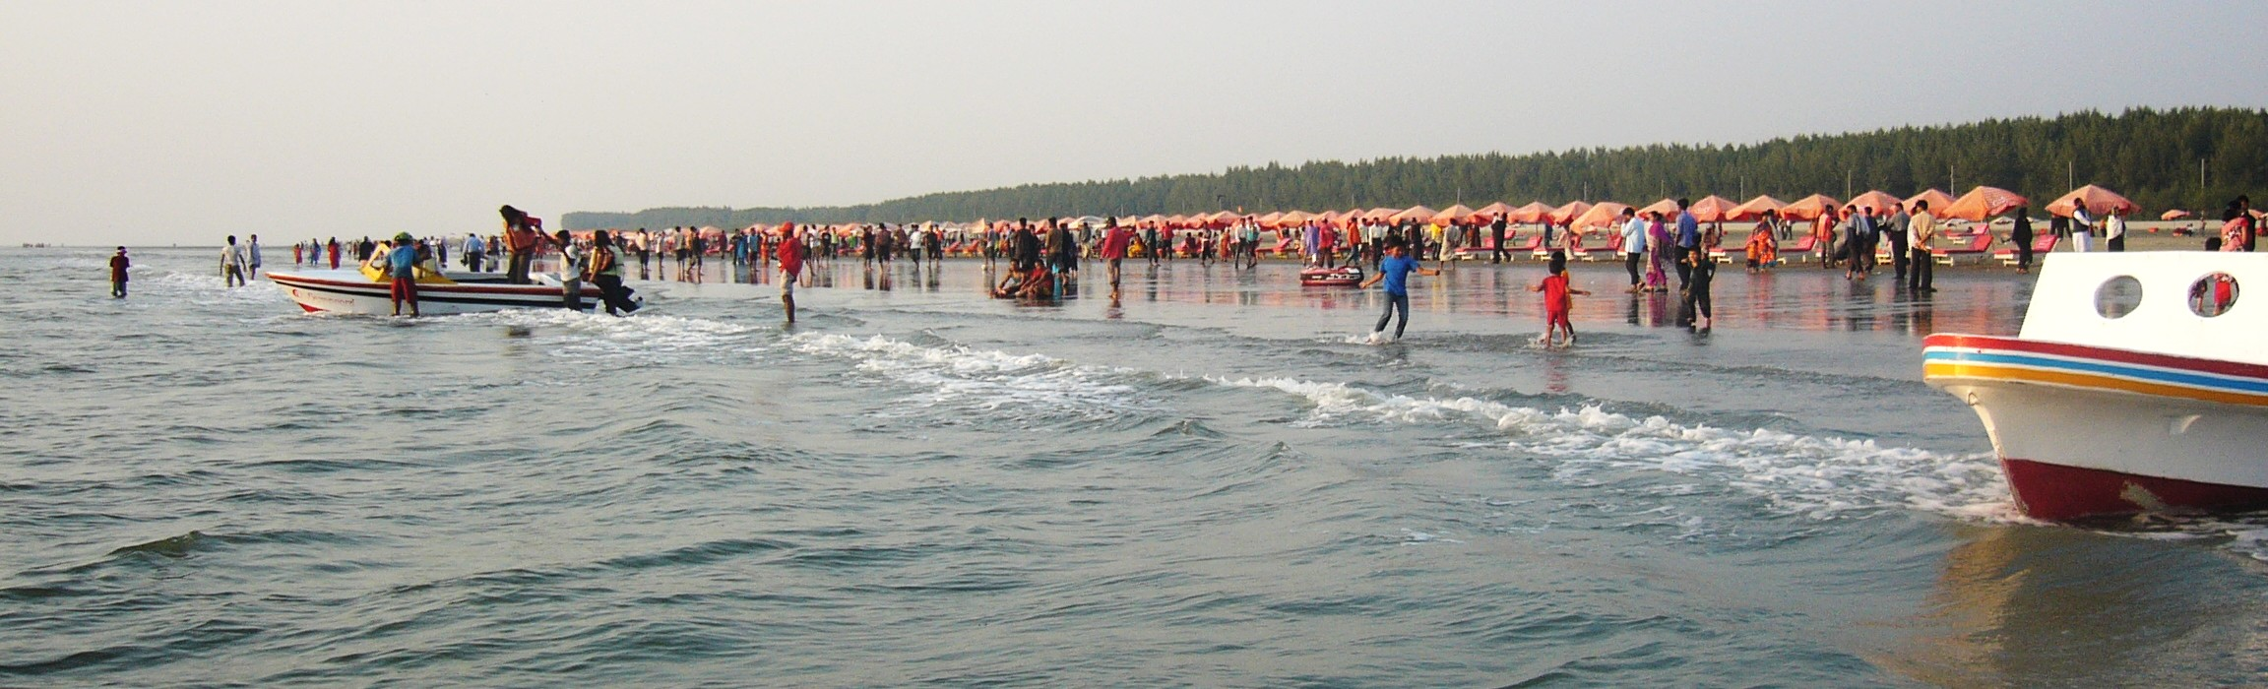
If in the sentence there is recently/already/just/just now/lately/ever/yet , the sentence will be Present Perfect tense.
I have recently visited Cox’s Bazar.

Slide 12

After shall/should/can/could/may/might/will/
would/would rather/had better, verb will be in base form.
We should take care of our health.

Slide 13
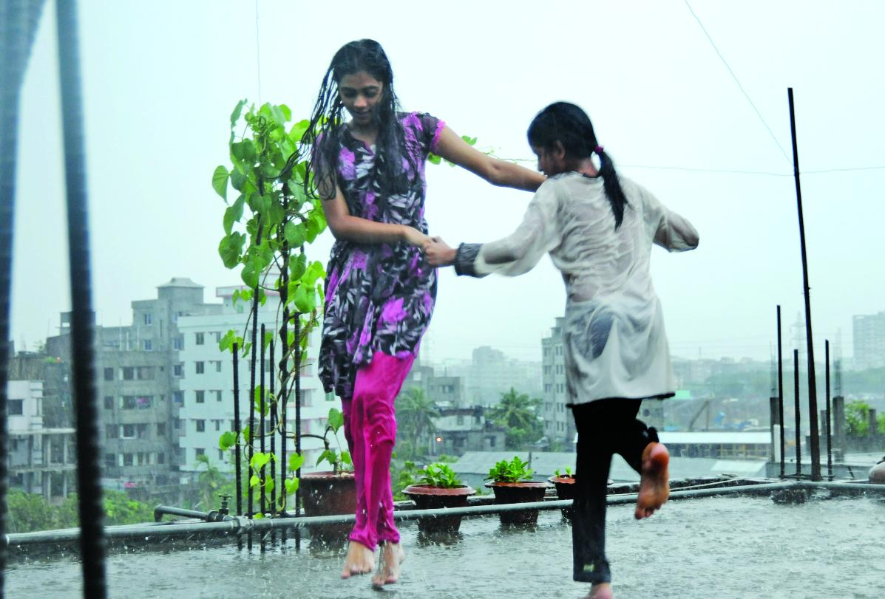
If in the sentence there is for/since+ time the sentence will be Present Perfect Continuous Tense.
It has been raining for three hours.

Slide 14

Once there lived a princess.
If in the sentence there is once/ago/long ago/last night/last week/last year/yesterday , the sentence will be Past Indefinite tense.

Slide 15
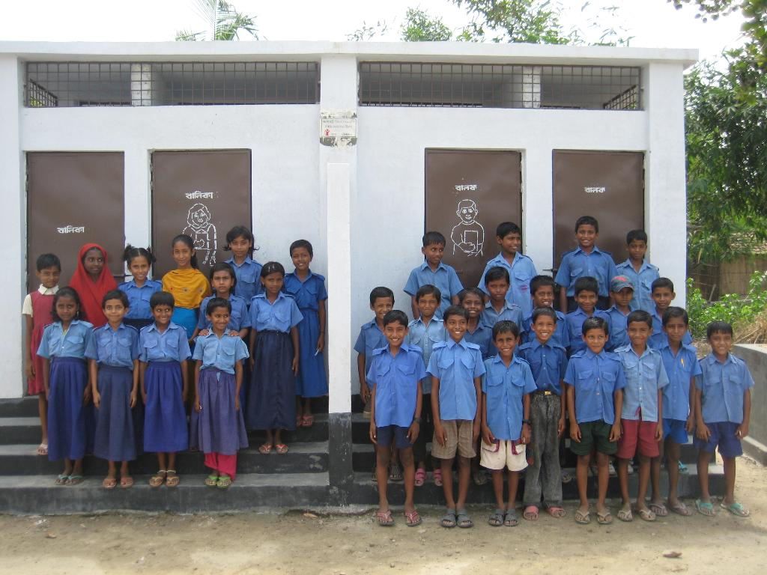
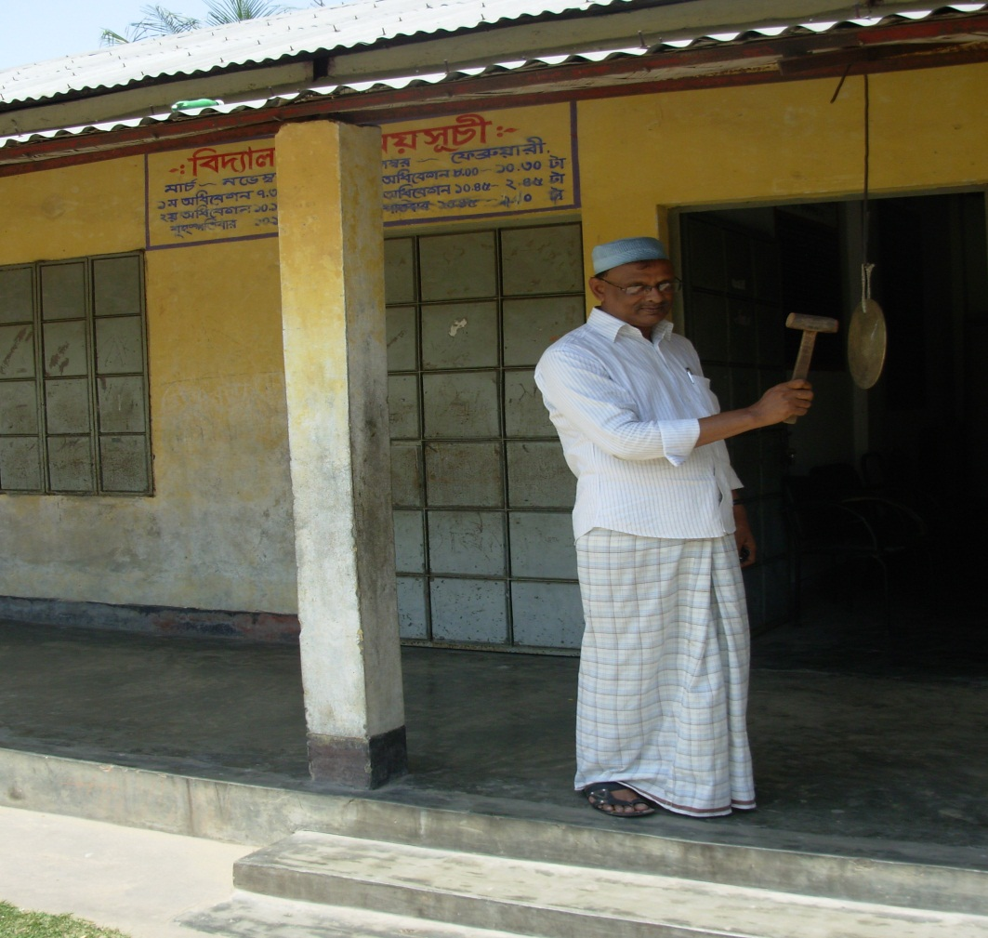
If in the past tense there is word ‘before’ between two clauses, the sentence structure will be-
The clause(Past Perfect)+ before +The clause (Past Indefinite).
They had reached the school before the bell rang.

Slide 16
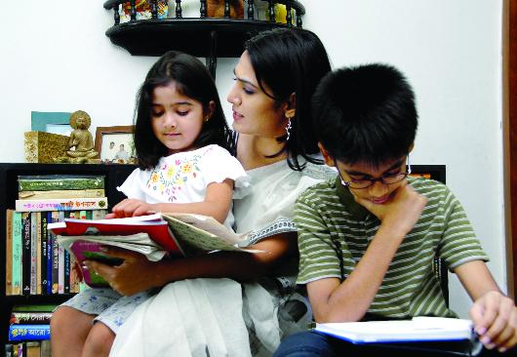
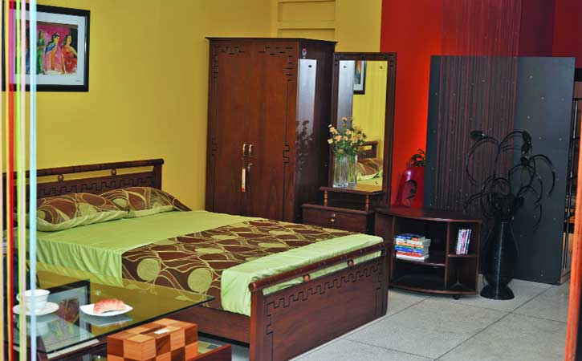
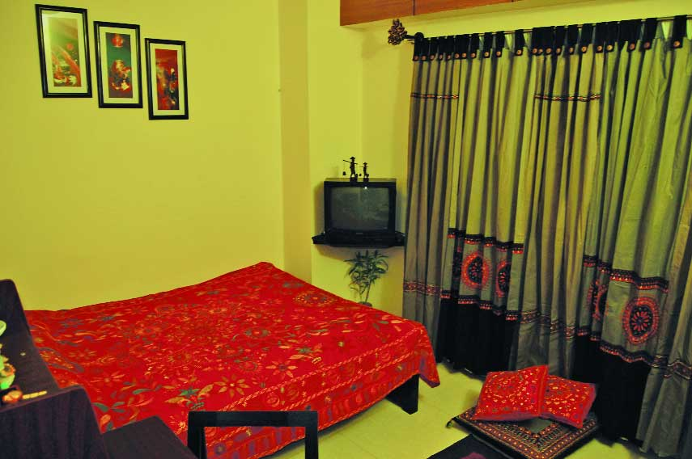
If in the past tense there is word ‘after’ between two clauses, the sentence structure will be-
The clause(Past Indefinite)+after +The clause (Past Perfect).
The children went to their bed after they had finished their study.

Slide 17
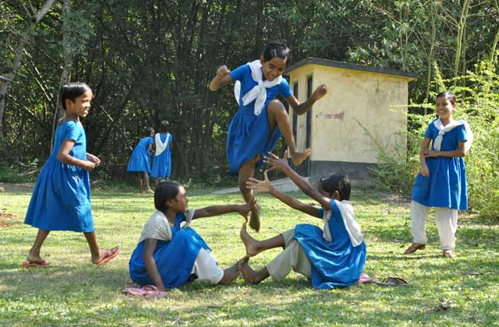
We saw them playing.

Slide 18
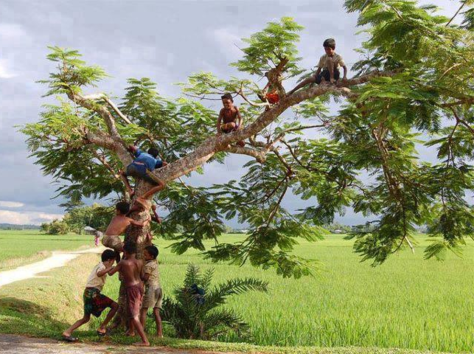
The boys wanted to climb the tree.

Slide 19
If in a simple sentence there are two verbs, one verb will be present participle(verb + ing) or before that verb there will be ‘to’ + verb(base form)
We saw them playing.
The boys wanted to climb the tree.

Slide 20
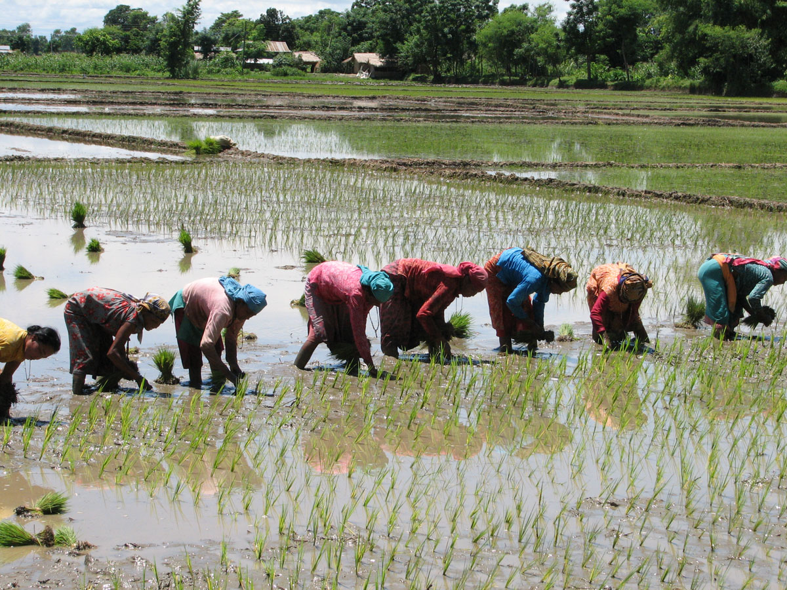
If in the sentence there is It is time/It is high time/I fancy/Would rather that, after the subject of these words verb will be in Past Indefinite form.
It is high time farmers planted paddy.

Slide 21

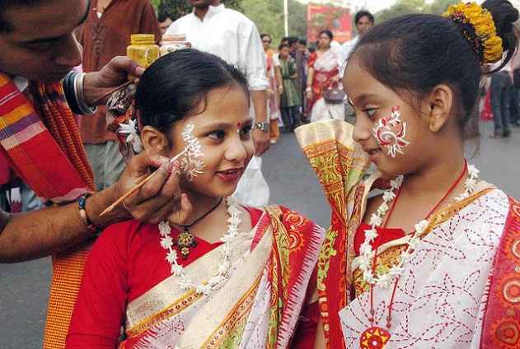

Evaluation
(Pair work)
Write the sentences using right forms of verbs.
is reading
1. She (read) a book now.
enjoyed
2. The girls (enjoy) very much in the last Pahela Boisakh.
took
3. They (take) their tiffin after they (finish) their lesson.
had finished

Slide 22
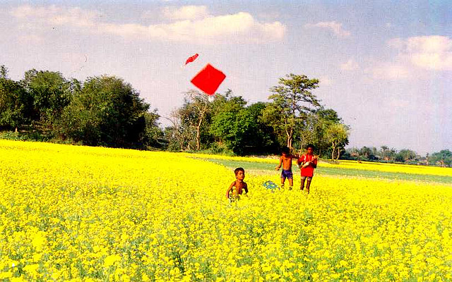
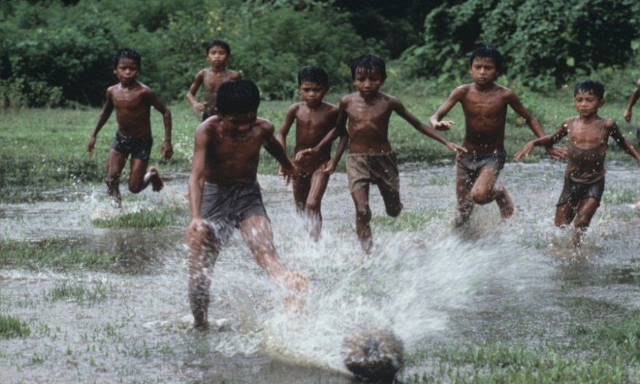
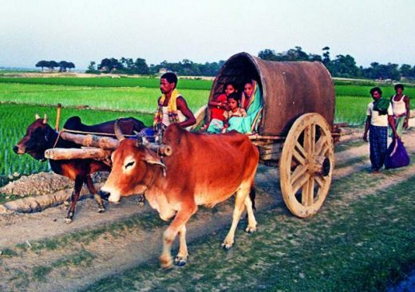
Evaluation
(Pair work)
have been flying
4. The boys (fly) kites since morning.
like
5. Children (like) to play.
6.The woman and her children went home (board) on a cart.
boarding

Slide 23
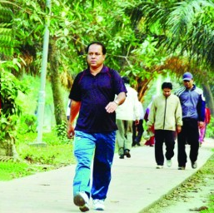

Evaluation
(Group work)
Take verb from the box and fill in the gaps. Use right forms of the verbs.
leave, walk, sleep, take, sit
Mr. Anwar Rahman _____ in the open air every morning. He feels fresh. Today he _________ already a mile. Now he _______
rest _____ on a bench. A dog ____________
for one hour near the bench. It is high time he ____ the place.
walks
has already walked
is taking
sitting
has been sleeping
left

Slide 24
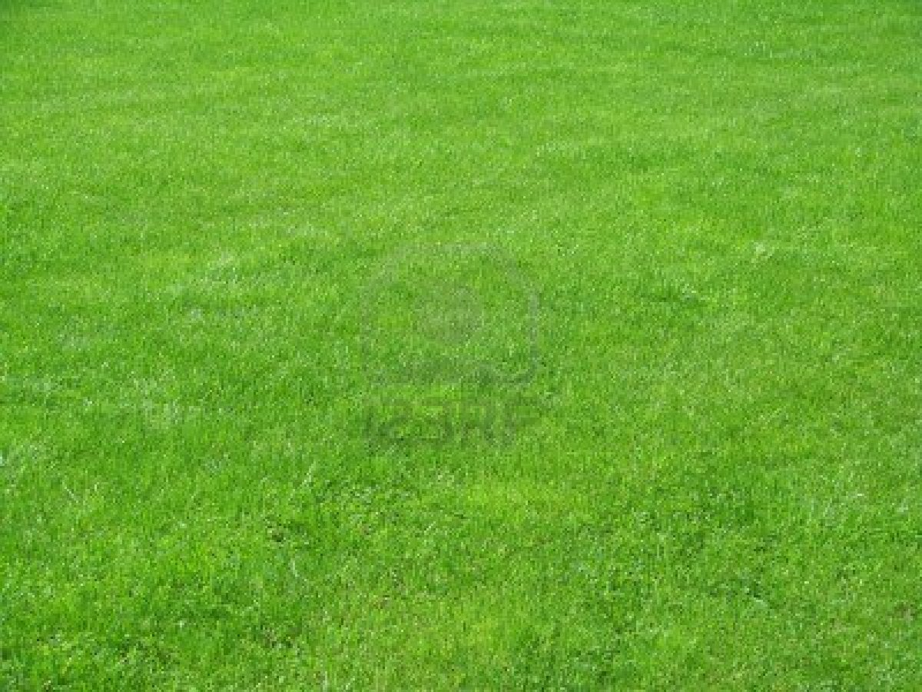
THANK YOU ALL

