Slide 2
Teacher’s introducing.
Mohammad Fayzuzzaman
Assistant Teacher
Lotibpur Govt. Pri: School
Kishoreganj Sador.

Slide 3
Lesson introduction
Class:- One
Unite: 22 ( In the village)
Lesson: 1 (B)
Time: 45 minutes
Date: 17/11/2019.

Slide 4
Learning outcomes:
After end of the lesson students will be able to:
Listening:
1.1.1: become familiar with English sounds by
listening to common English words.
Speaking:
1.1.1: repeat after the teacher simple words and phrases.
1.1.2: say simple words and phrases.

Slide 5
Let’s enjoy a video.

Slide 6
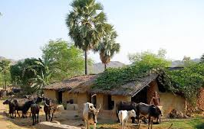
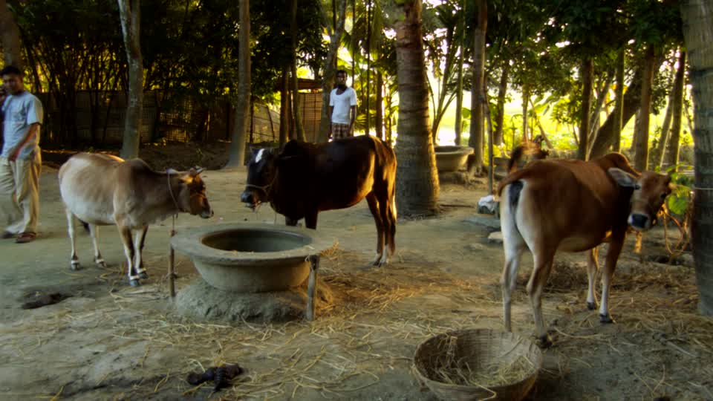
Look at the pictures and
think about these.
The pictures are about a village.

Slide 7
Today’s lesson is
‘In the village’
(cow, tub, tubewell , kitten.)

Slide 8
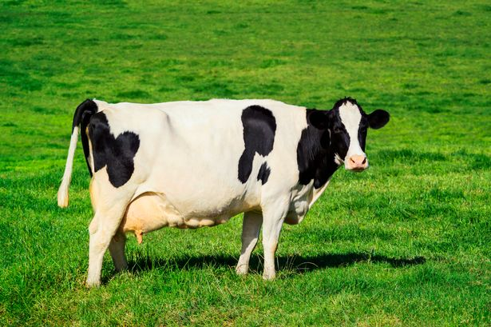
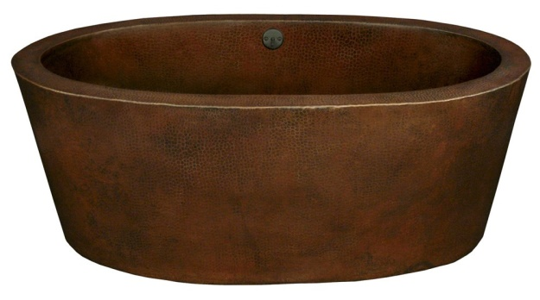
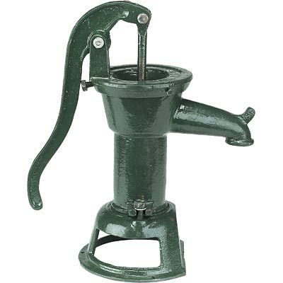
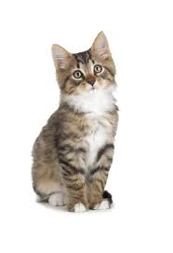
Dear students, at first listen to me attentively.
cow
tub
tubewell.
kitten.

Slide 9
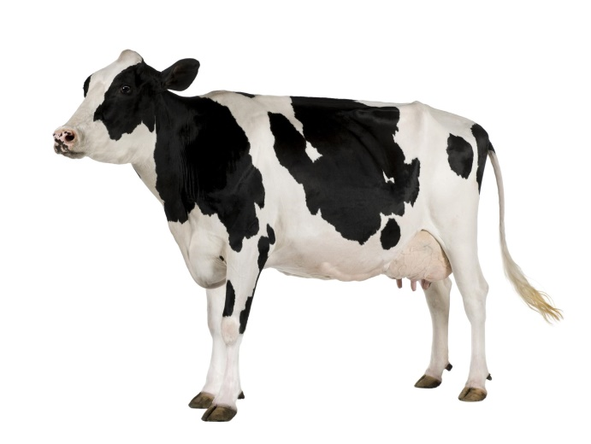
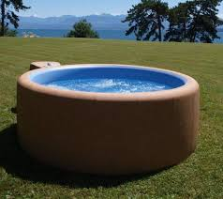
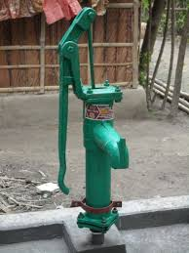
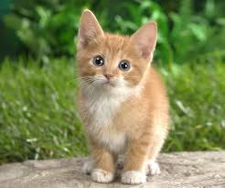
Dear students, say with me correctly.
cow
tub
tubewell.
kitten.

Slide 10
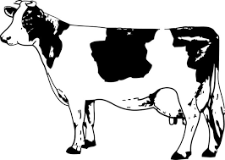
Dear students , what do you see in the picture ?
It is a cow.

Slide 11
Look, listen and say.
What is this ?
It is a Tub

Slide 12
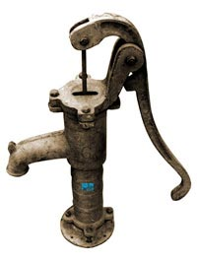
Look at the picture and say.
What is this ?
It is a Tubewell

Slide 13
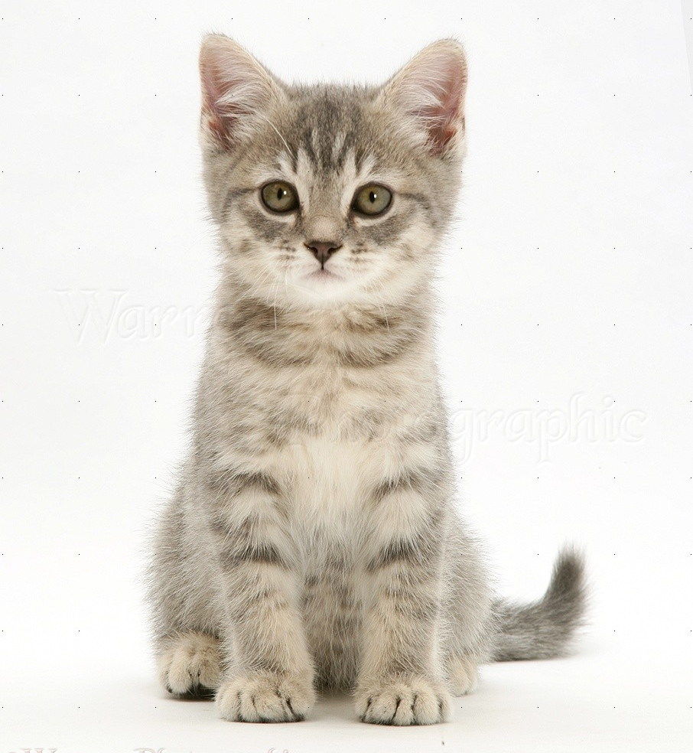
My dear students, say-
What is this ?
It is a kitten

Slide 14
Look at the pictures and say.
Where do you see these?
We see these in the village.

Slide 15
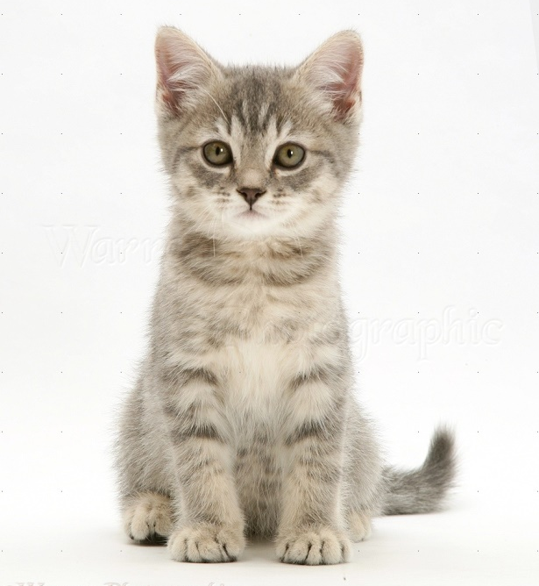
Dear students,
What are these ?
Where do you see these ?
These are Tubewell and kitten.
These are seen in the village.

Slide 16
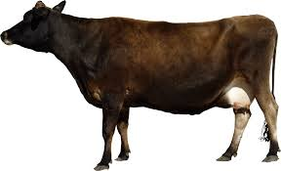
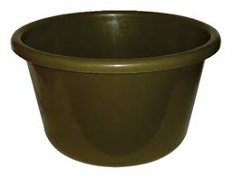
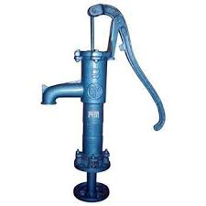
Come in front of the class
and say, what are these ?
cow
tub
tubewell.
kitten.

Slide 17
Everybody repeat after me.
cow
tub
tubewell.
kitten.

Slide 18
My dear students ,
Can you say ? Where do we see the scene ?
we see the scene in the village.

Slide 19
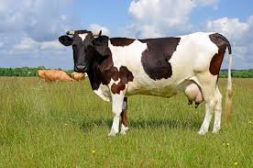
Are these pictures in the village or town?
These pictures are in the village.

Slide 20
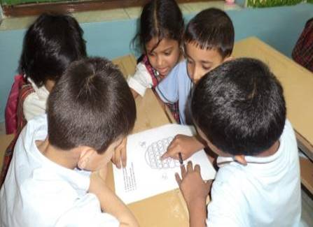
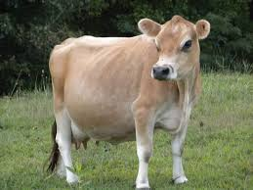
Look at the pictures and say in groups.
What are the names and where do we see the pictures?
It is a cow
It is a tub
This is a tubewell.
This is a kitten.
We see the pictures in the village.

Slide 21
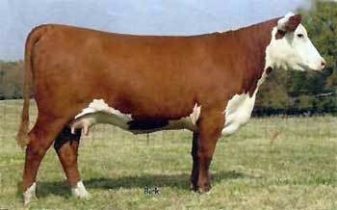
Look at the pictures and say in pairs.
It is a cow
It is a tub
It is a tubewell.

Slide 22
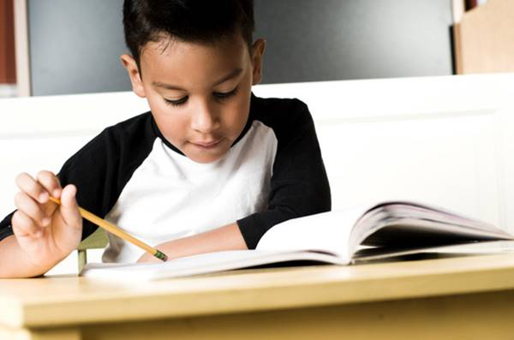
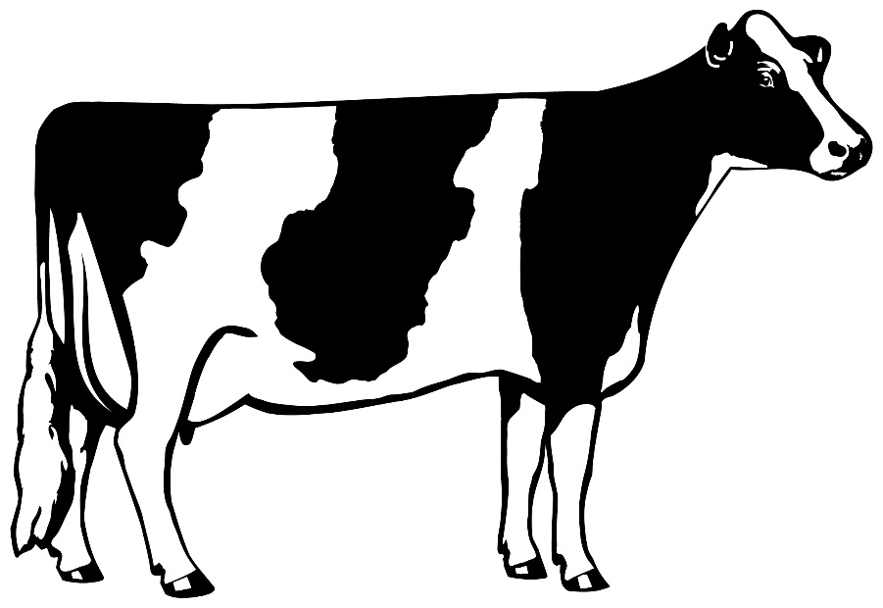
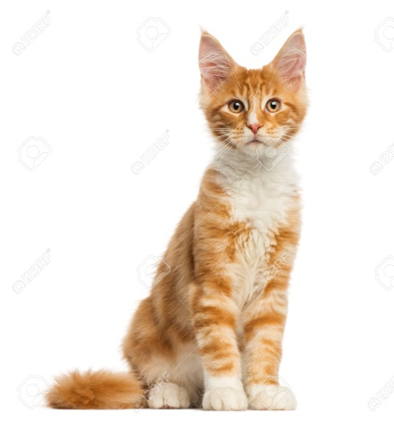
Look at the pictures and say lonely.
It is a cow
It is a kitten.

Slide 23
Evalution ( Oral )
Every students come in front of
and say the words by turns
cow
tub
tubewell.
kitten.

Slide 24
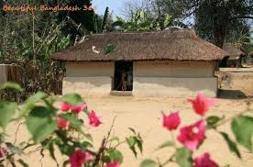
Home task
Everybody will read the today’s
lesson at your own house.

Slide 25
GOOD-BYE,
MY DEAR STUDENTS.

