Slide 1
Welcome

Slide 2
Introduction
Teachers Info
Abul kucher
Assistant Teacher, ICT
Bishowanathpur Salameia
Hossaina Dhakil Madrasha
Class Info
Class : Six
Subject: English 1st Paper
Lesson: ?
Time: 50 minutes

Slide 3
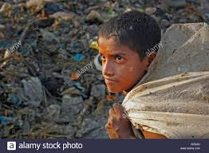
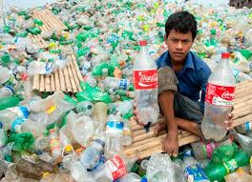
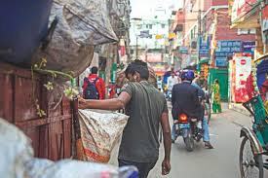
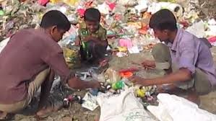
Let’s see some picture
What are you see in this picture?

Slide 4
Let’s see a video
https://www.youtube.com/watch?v=Wrm3XPO2FA8
Have you seen this type of scenery?
Notes:
Elicitation

Slide 5
Lesson Title
Thanks for your work
Notes:
Title of the lesson: Nakshi Kantha

Slide 6
After this lesson, student will be able to :
Talk important of every work.
Understand text by silent reading.
Participate in short dialogues and conversations on familiar topics.
Notes:
Title of the lesson: Nakshi Kantha

Slide 7
Read the passage silently

Slide 8
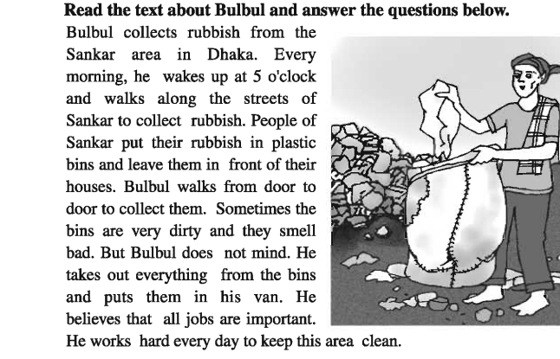
Silent Reading
Notes:
Title of the lesson: Nakshi Kantha

Slide 9
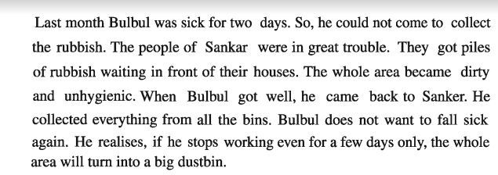
Silent Reading
Notes:
Title of the lesson: Nakshi Kantha

Slide 10
Let’s see the key words of the passage

Slide 11
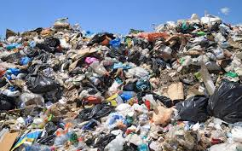
Key Words
Rubbish
Rubbish is a synonym for garbage or trash.
Notes:
Title of the lesson: Nakshi Kantha

Slide 12
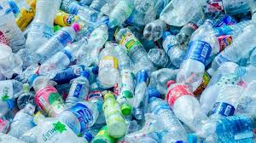
Key Words
Plastic
A plastic is a material that can change its shape.
Notes:
Title of the lesson: Nakshi Kantha

Slide 13
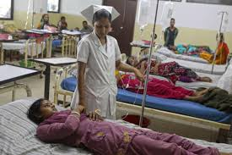
Key Words
sick
affected by physical or mental illness..
Notes:
Title of the lesson: Nakshi Kantha

Slide 14
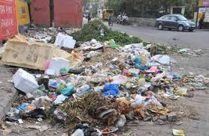
Key Words
unhygienic
not clean or sanitary.
Notes:
Title of the lesson: Nakshi Kantha

Slide 15
Individual Work
Complete the following sentences with the clues given.
their
jobs
dirty
rubbish
importent
two
plastic
1 Bulbul collect ----------------
2 People of Sankar area put ---------- rubbish in ---------bins.-
3 Bulbul belives that all -------- are--------
4 Last month bulbul was sick for ---------- days.
5 The hole area become -------
Notes:
Title of the lesson: Nakshi Kantha

Slide 16
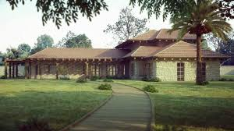
Home Work
Write 5 sentence
“How can you keep yours surroundings clean”.
Notes:
Title of the lesson: Nakshi Kantha

Slide 17
Thank you
Notes:
Title of the lesson: Nakshi Kantha

