Slide 1

Good Morning
Welcome everybody to English class

Slide 2

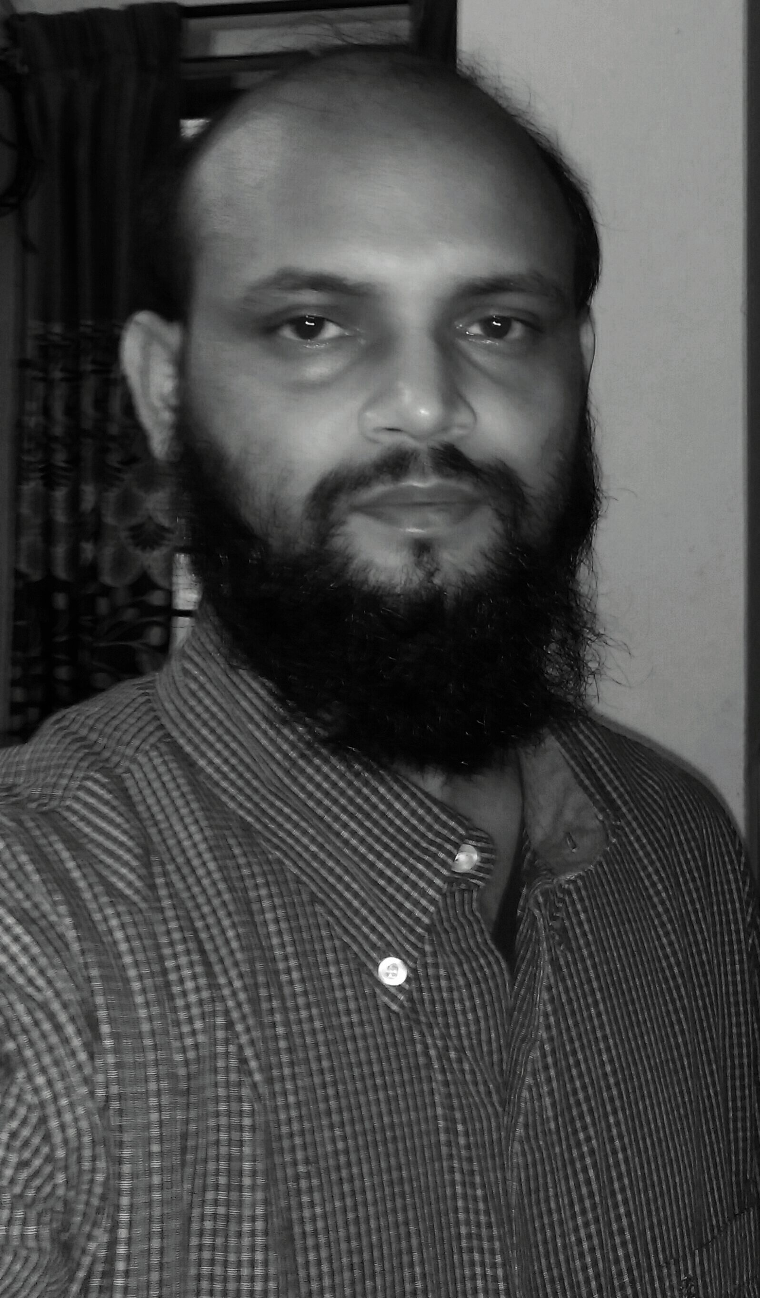
Prepared and presented by
Nurul Aziz
Assistant Teacher (English)
Krishnakumari City Corporation Girls’ High School,
Nandankanan,Chittagong
E-mail : naziz13.na@gmail.com
Skype: naziz392

Slide 3

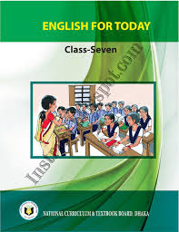
Today’s class
English For Today
Class : 7
Time : 45 Minutes

Slide 4
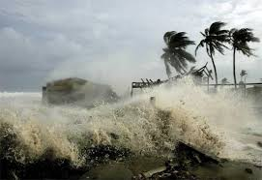
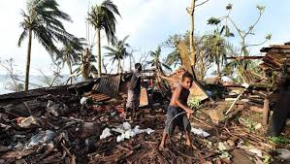
Let’s see the pictures
During a cyclone
After the cyclone

Slide 5
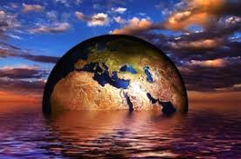
Our today’s lesson is
‘What happens next?’
Unit : 9
Lesson : 4
Page : 103

Slide 6

Objectives of the lesson
After the end of the lesson students will be able to
learn new word meaning
comprehend the text
tell about the harmful effects of climate change
write about the disastrous effects of ecological imbalance
learn role play

Slide 7
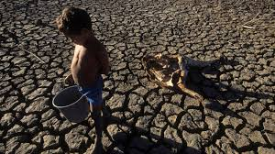
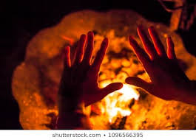
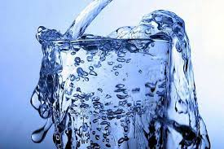
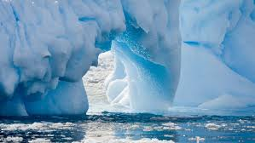
Vocabulary Presentation
extreme
  life-threating
warmth
  heat
overflow
  overspill
melt
liquefy

Slide 8
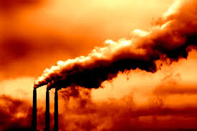
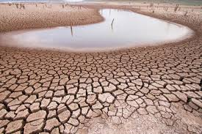
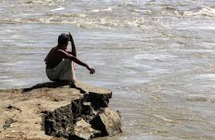
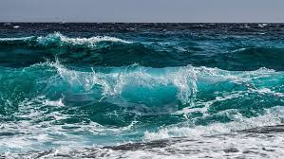
Vocabulary Presentation
emission
  release
drought
Scarcity of water
erosion
  Loss of soil
ocean
  Deep-sea

Slide 9
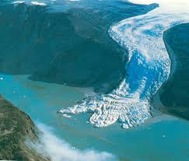
Silent Reading
What happens as a result of global warming? The ice on the Earth’s surface is melting fast due to extreme heat. Oceans and seas are warming too..
Melting earth surface

Slide 10
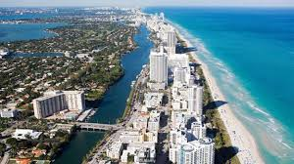
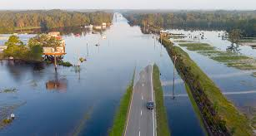
Silent Reading
All the ice that melts will fill up the oceans and seas and they will overflow on land. Thus a huge area of land will go under water.
Overflow of sea water
Land under water

Slide 11
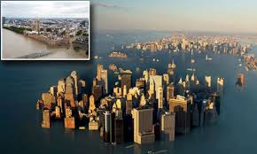
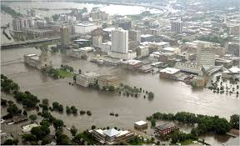
Silent Reading
Even some big cities like London, Kolkata and Bangkok will get flooded…That means thousands of people will lose their houses and land and they will go hungry.
Big cities under water
Flood in big city

Slide 12
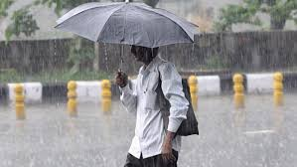
Silent Reading
Moreover, as the earth’s climate warms up, the weather gets more violent. Storms and cyclones will become more powerful. More areas will get drier and turn into deserts. There will be heavier rains too. So there will be more floods and river erosions.
Violent storms
Heavy rains

Slide 13
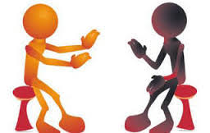
Pair work
Look at the list of the outcomes (results or effects) of global warming. First rank the outcomes according to their seriousness and tell your partner which of the following may affect your life most.
  Polar bears and penguins will disappear.
  Winters will be 10 degrees colder.
  Africa will become hotter and have more droughts.
  Cyclones and hurricanes will become more powerful.
  Diseases like skin cancers will increase.
  Many countries will have no drinking water.
  Countries such as the Maldives, Holland and Bangladesh will disappear under water.
  Wars will start between countries fighting over water.

Slide 14
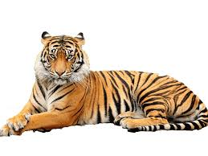
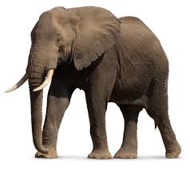
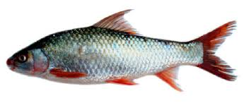
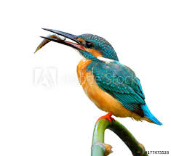
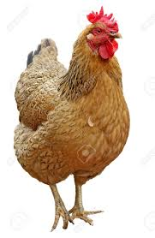
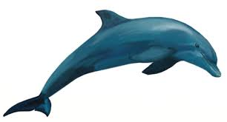
Group Work
If the world becomes warmer, many species of birds and animals will disappear or become extinct. How would your life change if these creatures disappear? Write five sentences in your own words

Slide 15
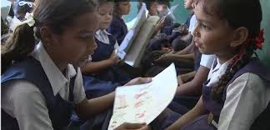
Role Play
Partner A plays the role of a person who loves Earth and Partner B plays the role of a car company dealer. First, read the role cards for both A and B. When you are ready, play the roles.

Slide 16
Evaluation
Choose the correct answer from the alternatives.
What is the synonym of the word ‘extreme’?
Mild (ii) excessive (iii) moderate (iv) great
(b) Storms and cyclones are becoming-----.
Weak (ii) fragile (iii) stronger (iv) faint
(c) The ice on the Earth’s surface is melting fast due to-----.
(i) Extreme heat (ii) less rainfall (iii) heavy rain (iv) storm and cyclones
(d) More areas will turn into----
Wetland (ii) ocean (iii) hill (iv) desert
(e) The word ‘erosion’ means -----
Destruction (ii) compassion (iii) community (iv) emission
Answer : (a) excessive , (b) stronger (c) extreme heat (d) desert (e) destruction

Slide 17
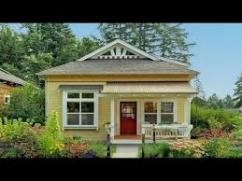
Home Work
Write a paragraph on ‘Climate change’ .

Slide 18


Thank you all for today..

