Slide 1

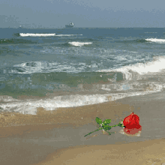
Welcome

Slide 2
Lesson Identity:
Objectives:
Presented by:
Students will be able to…
Zobeda Israt
Azhar Uddin Government Primary School.
Hatiya, Noakhali.
1.1.1become familiar with English sounds by listening to common English words
Class-Two
Subject: English
1.1.2 say simple words and phrases with proper sounds and stress
2.1.1 recognize and read cardinal numbers up to 8-10

Slide 3



What can you see in the picture?
How many apples?
How many fishes ?
How many eggs?

Slide 4
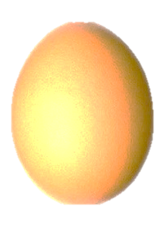


Look and say
8
9
10

Slide 5



Today our lesson is
Numbers
Lesson- 1 -3
Page- 12

Slide 6

Look and say
8
9
10
eight
nine
ten

Slide 7

Look, listen and say:
8
eight

Slide 8

Look, listen and say:
9
nine

Slide 9

Look, listen and say:
10
ten

Slide 10

How many flowers?
9
8
10
eight

Slide 11
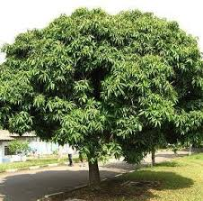

How many mangos?
10
9
8
nine

Slide 12

How many children?
9
10
8
ten

Slide 13


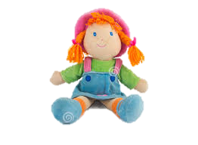
Look, listen and say:
Picture
Figure
Word
8
eight
9
nine
10
ten

Slide 14
nine
Say, trace and write.
8
9
10
ten
eight

Slide 15
Match the numbers with words:
P.W
Time: 5 minutes
Number
Word
9
ten
8
nine
10
eight

Slide 16

Write the missing numbers by using pictures:
I.W
Time: 5 minutes
7
8
10
seven
eight
ten

Slide 17














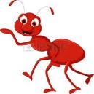
Checking learning
W.C.W
Count and write the numbers:
8
10
9

Slide 18

Thank you

