Slide 1



Slide 2
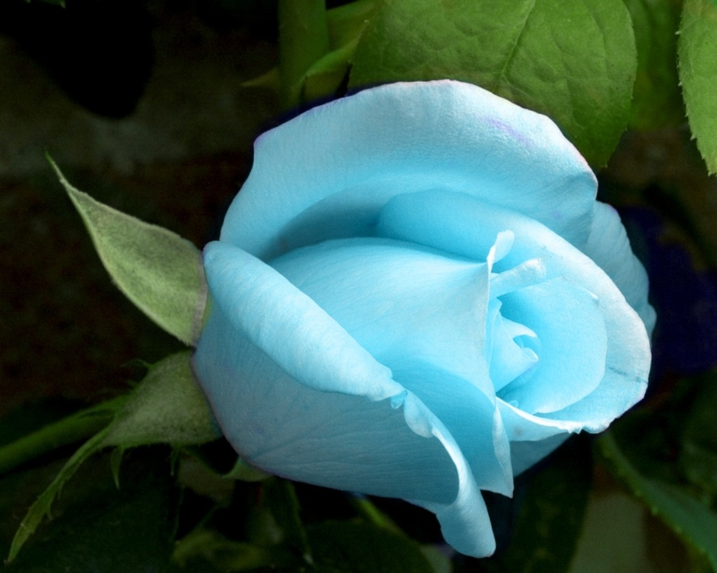
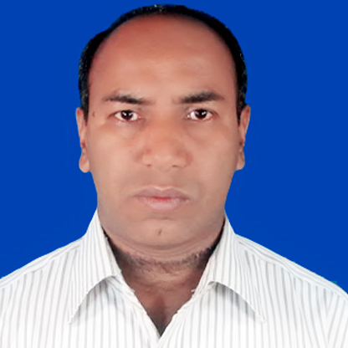
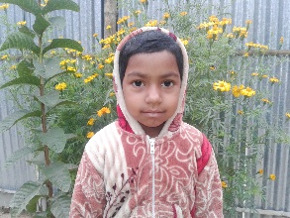
Welcome to my presentation
Sub: English
2nd Paper
Class VIII
Presented by-
Md. Alamgir Hossain
Asstt. Teacher (Computer)
Rahimapur Fazil madrasah
patnitala, Naogaon

Slide 3
So our today’s topic is -
Adverb

Slide 4
By the end of the lesson the learners will be able-
define adverb and its classification
formation of adverb

Slide 5
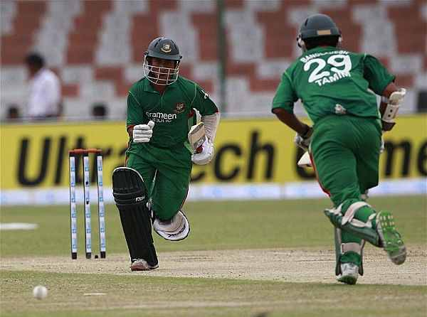
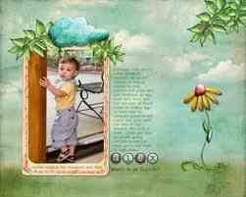
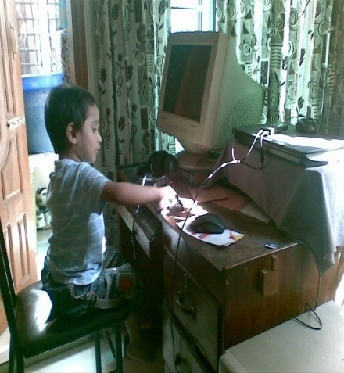
The batsman runs
fast
The baby peeps
outside
early
The child learns computer his at age

Slide 6
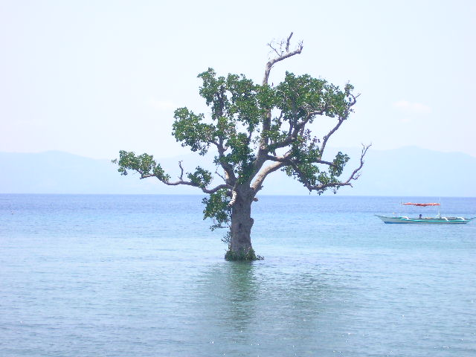
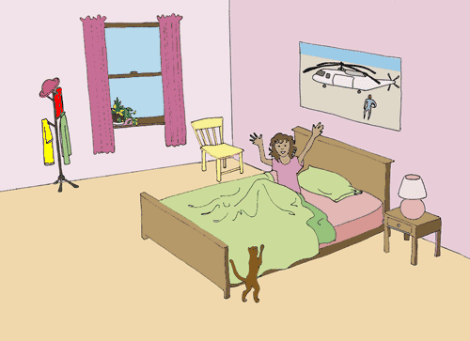
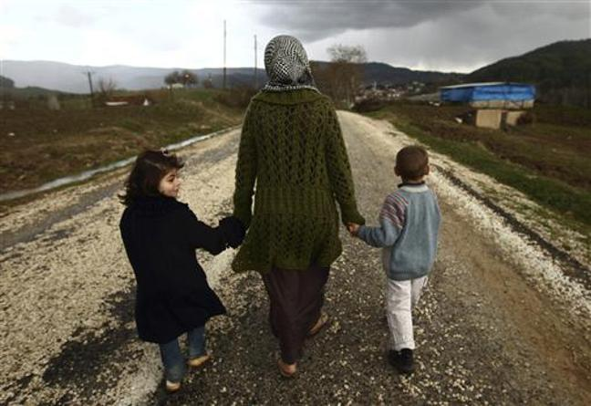
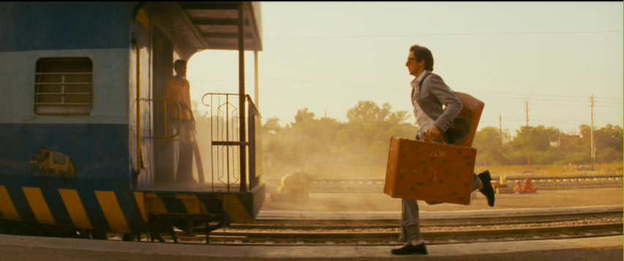


The girl wakes up in the morning
early
They walk
Very Slowly
The man is running to catch the train
quickly
just
The bird flew over my head
The scenery is nice
very

Slide 7
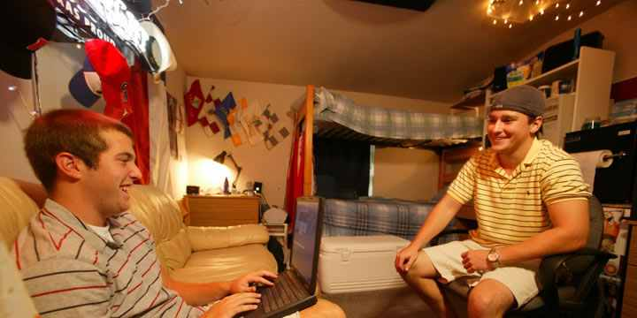
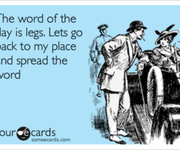
He as well as his friend are gossiping
only
Fie ! you are a liar.
Upon

Slide 8
Press the button now.
Here underlined words
are various types of adverbs
I have never been gone
Daisies grow everywhere
I found the film incredibly dull
I often have eggs for breakfast.
That is the farthest I have ever jumped
The heavily blue light shone on the water
The meeting went well, and the directors were extremely happy with the outcome!

Slide 9
Classification of Adverbs
Adverb of Time
There are several kinds of adverbs
Adverb of Place
Adverb of Manner
Adverb of Degree
Adverb of Affirmation or Negation

Slide 10

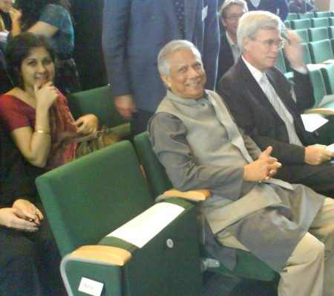
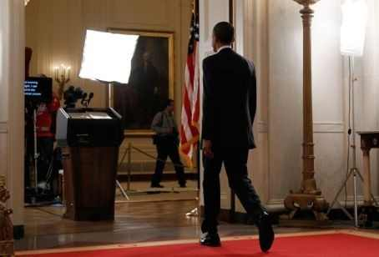
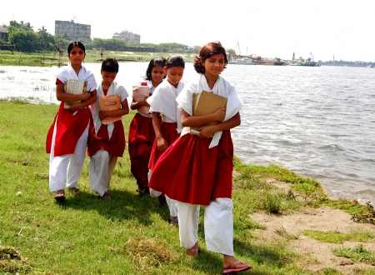
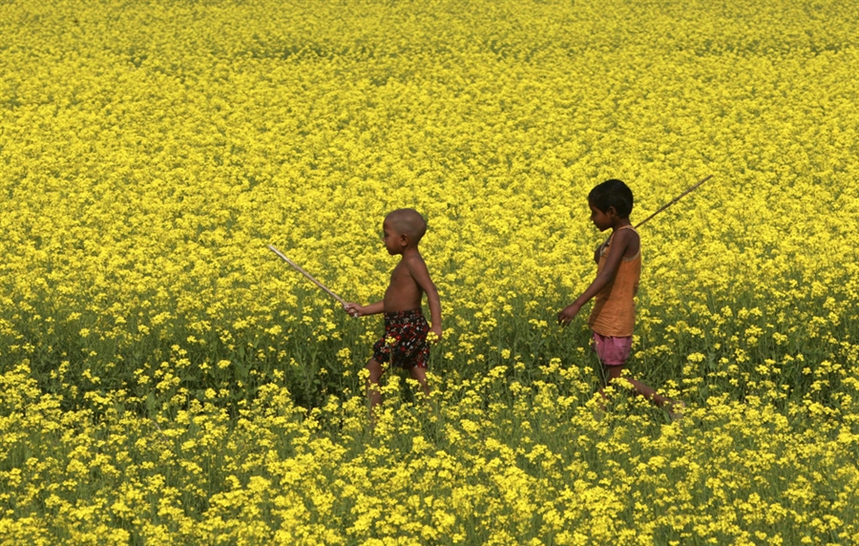
Adverb of Affirmation
Adverb of Place
Adverb of Degree
Adverb of Time
Adverb of Manner
The children are walking early in the morning
Walking slowly is definitely an obstacle to their timely arrival
Truly, she needs a job
Dr. Younus stayed inside the hall room
The President barely arrived on time.

Slide 11
Now I am going to discuss
Formation of Adverbs

Slide 12
Formation of Adverbs
Their teacher speaks quick
ly
y
He threw away the glass angr
ly
The magician show the magic scientific
i
Wind blows gentl
e
y
ically

Slide 13
1. If the adjective ends in -y, replace the -y with -ily.
Adjective | Adverb
happy | happily
angry | angrily
lucky | luckily

Slide 14
2. If the adjective ends in -able, -ible, or -le, replace the -e with -y.
Adjective | Adverb
probable | probably
gentle | gently
humble | humbly

Slide 15
3. If the adjective ends in -ic, add -ally.
Adjective | Adverb
basic | basically
economic | economically

Slide 16
Fill in the gaps with suitable adverbs from the list
Evaluation
quickly
Slowly
smoothly
always
Very quickly
The kid was walking ……………
At first the bird was flying ……………
After a few seconds it began to fly …………
Finally the bird was flying ……………
It …………… flies in search of food

Slide 17

Fill in the gaps with suitable adverbs from the list
Evaluation
always
quickly
smoothly
slowly
very quickly
The kid was walking ……………
At first, the bird was flying ……………
After a few seconds it began to fly …………
Finally the bird was flying ……………
It …………… flies in search of food

Slide 18
Home Work
Write the classification of adverbs and its examples

Slide 19

আল্লহ্ হাফেজ

