Slide 1


Welcome

Slide 2
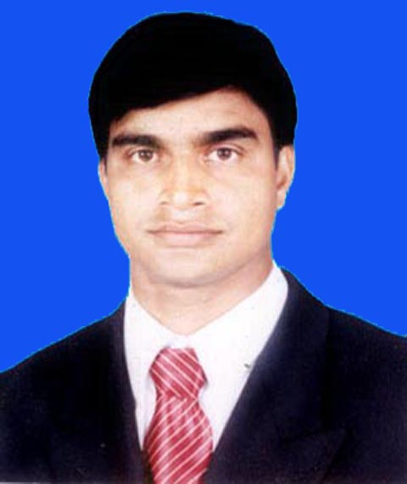
Teacher’s Introduction
Md. Soriful Islam
Assistant Teacher
Chowrapara fazil madrasha
Niamatpur, Naogaon.

Slide 3
Lesson Introduction
Class- Six
Subject: English 2nd paper
Time: 5o minute
Date:2/11/2019

Slide 4
Learning outcome:----
Students will be able to
1. learn the definition of the parts of speech .
2.the classification of parts of speech.
3. how to fill up the gap by parts of speech.

Slide 5
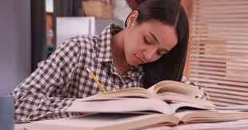

Look at the picture.
Mina writes a note.
She reads a book.
Ques: What do you think about colourful wods?

Slide 6
Todays our topice:
Parts of speech

Slide 7
Noun
Pronoun
Adjective
Verb
Adverb
Priposition
Conjuntion
Interjection
Classifications of Part of speech
Parts of speech

Slide 8

Look at the picture.
Rina warks the computer.
Mina reads a book.
Rina,Mina
Noun
A Noun is a naming word

Slide 9


Look at the picture.
He reads a book.
She reads a book.
He, She
Pronoun
A pronoun is a word Used instead of a noun

Slide 10
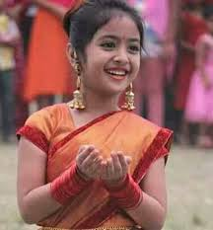
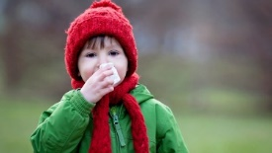
Look at the picture.
Rima is a good girl
Roni is very claver
Good, claver
Adjective
The word Adjective means adding.

Slide 11

Look at the picture.
Mina reads a book.
Rina goses to madrasha.
Reads, goses
Verb
A verb is a word used for saying something about a person or thing.

Slide 12
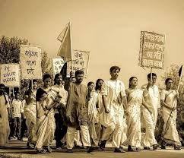
Look at the picture.
They walk slowly
She is a very beautiful girl.
Slowly, very
Adverb
An Adverb qualifies anything except a Noun or Pronoun

Slide 13

Look at the picture.
Mina writes a letter to her brither
Rana reads with her sister.
To, with
Preposition
A Preposition is a word placed before a noun or pronoun.

Slide 14
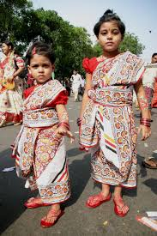
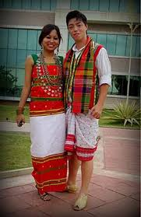
Look at the picture.
Sila and Shilpy are sister
Dlip is a boy but diba is a girl.
And, but
Conjunction
A Conjunction is a word used to join words or sentense

Slide 15

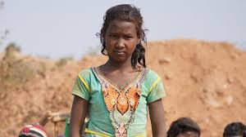
Look at the picture.
Oh! What a nice view
Hurrah! Today is holiday.
Oh , Hurrah
Interjection
An Interjection is a word which expresses some sudden feeling.

Slide 16
Individual work
What kind of parts of speech?
Solution:
Noun
Pronoun
Adjective
Verb
Adverb
Priposition
Conjuntion
Interjection

Slide 17
Group work:
Questions: Find out the Nouns, Pronouns, Verbs, Adjectives, and from the sentences:
Tendulkar is a famous player of India.
The goat gives us nutritious milk .
They walk slowly.

Slide 18
Solution:
Nouns: Tendulkar, player, India, goat, milk,
Pronouns : us, they.
Verbs: is, gives, walk.
Adjectives: famous. Nutrious.

Slide 19
Evaluation:
1.What is parts of speech?

Slide 20
Home work:
1. Give the definition all kind of parts of speech with examples.

Slide 21
THANK YOU

