Slide 1
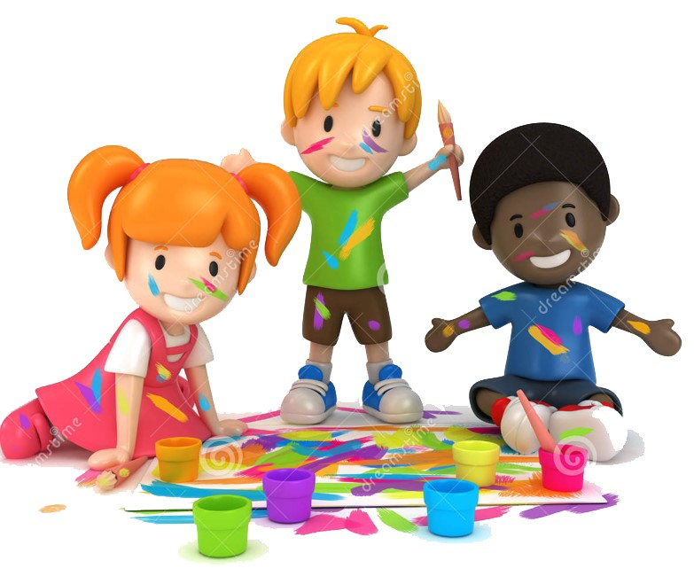


Slide 2
MD. KOWSER ALI
ASISSTANT TEACHER
DURLOVPUR GOVT. PRIMARY SCHOOL
HORINAKUNDU, JHENIDAH.
kowser.gps@gmail.com
Sub: English
Class: Two
Lesson : Colors
Parts of the lesson: Activity-C
Page No-34

Slide 3

Safety environment by greetings song.
Hello! Hello! How are you?
I’m well, I’m good.
I’m great, I’m wonderful.
Hello! Hello! How are you?
I’m fine! I’m great today.

Slide 4
Checking homework and justify the previous lesson.

Slide 5
Our today’s lesson is too--
Colors-Unite-17
Activity-C

Slide 6
LEARNING OUTCOMES
By end of the lesson students will be able to-------
Speaking: 1.1.2 say simple words and phrases with proper sounds and
stress.
Reading: 1.4.1 read words and phrases with the help visual clues and simple
sentences.

Slide 7

What is this?
rainbow
Let’s practice drawing the rainbow on the board.

Slide 8
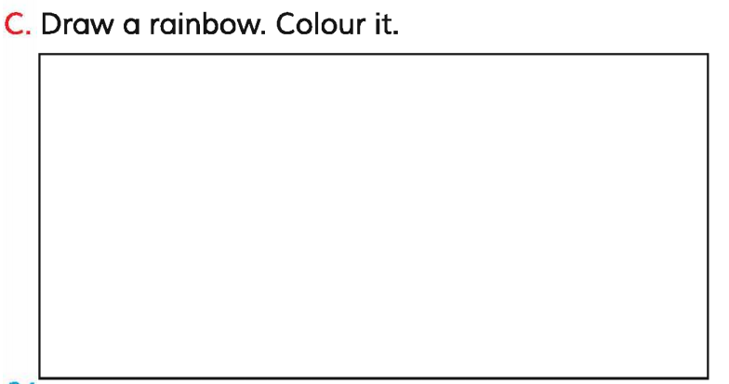
Open your English book at page-34 and see the Activity-C.
Best drawer will gate a prize.

Slide 9
Read and say.
violet
orange
red
yellow
indigo
blue
green
orange
indigo
violet
violet
orange
red
yellow
indigo
blue
green
orange
indigo
violet
Identifying weak students and taking to cure.

Slide 10

One day one word
Do you understand the picture?
round
গোলাকার
Spell out the word - SGW

Slide 11
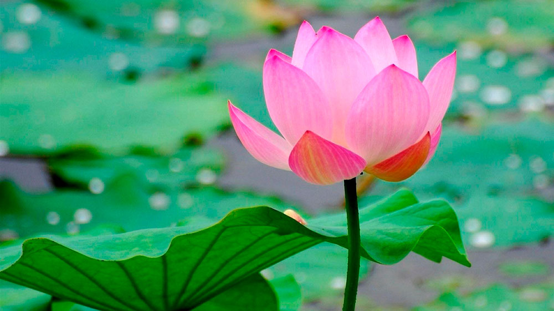
Find out the letters that are made by the word-------.
r
w
o
c
u
e
n
t
d
p
Find out the correct word--------.
roond
rsund
round
rounde

Slide 12
Say the missing letter.
rou--d
r--und
--ound
ro--nd
roun--
Write the word to your notebook.
Date-
/ /20
round
রাউন্ড
গোলাকার

Slide 13
Home work
Page 30 will be well read and written.

Slide 14

That’s all for today. Goodbye. See you tomorrow.

