Slide 1
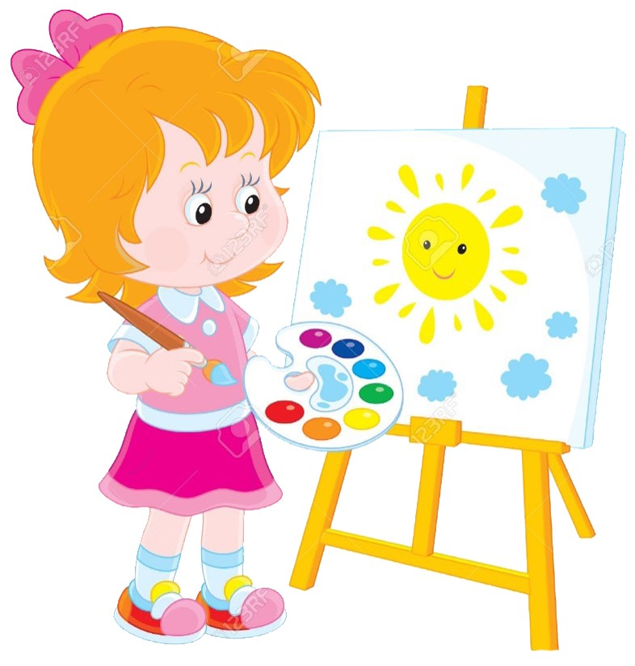


Slide 2
MD. KOWSER ALI
ASISSTANT TEACHER
DURLOVPUR GOVT. PRIMARY SCHOOL
HORINAKUNDU, JHENIDAH.
kowser.gps@gmail.com
Sub: English
Class: Two
Lesson : Colors
Parts of the lesson: Activity-B
Page No-34

Slide 3

Safety environment by greetings song.
Hello! Hello! How are you?
I’m well, I’m good.
I’m great, I’m wonderful.
Hello! Hello! How are you?
I’m fine! I’m great today.

Slide 4
Checking homework and justify the previous lesson.

Slide 5
Our today’s lesson is too--
Colors-Unite-17
Activity-B

Slide 6
LEARNING OUTCOMES
By end of the lesson students will be able to-------
Reading: 1.4.1 read words and phrases with the help visual clues and simple
sentences.

Slide 7
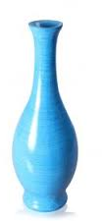
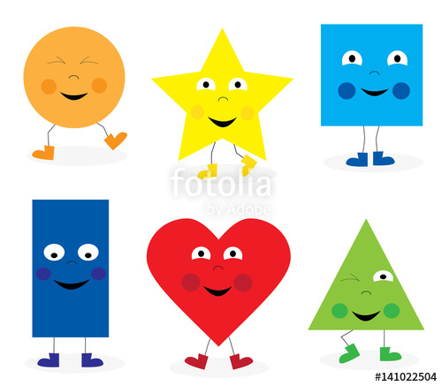
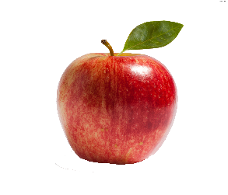
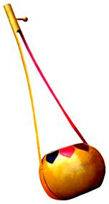
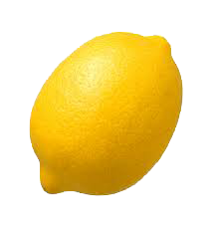
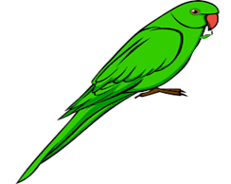

What color is it?
blue
red
indigo
green
yellow
orange
violet

Slide 8
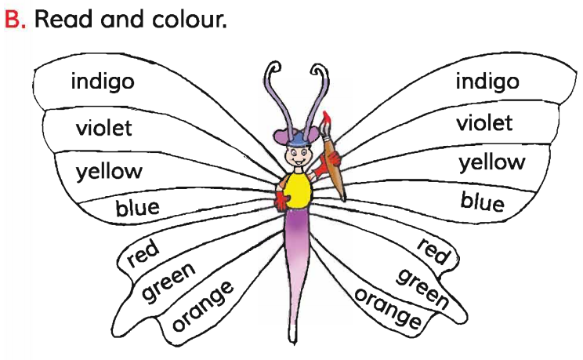
Open your English book at page-34 and see the activity-B.
Read and color.
Exchange your book and check the text of other.

Slide 9
What color is it?
Jannat
Sadia
Pushpo
Nirzon
Mahim
Promika
Sumya

Slide 10
Read and say.
violet
orange
red
yellow
indigo
blue
green
orange
indigo
violet
violet
orange
red
yellow
indigo
blue
green
orange
indigo
violet
Identifying weak students and taking to cure.

Slide 11
One day one word
What is this?
?
question
প্রশ্ন
Spell out the word - SGW

Slide 12
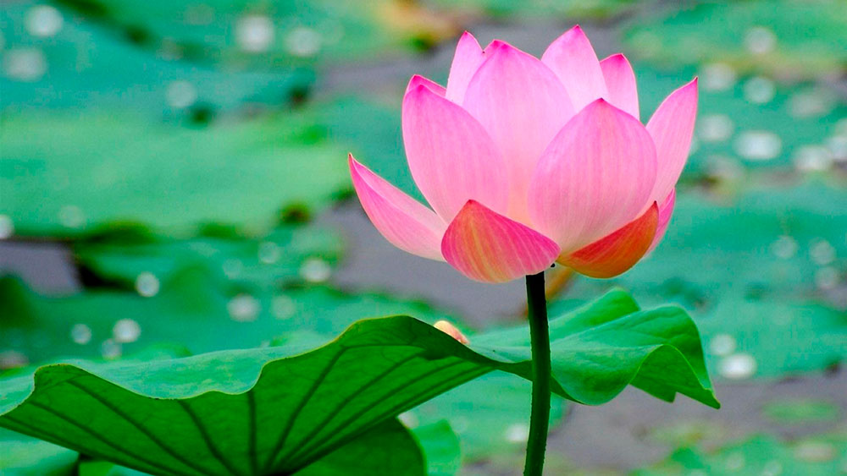
Find out the letters that are made by the word----------.
q
u
w
i
s
a
n
e
k
t
j
n
o
Find out the word-------.
qesetion
question
questoin
qeustion

Slide 13
Say the missing letter.
q--estion
que--tion
quest--on
qu--stion
Write the word to your notebook.
Date-
/ /20
question
কুসসিন
প্রশ্ন

Slide 14
Home work
Page 29 will be well read and written.

Slide 15

That’s all for today. Goodbye. See you tomorrow.

