Slide 1
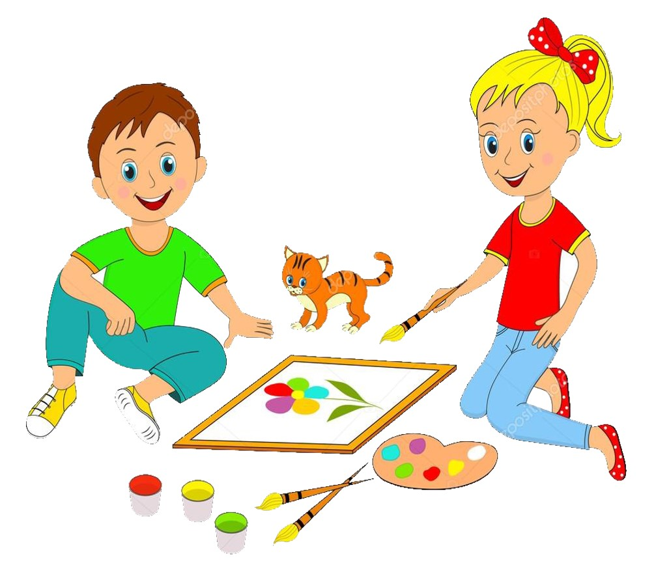


Slide 2
MD. KOWSER ALI
ASISSTANT TEACHER
DURLOVPUR GOVT. PRIMARY SCHOOL
HORINAKUNDU, JHENIDAH.
kowser.gps@gmail.com
Sub: English
Class: Two
Lesson : Colors
Parts of the lesson: Activity-A
Page No-34

Slide 3
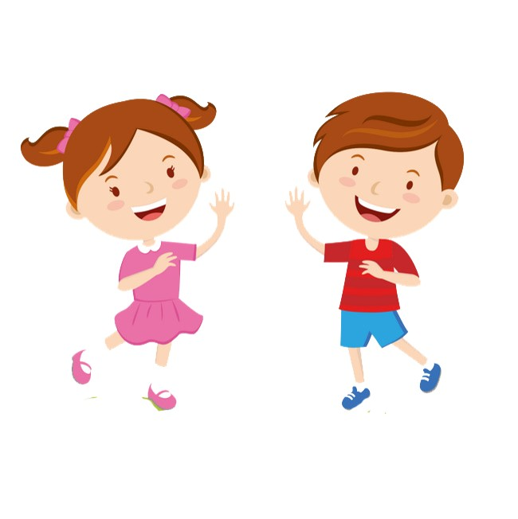
Safety environment by greetings song.
Hello! Hello! How are you?
I’m well, I’m good.
I’m great, I’m wonderful.
Hello! Hello! How are you?
I’m fine! I’m great today.

Slide 4
Checking homework and justify the previous lesson.
Recite the rhyme we learned the previous class. WCW

Slide 5
Our today’s lesson is--
Colors-Unite-17
Activity-A

Slide 6
LEARNING OUTCOMES
By end of the lesson students will be able to-------
Listening: 3.1.2 understand simple questions and statements about familiar
objects.
4.1.1 enjoy the rhyme and music of simple rhymes.
Speaking: 1.1.2 say simple words and phrases with proper sounds and stress.
4.1.1 repeat rhymes after the teacher.

Slide 7
Say name of the colors you learned the previous class.
red
orange
yellow
green
blue
indigo
violet

Slide 8
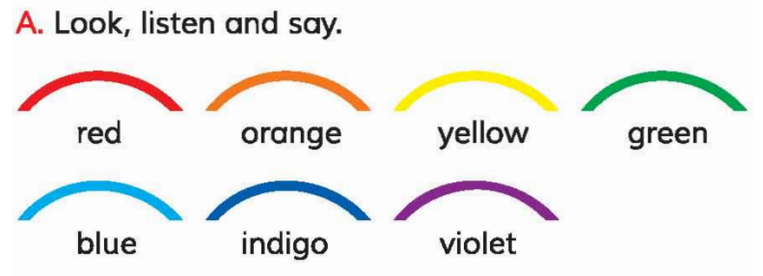
Open your English book at page-34 and see the activity-A.
Look listen and say.
red
orange
yellow
green
blue
indigo
violet
Spell out the words. (SGW)

Slide 9
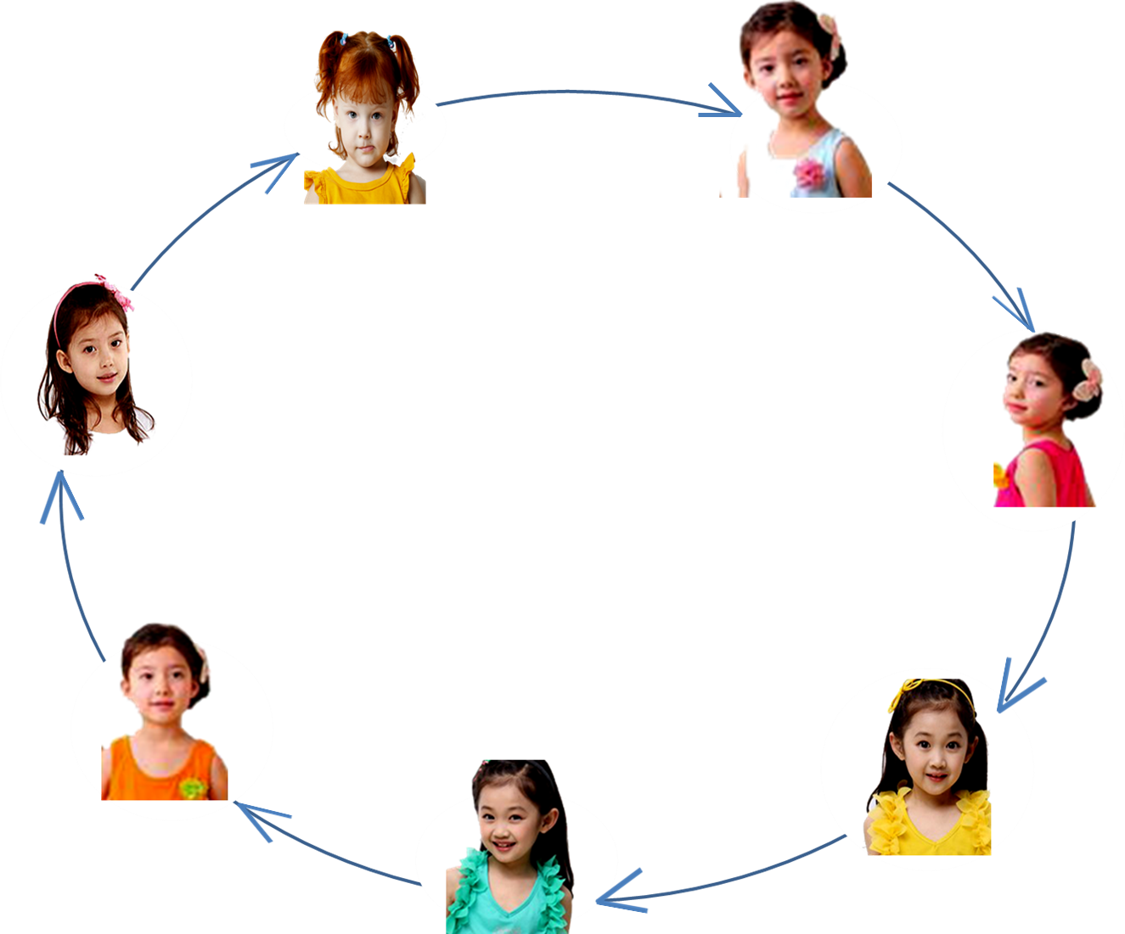
playing game.
red
orange
violet
yellow
indigo
green
blue
Notes:
Show up in reality

Slide 10
Read and say.
violet
orange
red
yellow
indigo
blue
green
orange
indigo
violet
violet
orange
red
yellow
indigo
blue
green
orange
indigo
violet
Identifying weak students and taking to cure.

Slide 11
One day one word
Read and say
part
অংশ
Spell out the word - SGW

Slide 12
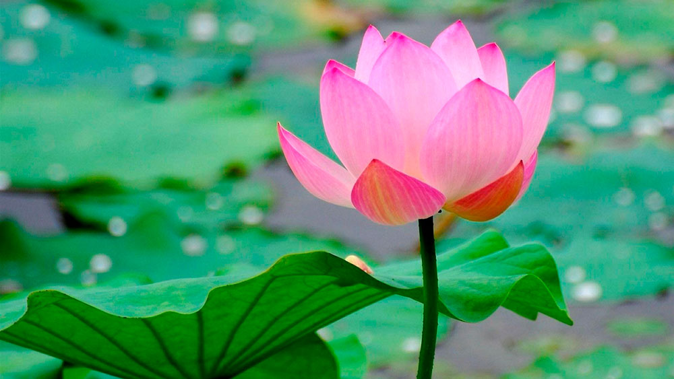
Find out the letters that are made by the word------.
h
a
p
a
r
x
p
k
n
t
Find out the correct word------.
parte
part
parrt
perte

Slide 13
Say the missing letter.
pa--t
--art
par--
p--rt
Write the word to your notebook.
Date-
/ /20
part
পার্ট
অংশ

Slide 14
Home work
Page 27 will be well read and written.

Slide 15

That’s all for today. Goodbye. See you tomorrow.

