Slide 1
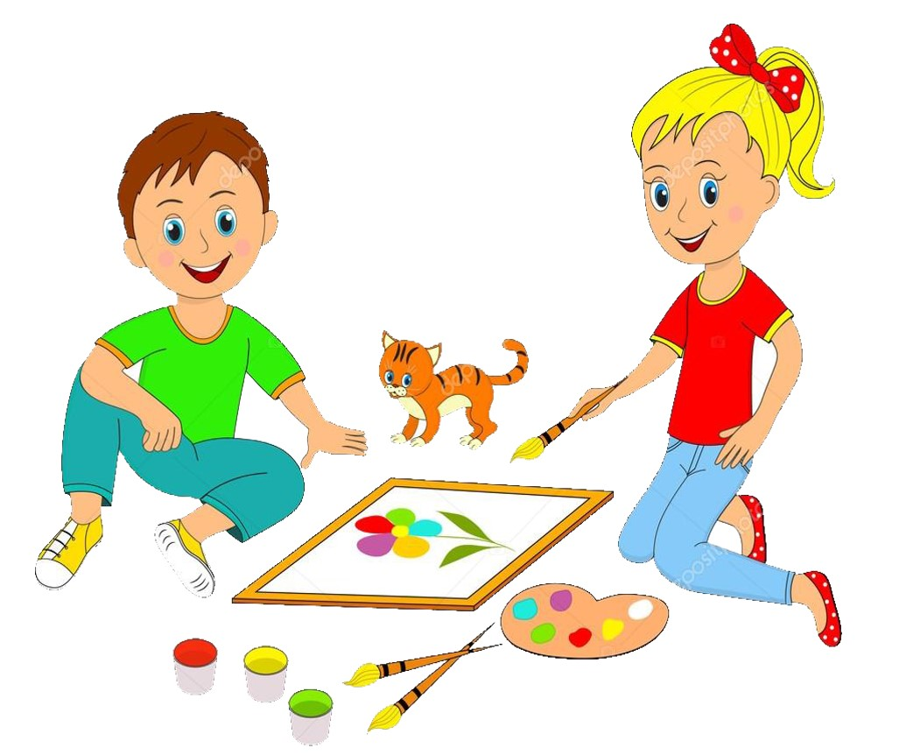


Slide 2
MD. KOWSER ALI
ASISSTANT TEACHER
DURLOVPUR GOVT. PRIMARY SCHOOL
HORINAKUNDU, JHENIDAH.
kowser.gps@gmail.com
Sub: English
Class: Two
Lesson : Colors an numbers
Parts of the lesson: Activity-C
Page No-35

Slide 3
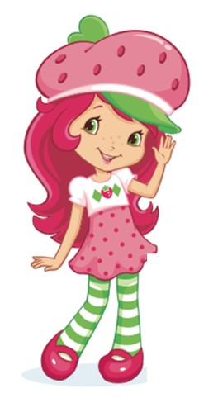
Safety environment by greetings song.
Hello! Hello! How are you?
I’m well, I’m good.
I’m great, I’m wonderful.
Hello! Hello! How are you?
I’m fine! I’m great today.

Slide 4
Checking homework and justify the previous lesson.

Slide 5
Our today’s lesson is too--
Colors and numbers
Activity-C

Slide 6
LEARNING OUTCOMES
By end of the lesson students will be able to-------
Listening: 1.1.1 become familiar with English sounds by listening to
common English words
Speaking: 1.1.2 say simple words and phrases with proper sounds and stress.
Reading: 1.4.1 read words and phrases with the help visual clues and simple
sentences.
2.1.1 recognize and read cardinal numbers up to 30.
Writing: 3.1.1 write words and phrases using nun-cursive capital letters.
3.1.2 write words and phrases using nun-cursive small letters.

Slide 7
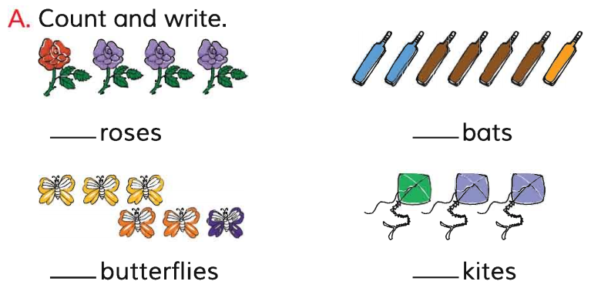
Look, listen and say.
red
One rose is -----.
violet
Three roses are --------.

Slide 8
What is this?
yellow
Spell out the word.
Teacher write the word on the board using dot.
Student come to the board and trace the word.

Slide 9
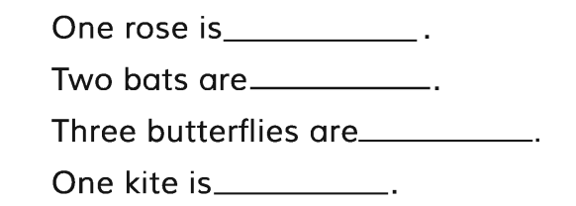
Open your English book at page-35 and see the Activity-C.
Look at the pictures in Activity A.
Trace and write.
yellow
blue
green
red
red
blue
SGW
yellow
green
Match your answers.

Slide 10
IW
Read, say and write.
4 roses are violet.
7 bats are brown.
1 butterfly is indigo.
3 kites are violet.
2 bats are blue.
1 balls is yellow.
Identifying weak students and taking to cure.

Slide 11
One day one word
Read and say.
our
আমাদের
Spell out the word - SGW

Slide 12
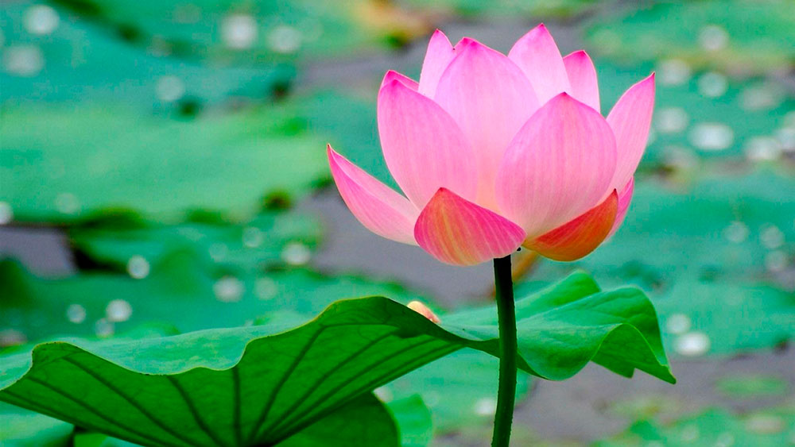
Find out the letters that are made by the word-------.
o
d
c
u
s
r
h
k
Find out the correct word-------.
oure
aure
aur
our

Slide 13
Say the missing letter.
ou-
o-r
-ur
Write the word to your notebook.
Date-
/ /20
our
আওয়ার
আমাদের

Slide 14
Home work
Page 26 will be well read and written.

Slide 15

That’s all for today. Goodbye. See you tomorrow.

