Slide 1
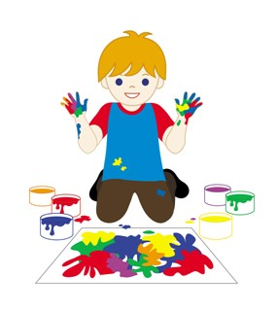


Slide 2
MD. KOWSER ALI
ASISSTANT TEACHER
DURLOVPUR GOVT. PRIMARY SCHOOL
HORINAKUNDU, JHENIDAH.
kowser.gps@gmail.com
Sub: English
Class: Two
Lesson : Colors an numbers
Parts of the lesson: Activity-B
Page No-35

Slide 3
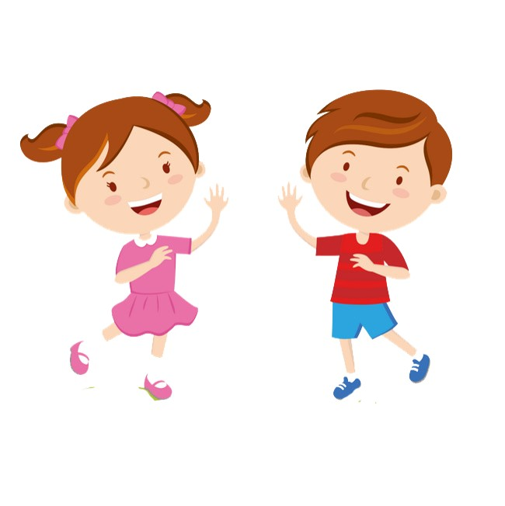
Safety environment by greetings song.
Hello! Hello! How are you?
I’m well, I’m good.
I’m great, I’m wonderful.
Hello! Hello! How are you?
I’m fine! I’m great today.

Slide 4
Checking homework and justify the previous lesson.
Recite the rainbow rhyme. wcw
How many colors of rainbow?

Slide 5
Our today’s lesson is too--
Colors and numbers
Activity-B

Slide 6
LEARNING OUTCOMES
By end of the lesson students will be able to-------
Listening: 1.1.1 become familiar with English sounds by listening to
common English words
Speaking: 1.1.2 say simple words and phrases with proper sounds and stress.
Reading: 1.4.1 read words and phrases with the help visual clues and simple
sentences.
2.1.1 recognize and read cardinal numbers up to 30.
Writing: 2.1.1 cardinal numbers up to 30 in figures.

Slide 7
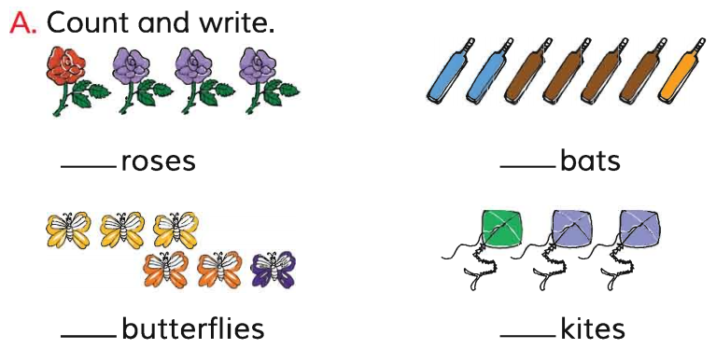
How many ---------?
4
7
6
3

Slide 8
What’s the color of the flowers?
How many red rose?
How many violet roses?
1 red rose.
3 violet roses.

Slide 9
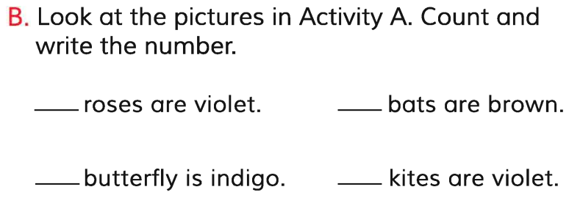
Open your English book at page-35 and see the activity-B.
4
7
6
3
Exchange your book and check the text of other.
Match your answers.

Slide 10
3 roses are violet.
4 bats are brown.
1 butterfly is indigo.
2 kites are violet.
Which sentence is different from others?
1 for
is.
are.
1 more for

Slide 11
Read and say.
4 roses are violet.
7 bats are brown.
1 butterfly is indigo.
3 kites are violet.

Slide 12
One day one word
Read and say.
his
তার
Spell out the word - SGW

Slide 13
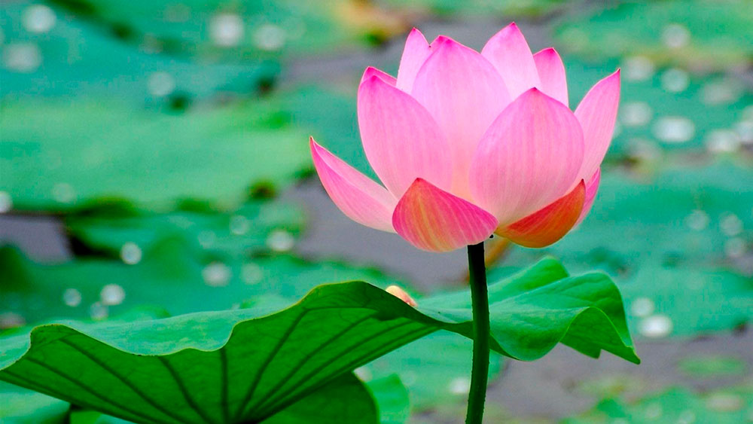
Find out the letters that are made by the word-------.
h
w
a
i
m
s
k
o
x
Find out the correct word--------.
hes
his
has
hise

Slide 14
Say the missing letter.
hi-
-is
h-s
Write the word to your notebook.
Date-
/ /20
his
হিজ
তার

Slide 15
Home work
Page 24 will be well read and written.

Slide 16

That’s all for today. Goodbye. See you tomorrow.

